Slide 1
Great Britain,
its geography
Даулетова Шолпан Умбетовна
228-129-943
презентация

Slide 2
- students will be able to speak about geography and nature of Great Britain
- to practise keeping in mind important historical dates of Great Britain, enriching knowledge about English grammar.
-to learn Great Britain symbols.
-to bring up them to love Great Britain.
The Objectives:

Slide 3
Accessories: computer, Interactive board, flashcards, map of GB, cards, pictures, the state symbols.

Slide 4
The Procedure of the lesson:
I.The org moment.
Greeting

Slide 5
II. Read this text .
Great Britain
The official name of Great Britain is the United Kingdom of Great Britain and Nothern Ireland.
The United Kingdom of Great Britain and northern Ireland is situated in the north-west coast of Europe between the Atlantic Ocean on the north and north-west and the north-west and the North sea on the east.
The United Kingdom of Great Britain and Northern Ireland consists of England, Scotland, Wales and Northern Ireland. The UK lies on the British Isles. There are some 5500 islands. The two of them are the main island.They are: Great Britain and Ireland.The English Channel and the Strait of Dover separate Britain from the continent. The climate on the British Isles is temperate. The Gulf Stream makes the climate warmer in winter and cooler in summer. There is much humidity in the air of England. Britain is known as a foggy country. Geographically Great Britain is divided into Lowlands, Midlands, and Highlands.
The population of Great Britain is over 57 million. London is the capital of the UK.London is situated on the Thames. The large cities of Great Britain are London,Birmingham,Glasgow,Liverpool.There are many rivers and lakes in Great Britain.The main rivers of GB are the Thames and the Severn. The British money are pounds.
The colours of the GB’s flag are red,white,blue.The National emblem of England is rose. Ben Nevis is the highest point in the United Kingdom. It is located in the Northern Highlands in Scotland. Great Britain is not rich in natural resources.Coal and oil are the most spread natural resources of Great Britain.Cambridge and Oxford are Great Britain’s oldest universities. Wheat,vegetables are grown by the British people in the agricultural sector.

Slide 6
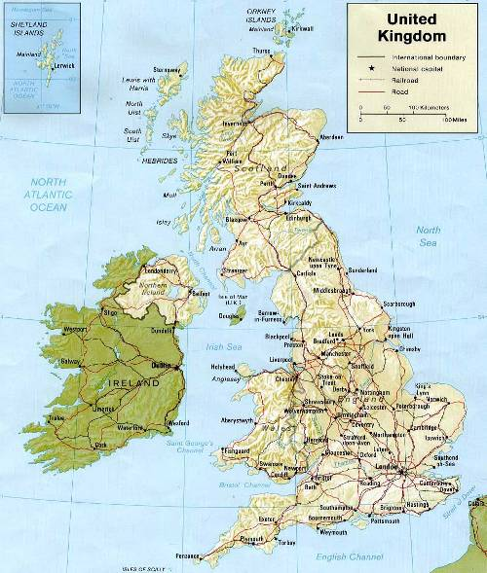

Slide 7
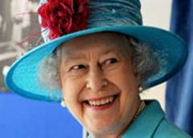
The anthem of the United Kingdom is
«God Save the Queen»
God save the Queen.
God save our gracious Queen
Long live our noble Queen
God save the Queen
Send her victorious
Happy and glorious
Long to reign over us
God save the Queen.
O Lord our God arise,
Scatter her enemies,
And make them fall:
Confound their politics,
Frustrate their knavish tricks,
On Thee our hopes we fix:
God save us all.
Thy choicest gifts in store
On her be pleased to pour;
Long may she reign:
May she defend our laws,
And ever give us cause
To sing with heart and voice
God save the Queen.
Боже храни Королеву
Боже храни нашу милостливую Королеву
Долгой жизни нашей благородной Королеве
Боже храни Королеву
Пошли ей победного
Счастья и славно
Долго царствовать над нами
Боже храни Королеву
O властелин наш Боже появись,
Рассей её врагов,
И заставь их падать:
Разрушь их политику,
Разбейте их мошеннические уловки,
На Тебя наши надежды мы возлагаем:
Боже храни нас всех.
Твои подарки в изобилии
На ней, чтобы излучать удовольствие;
Долго может она править:
Может она защищать наши законы,
И вечно дай нам причину
Петь с сердцем и голосом
Боже храни Королеву

Slide 8
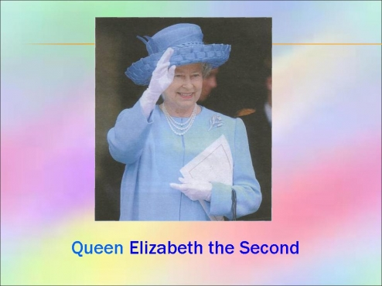
Elizabeth II
The Queen is Head of State of the UK and 15 other Commonwealth realms. The elder daughter of King George VI and Queen Elizabeth, she was born in 1926 and became Queen at the age of 25, and has reigned through more than five decades of enormous social change and development. The Queen is married to Prince Philip, Duke of Edinburgh and has four children and eight grandchildren.

Slide 9
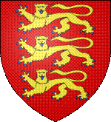
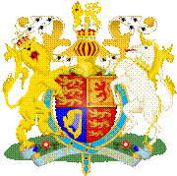
National symbols
The two main symbols of England are the St George's Cross (the English flag), and the Three Lions coat of arms of England.
The royal coat of arms of England was the official coat of arms of the monarchs of England, and were used as the official coat of arms of the Kingdom of England until the Union of the Crowns in 1603..
England's National Day is St George's Day (Saint George being the patron saint), which is on 23 April.
Coat of arms of England.
(герб Англии)
Coat of arms of the Great Britain
(Королевский герб Великобритании)

Slide 10
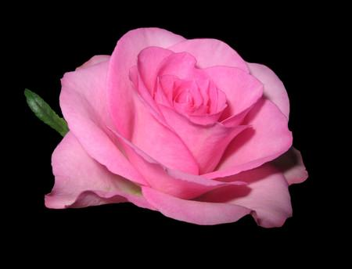
Tudor rose
The Tudor rose is the national emblem of England, and was adopted as a national emblem of England around the time of the Wars of the Roses

Slide 11

Geography
England is a country that is part of the United Kingdom. England shares land borders with Scotland to the north and Wales to the west and elsewhere is bordered by the North Sea, Irish Sea, Celtic Sea, Bristol Channel and English Channel.
London, the capital of Great Britain, lies in the valley of the Thames. «Greater London» stretches for over thirty miles from north to south and for over thirty miles from east to west.

Slide 12
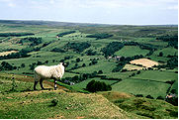
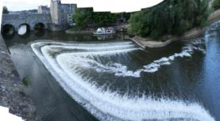
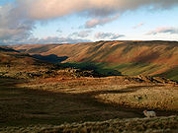
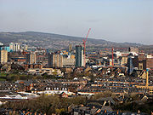
Geography
The rolling terrain of the North York Moors (национальный парк в Северной Англии)
Pulteney Bridge across the River Avon
A view of Sheffield, one of England's largest cities
A view of Borrowdale from Grayrigg Forest in the Lake District.

Slide 13
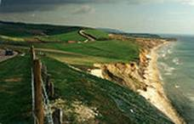
  England comprises the central and southern two-thirds of the island of Great Britain, plus offshore islands of which the largest is the Isle of Wight. ( остров Уайт)
На побережье острова. Общая площадь территории 380 км² . От Великобритании остров отделён проливом

Slide 14
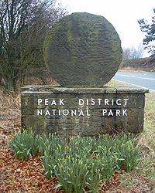
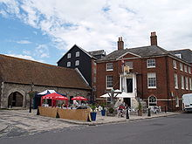
Other hilly areas in the north and Midlands are the Lake District, the North York Moors, and the Peak District.
The largest natural harbour in England is at Poole, on the south-central coast. Some regard it as the second largest harbour in the world, after Sydney, Australia..
Peak District entrance stone on Hathersage Road, Sheffield

Slide 15
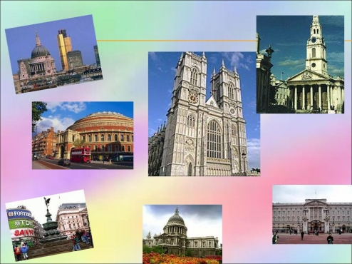
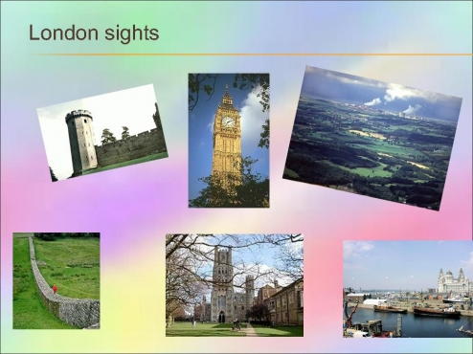
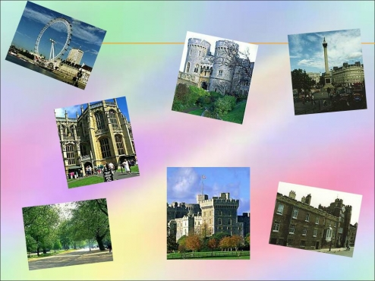
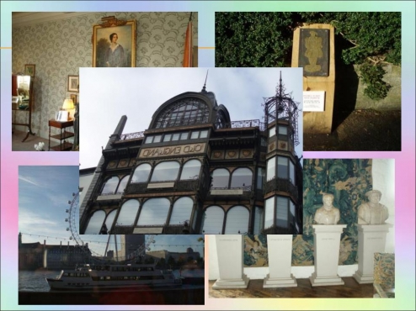

Slide 16
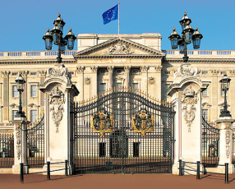
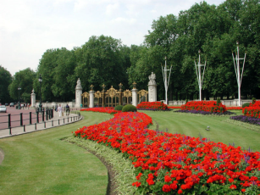
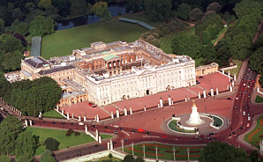
Букингемский дворец (Buckingham Palace)
The Queen of England lives in Buckingham Palace. It is a wonderful building with
a monument in front of it that is the Queen Victoria memorial.
Buckingham palace is the official London residence of Her Majesty The Queen and
as such is one of the best known and most potent symbols of the British monarchy.
Yet it has been a royal residence for only just over two hundred and thirty years and
a palace for much less; and its name, known the world over, is owed not to a monarch
but to an English Duke.

Slide 17
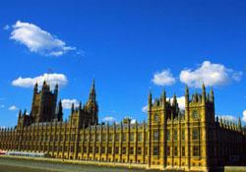
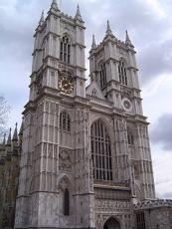
Westminster Abbey
Opposite the Houses of Parliament stands Westminster Abbey, famous for its architecture and historical associations. It is one of the most famous and beautiful churches in London. It is more than nine hundred years old. Nearly all kings and queens have been crowned in the Abbey since the time of the Conquest. Chaucer, Spencer Tennyson, Dickens, Kipling were buried there. Westminster Abbey is famous for the Poet’s Corner too. In the Poet’s Corner there are memorials to Shakespeare, Milton, Burns, Byron and many other poets and writers.

Slide 18
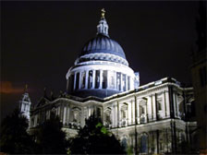
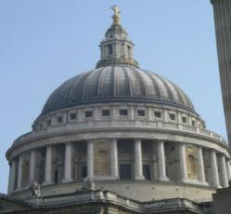
St.Paul’s Cathedral
St.Paul’s Cathedral is not very far from the Tower. The cathedral, the most striking building in the City, was designed by Christopher Wren an outstanding British architect. He built it in the 17th century after the Great Fire. It took him 35 years. In one of the towers of the cathedral is one of the largest bells in the world.
Собор Святого Павла (англ. St. Paul's Cathedral) — кафедральный собор в Лондоне, резиденция епископа Лондона.

Slide 19
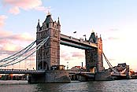
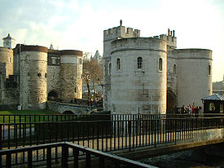
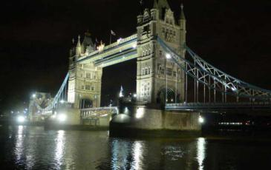
Tower of London
One of the oldest buildings in London is the Tower. William the Conqueror, the first Norman king, built it in the eleventh century. For hundreds of years the Tower was used as a fortress, a residence of kings and a prison. Now it is a museum. You can see a lot of interesting things in the halls of the White Tower. Its walls are white and very tall.
There are always black ravens in the Tower of London people take care and look after them, as they believe, that London will be rich while ravens live there.
Tower bridge at night

Slide 20



III. Now,it’s time solve the crossword.
Look at the Interactive board. Complete the sentences and guess the crossword.
If you solve this crossword and you can see our today’s lesson.
is the large city of Great Britain.
is the national emblem of England.
The highest mountain in GB is

Slide 21


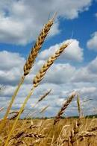



is the oldest English University.
is grown by the British people in the agricultural sector.
are grown by the British people in the agricultural sector.
is the oldest English University.

Slide 22
IV. Guessing riddle
I will give a riddle and you try to guess it.
I have cities but no houses, forests but no trees, rivers without water.
What am I?

Slide 23
V. Practice
1. Answer the questions using the map.
-What is the official name of Great Britain?
-The official name of Great Britain is the United Kingdom of Great Britain and Northern Ireland.
-Where does the UK lie?
The UK lies on the British Isles.
-What is the capital of the UK?
The capital of the UK is London.
-How many parts are there in UK? What are they?
They are England, Wales ,Scotland and Northern Ireland.
-What large cities of Great Britain do you know?
The large cities of Great Britain are London, Birmingham, Glasgow, Liverpool.
-How many people live in Great Britain?
In Great Britain live more than 57 million people.
-What are the main rivers of Great Britain?
- The main rivers of Great Britain are the Severn and Thames.
-What are the colours of the Great Britain’s flag?
The colours of the Great Britain’s flag are red, white,blue.
-What is the national emblem of England?
The national emblem of England is rose.
-What are the British money?
The British money are pounds.

Slide 24
Card# 1
Complete the sentences
1. ……… is not rich in natural resources.
2. The population of Great Britain is ……… million.
3..London is situated on the ……...
4………… are London,Birmingham,Glasgow,Liverpool.

Slide 25
Card# 2
Complete the sentences
1.There are many ………. .
2………. are the Thames and the Severn.
3………… are Great Britain’s oldest universities.
4. The British money are ……….

Slide 26
Card# 3
1. Find the English equivalents in the text.
1.Лондон Ұлыбританияның астанасы.
2.Ұлыбританияның туының түсі қызыл,ақ,көк.
3.Бен Невис Ұлыбританиядағы ең биік тау.

Slide 27
Сard # 4
Put the correct preposition from the following list.
in, of, on,
1. The official name ……Great Britain is the United Kingdom …… Great Britain and Nothern Ireland.
2.The United Kingdom …… Great Britain and northern Ireland is situated ……. the north-west coast …….. Europe between the Atlantic Ocean ……. the north and north-west and the north-west and the North sea …… the east.
3. The United Kingdom ……Great Britain and Northern Ireland consists…… England, Scotland, Wales and Northern Ireland.
4.The UK lies ……the British Isles.

Slide 28
Giving up of hometask
Ex 1p 117

Slide 29
VII. The conclusion
We have finished our lesson. We have spoken about Great Britain. You all were very active today. Thank you for your hard work. Your marks for today’s lesson are…. .
The lesson is over. Good bye.

