Slide 2
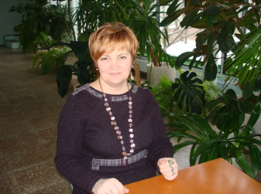
ГОСУДАРСТВЕННОЕ БЮДЖЕТНОЕ ОБРАЗОВАТЕЛЬНОЕ УЧЕРЕЖДЕНИЕ ЦЕНТР ОБРАЗОВАНИЯ №1454
ПОПОВА Т.Н., УЧИТЕЛЬ АНГЛИЙСКОГО ЯЗЫКА, ВЫСШАЯ КАТЕГОРИЯ, ОБЩИЙ СТАЖ-28 ЛЕТ, ПЕДАГОГИЧЕСКИЙ СТАЖ-19 ЛЕТ, В ДАННОЙ ШКОЛЕ-14 ЛЕТ.

Slide 3
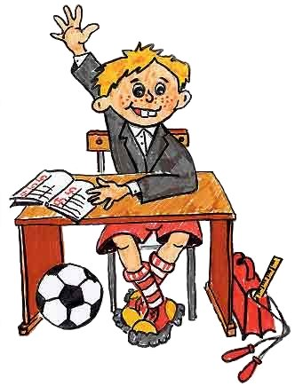
Oткрытый урок по теме «Британский образ жизни» в технологии: развитие критического мышления через чтение и письмо.
Приемы и методы работы нa уроке: шесть думающих шляп, синквейн

Slide 4
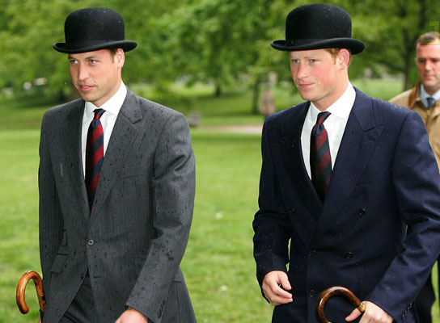
The British Ways of Life

Slide 5
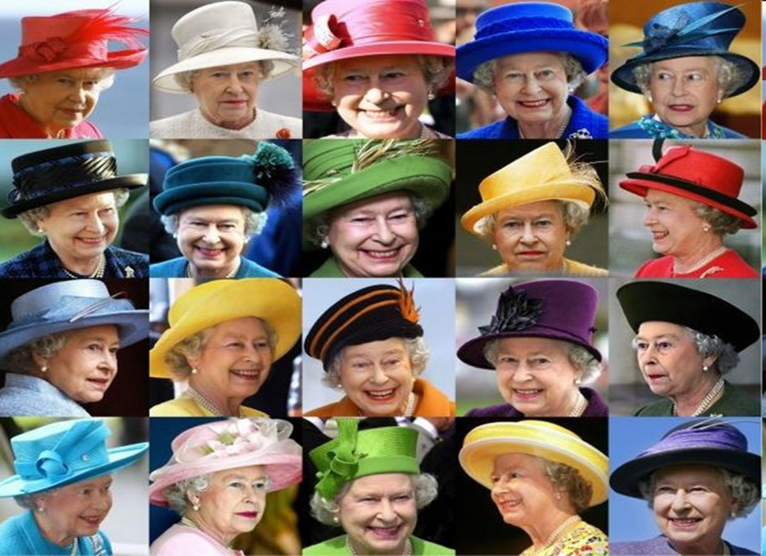

Slide 6
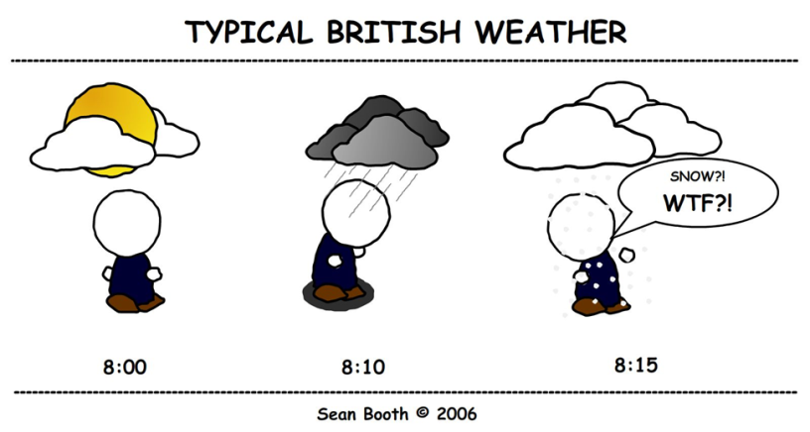
The English like to talk
about the weather

Slide 7
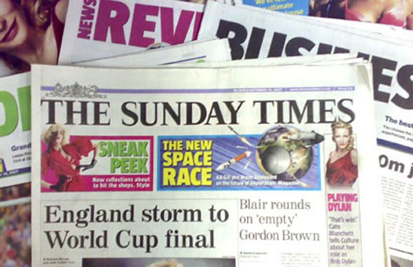
Sunday papers appear on Sunday

Slide 8
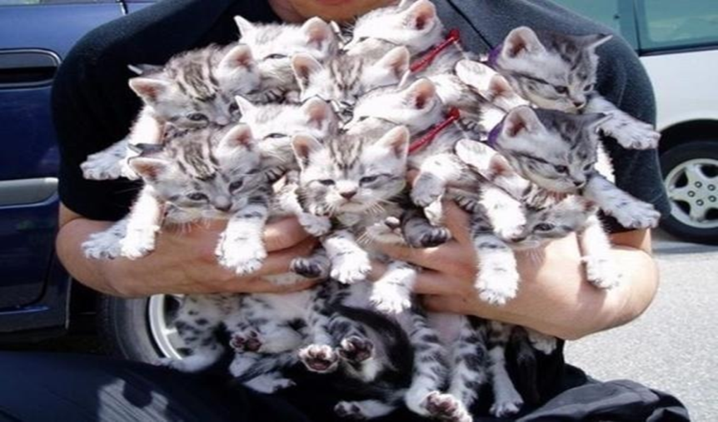
Everyone in England loves cats
and takes care of them

Slide 9
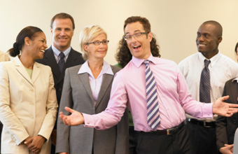
On the continent people show off their knowledge, in England they don’t do it

Slide 10
The English have good
sense of humour.

Slide 11
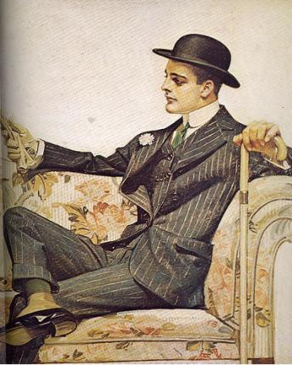
The English tell you neither a lie, nor the truth.

Slide 12
In England every man dresses in some old clothes and don’t shave.

Slide 13
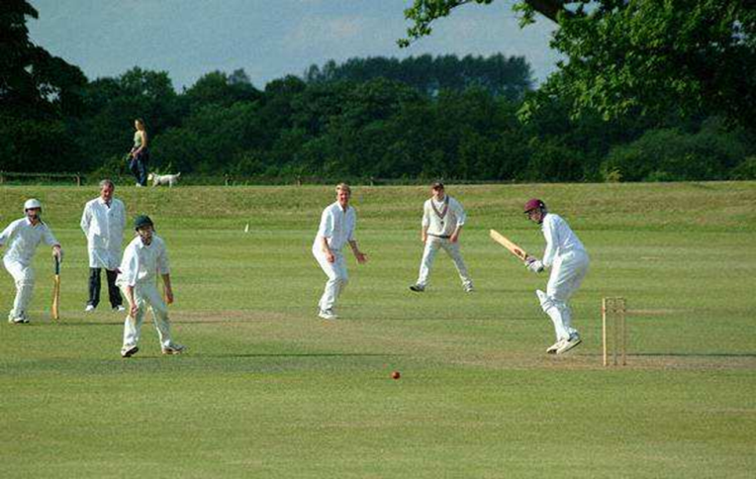
Cricket is a game!

Slide 14
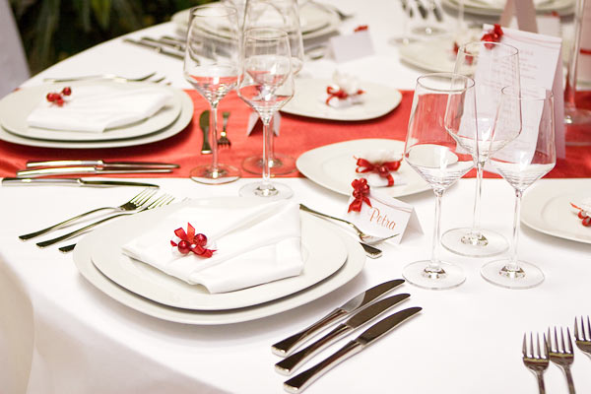
They have good table manners

Slide 15
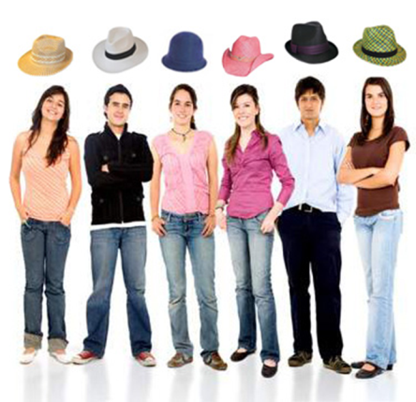

Slide 16
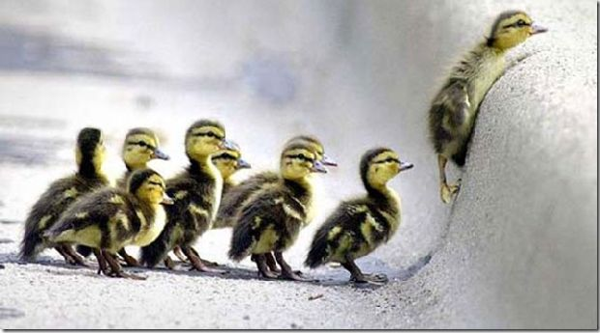
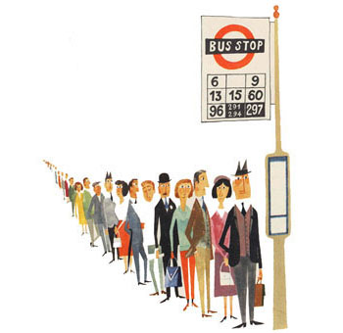
The British like queuing

Slide 17
They are very polite

Slide 18
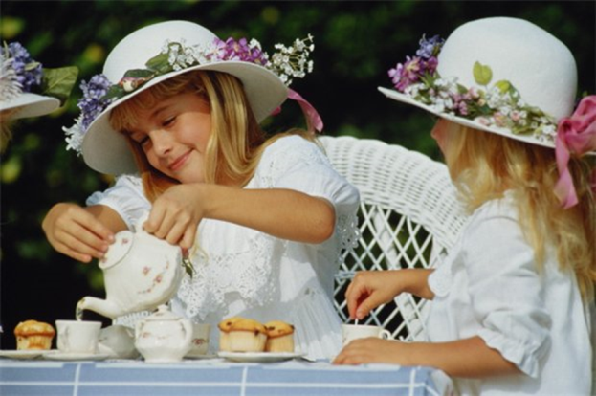
They are great tea lovers

Slide 19
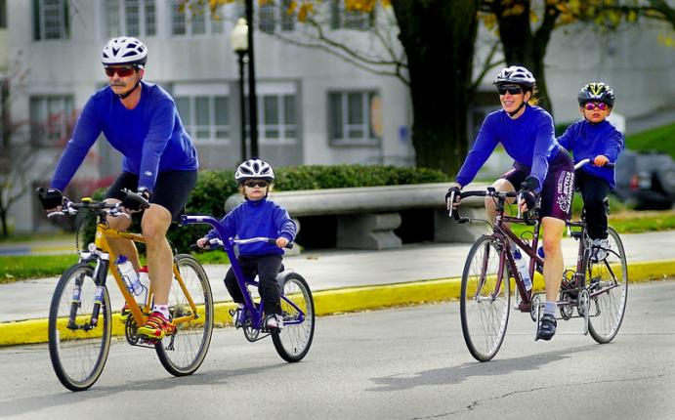
They like cycling at the
weekend.

Slide 20
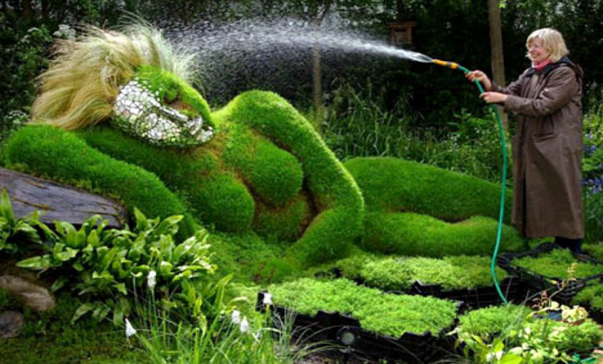
They like gardening,
when they have free time

Slide 21
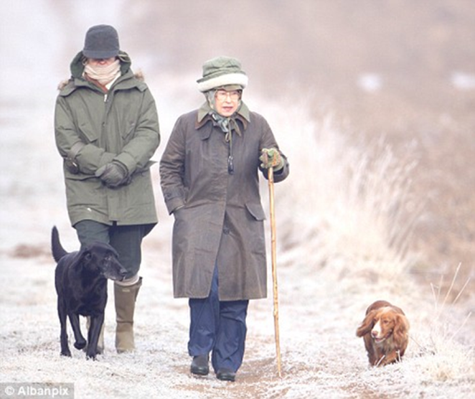
They like walking in the countryside

Slide 22
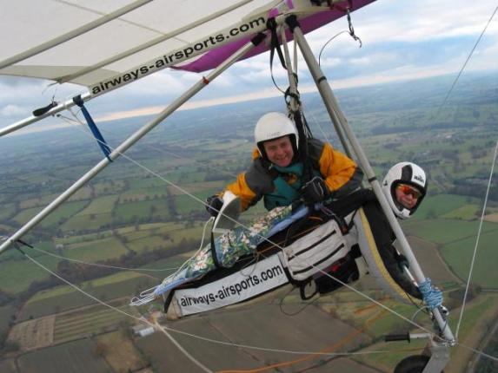
The men like extreme ironing

Slide 23
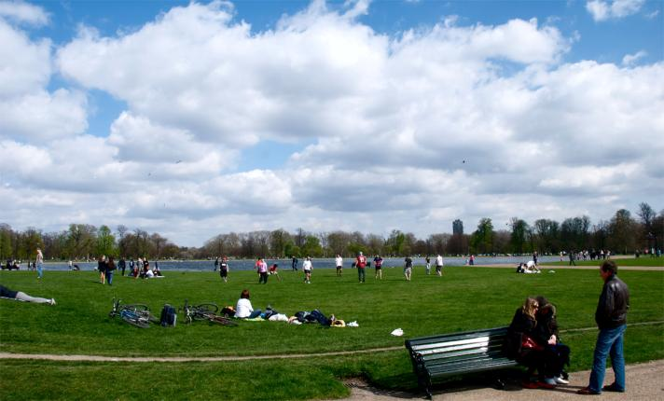
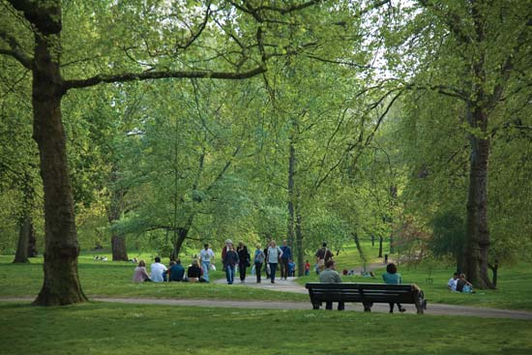
They like walking in the park

Slide 24
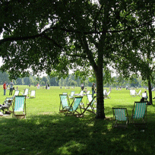
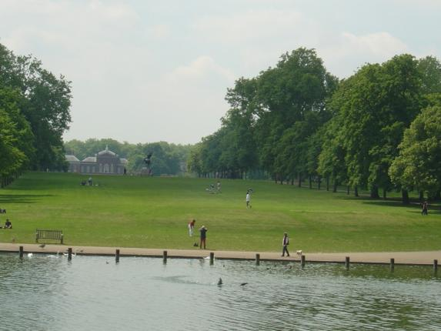
Hide Park

Slide 25
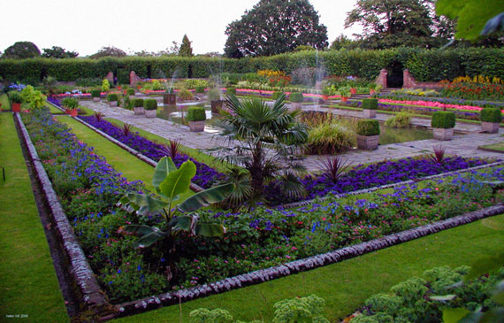
Kensington Garden

Slide 26
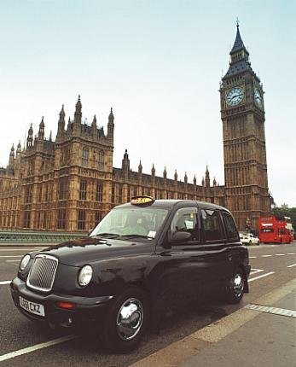
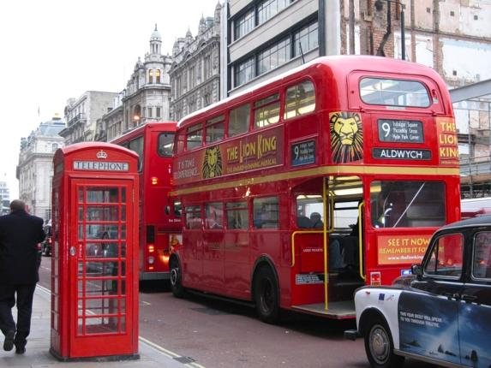
The British respect their traditions

Slide 27
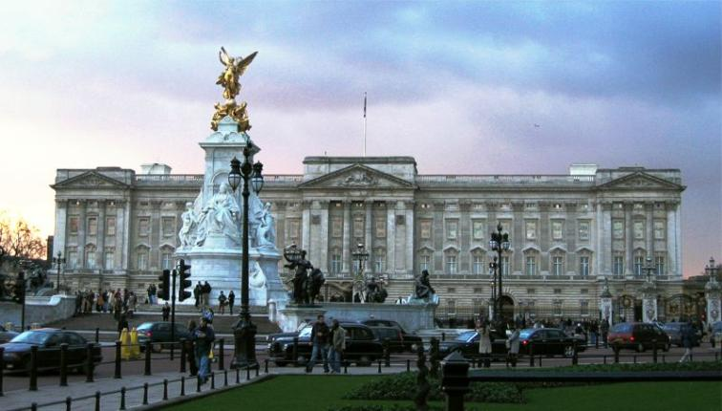
British Symbols Buckingham Palace

Slide 28
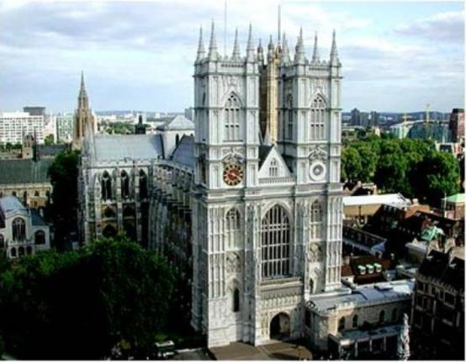
British Symbols Westminster Abby

Slide 29
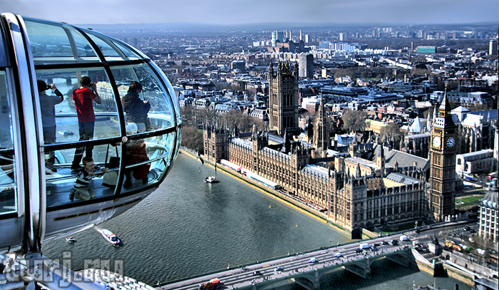
British Symbols London Eye

Slide 30
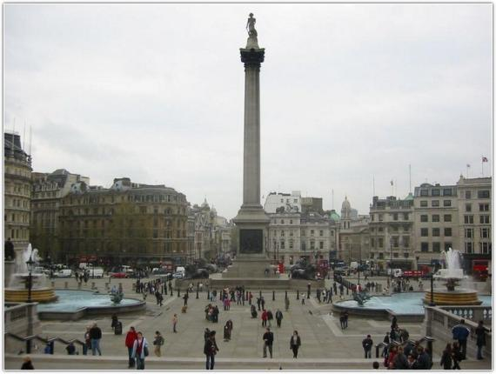
British Symbols Trafalgar Square

Slide 31
CINQUAINS
England
Beautiful, hospitable
Visit, see, admire
The country is worth visiting
The UK
Amatova Akylai 5”B”
Scotland
Picturesque, with lots of lakes
Walk around, go sightseeing, remember
It is possible to see Lock Ness Monster
Great Britain
Korovyakovski Konstantin 5”B”

Slide 32
CINQUAINS
Northern Ireland
Mysterious, fantastic
Listen to myths, tell legends, follow traditions
St. Patrick Day is very popular everywhere.
Great Britain
Martynova Irina 5”B”
Wales
Wonderful, with lots of hills
Speak Welsh, breed sheep, make cheese
There are a lot of castles in Wales
The UK
Trusov Kirill 5”B”

Slide 33
Homework
Homework
to read more about the British ways of life
Home reading:
Lesson 17
George Mikes and his Book

