Slide 1
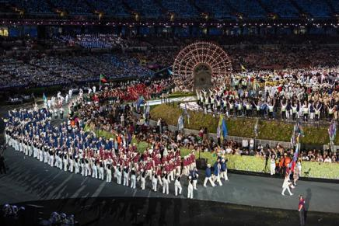
Uniform as integral part of culture .
www.nr2.ru - 640 × 412 -Июль 2012
Сборная России на Олимпийском стадионе в Лондоне
Notes:
www.nr2.ru - 640 × 412 -Июль 2012
Сборная России на Олимпийском стадионе в Лондоне

Slide 2
What is uniform?
“A uniform is a type of clothing worn by members of an organization while participating in that organization's activity”.
http://en.wikipedia.org/wiki/Uniform

Slide 3
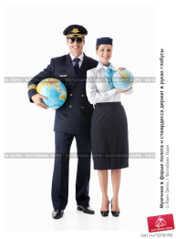
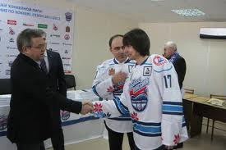
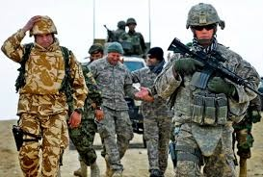
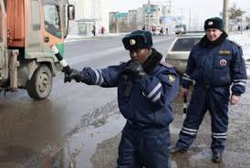
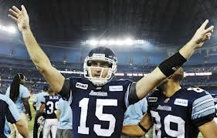
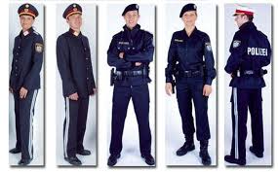
Can you think of some of the types of jobs or other activities that require special uniform?
Military service: Soldiers
Doctors and nurses
Police personnel

Slide 4
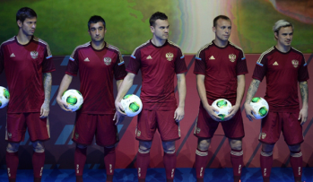
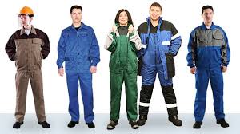
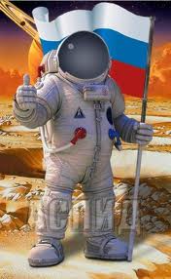
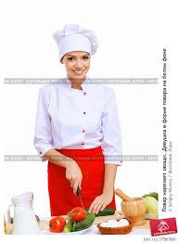
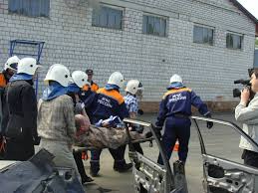
What is the purpose of the uniform?
Workers
firefighters
cosmonaut
Chefs, cooks, waiters

Slide 5
They wear uniform
Police personnel and firefighters
Doctors and nurses
Military service: Soldiers
Chefs, cooks, waiters
Sportsmen
Pilots
Workers
Students in many schools
Can you add more?

Slide 6
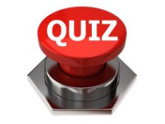
People of what professions does their uniform
help identify them with their profession?
help protect them from the heat of fires?
help them stay clean in an environment where they frequently encounter germs [ʤɜːmz]?
help people feel more comfortable?
help to increase identification with their fellow soldiers and their mission, provide camouflage to help them do their jobs?
help customers identify workers?
help stay safe and perform their best?

Slide 7
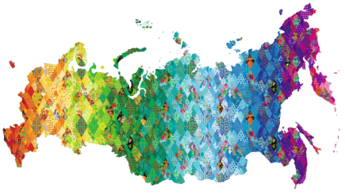
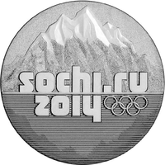
Sochi 2014’s «Patchwork quilt» http://boscosport.ru/ru/catalog/collection.
The main design element of the uniform is Sochi 2014’s «patchwork quilt» design from its visual identity, which represents the different regions of Russia

Slide 8
Bosco exclusive supplier to Russia's Olympic and Paralympic national teams (at Vancouver 2010, London 2012, Sochi 2014 and Rio de Janeiro 2016), and General Partner for the XXII Olympic Winter Games and XI Paralympic Winter Games of 2014 i
The Olympic patchwork quilt, developed by Bosco’s creative department and given to the Sochi 2014 Organising Committee, will be the official Look of Russia’s first Winter Games.
“Our goal was to represent a diverse range of emotions and feelings, connecting concepts like
Motherland, Family, Culture, Time, Olympism, Peace, Nobility, Friends, Memory, Honour, Dreams, Beauty, Freedom, Pride, Warmth, Happiness, Greatness, Reliability, Victory, Creativity, Hospitality, Creation, Future, Russia, Planet Earth.
Every region in the world is proud of its unique origins, and it is no different in Russia. That is why there are so many different local traditions, songs and crafts
http://sochi2014.bosco.ru/en/collection.html

Slide 9
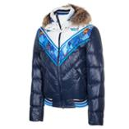
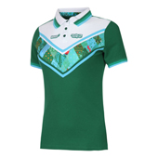
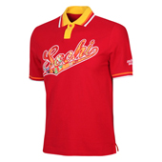
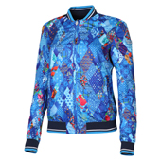
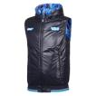
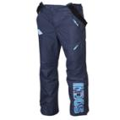
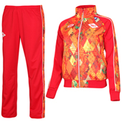
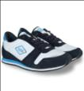
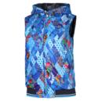
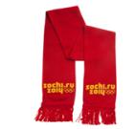
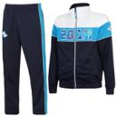
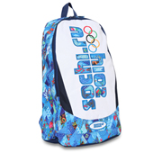
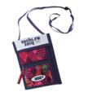
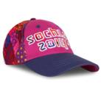
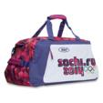
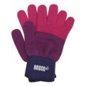
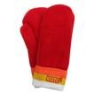
The official Sochi 2014 uniform http://boscosport.ru/ru/catalog/collection.

Slide 10
We present our “patches” of national Russian arts and crafts

Slide 11
We present our Olympic uniform and wish victory to our Russian skiers at the Sochi 2014 winter Olympic Games!
With our Arts Teacher Gerasimova N.L.

