Slide 1
Catchy caption

Slide 2
Catchy caption – Броский заголовок (language art)
Students write captions for pictures cut from newspapers and then match the real captions to the pictures.
Keywords:
newspaper, caption, catchy, picture, photo, creative writing, creative thinking.

Slide 3
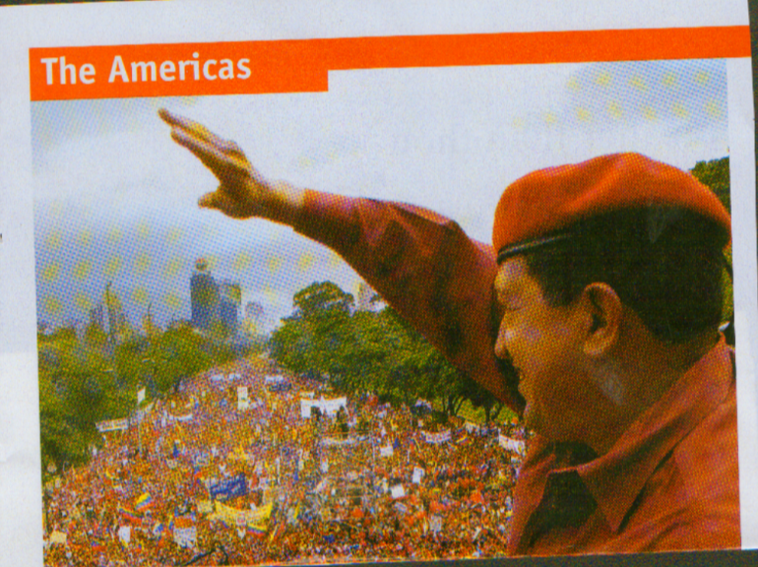
The erratic economic course of Venezuela’s populist president

Slide 4
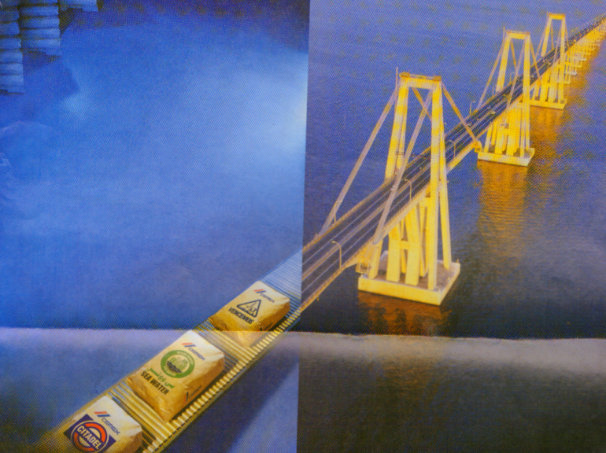
By connecting with customer needs, we deliver value worldwide

Slide 5
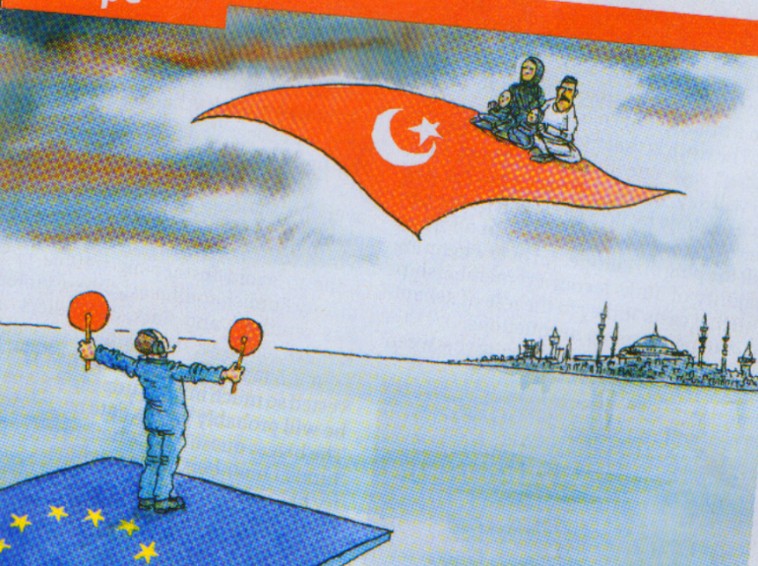
As expected, the European Commission has recommended the opening of EU membership talks with Turkey

Slide 6
Nuclear confusion. Does George Bush want to curb proliferation or court allies? He can’t easily do both.

Slide 7
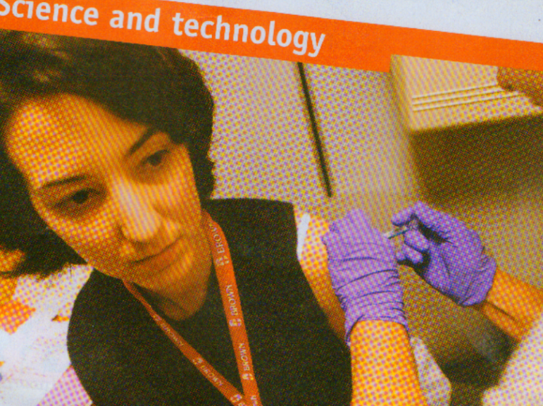
Preparing for pandemic.
More vaccine is needed to prepare the world for an influenza pandemic

Slide 8
Alarm over bird flue has focused attention on a reparing for a human version.

Slide 9
Those strange European countries that kept out of the European Union

Slide 10
The G7 no longer governs the world economy. Does anyone?

Slide 11
The battle of the portals
Why Microsoft, Google and Yahoo are fighting?

Slide 12
Welcome to Kyoto-land. Why European companies may not lose out to their American rivals under the Kyoto treaty on greenhouse-gas emissions

Slide 13
US Election 2004. A special briefing.

Slide 14
Thank you for attention!

