Slide 1
Frame Greeting

Slide 2
Present a frame I Had Fun Yesterday
I got up early,
Jumped out of bed,
I washed my hands
And stood on my head.

Slide 3
Present a frame Peter Beam Was Ill the Day Before Yesterday
Peter Beam liked ice-cream.
But he was in bed the day before yesterday.
He didn’t jump,
He didn’t sing,
He didn’t want to play.

Slide 4
Present a frame Last Summer
Did you swim?
Did you run?
Did you lie in the sun?
Five Days Ago
Where did you go?
What did they know?
Why did she learn?
How much did he earn?

Slide 5
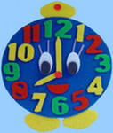
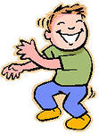
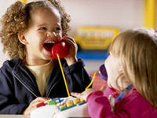
Present a frame Yesterday at 8 o’clock p.m.
Bill was dancing,
Phil was singing,
The girls were talking,
They were joking!

Slide 6
Present a frame When Their Mother Came Home,
Was he dancing?
Was he singing?
Were they talking?
Were they joking?

Slide 7
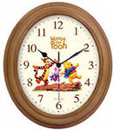
Present a frame
While the mother was cooking dinner…
I wasn’t listening to music.
I wasn’t watching TV.
I wasn’t sleeping in my bed.
I wasn’t drinking my tea.
I was learning English in my ear-phones!

Slide 8
Present a frame What were you doing at one?
What were you doing at one?
I was lying in the sun.
What was he doing at three?
He was watching TV.

Slide 9
Framing Group 1
They were watching TV when I came in.
What did they buy
yesterday ?

Slide 10
Framing Group 2
The train didn’t come on time so we were late.
She was crying because she could’t find her dog.

Slide 11
Framing Group3
How many chairs did you bring to the room?
When I phoned her she was having a bath.

Slide 12
Framing Group 4
Mary understood he was not right.
What were doing when your mother came back home ?

Slide 13
Make up sentences using:
Group 1
1.yesterday - 2. yesterday at 3 o’clock
Group 2
1. last Sunday - 2.when the telephone rang
Group 3
1. 3 days ago – while I was reading a book
Group 4
the day before yesterday –
when Liz came home

Slide 14
Circle the correct answer.
Mag and Frank … to stay outside yesterday.
a) wanting b) didn’t want c) hasn’t wanted d) wasn’t wanting
2. Mag and Frank … into the room.
a) came b) coming c) has come d) comed
3. There … a lot of girls and boys there.
a) have been b) been c) were d) had been doing
4. They … sweet presents and Valentine’s cards to each other when Mag and Frank came into the room.
a) were giving b) given c) has been giving d) give
5.What holiday they (celebrate) when Mag and Frank saw them?
a) did celebrated b) they have being celebrating c) celebrate d) were they celebrating

Slide 15
Home Task
№ 7 p. 123
-
№ 28 p. 122

Slide 16
Frame Parting

