Slide 1
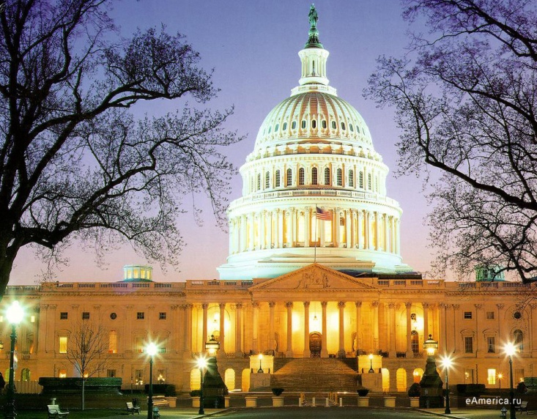
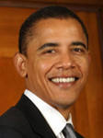
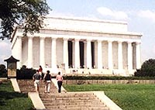
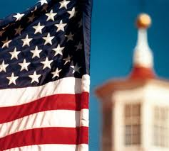

Slide 2
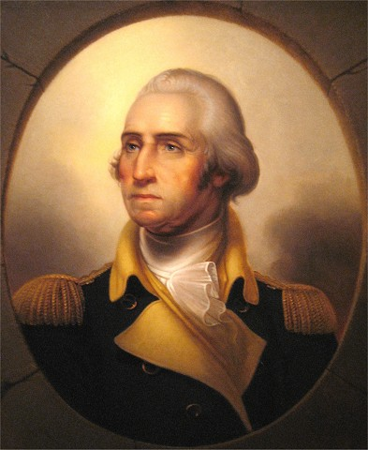
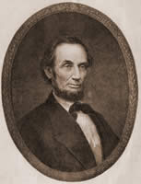
Two American Presidents
G.Washington
A.Lincoln
1732-1799
1809-1865

Slide 3
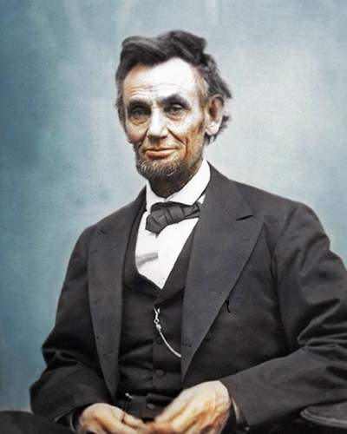
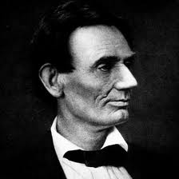
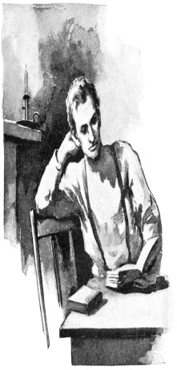
A.Lincoln
1809-1865

Slide 4
Тrue or False:
1. A. Lincoln was born into a rich family.
2. His father moved to Indiana to make a better living.
3. Abe’s stepmother didn’t want him to study.
4. A. Lincoln became a doctor.
5. He led the country through the four years of the Civil war.
6. President Lincoln was shot in his house in 1865.

Slide 5
Abraham Lincoln: Ex.23 p.260
was the 16th American president
was born into a poor family
had no teachers
when a young man he learned to do the hard work
took part in the Civil War
he was a professional lawyer
people had a lot of respect for him because he was honest
people remember him because he ended slavery

Slide 6
A.Lincoln

Slide 7
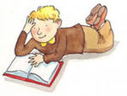
A book is a blessing

Slide 8
