Slide 1
Учитель английского языка МОУ «ТСШ №9» г.Тирасполь Гроза Н.Д.
American Symbols
Автор

Slide 2
Цели:
Образовательные
- закрепить и расширить знания учащихся об американских символах;
Развивающие
- навыки монологической и диалогической речи;
- закрепить навыки аудирования;
- развивать навыки проектных исследований;
- формировать навыки работы с дополнительными источниками информации (журналы, книги, интернет).
Воспитательные
- прививать уважение к культуре, традициям и обычаям страны изучаемого языка и к культуре своей республики.

Slide 3
Ход урока
Организационный момент – 2 мин.
Фонетическая зарядка – 1мин.
(Фронтальный опрос, хоровое повторение)
Лексическая зарядка – 3 мин.
(Фронтальный опрос)
Речевая зарядка – 6 мин.
(Индивидуальный опрос, фронтальный опрос)
Презентация проектов – 13 мин.
Физ.Минутка – 1 мин.
Аудирование – 5 мин.
Письмо (тест) – 7 мин.
Итоги урока – 2 мин).

Slide 4
PHONETIC DRILL
[‘i:gl] [‘stætju:] [‘dolə]
[ə‘fi ∫əl] [‘oliv] [‘ailənd]
[‘fra:ns] [bra:nt∫] [streŋƟ]

Slide 5
LEXICAL DRILL What is the Russian for:
The American flag an olive branch
The Stars and Stripes a symbol of peace
Each state peaceful
The Statue of Liberty a symbol of strength
France a dollar bill
The Eagle
Newspapers an official song
Magazines own flag ?

Slide 6
LEXICAL DRILL What is the English for:
Американский флаг оливковая ветвь
“Звезды и Полосы“ символ мира
Каждый штат мирный
Статуя Свободы символ силы
Франция долларовая банкнота
Орел
Газеты официальная песня
Журналы собственный флаг?

Slide 7
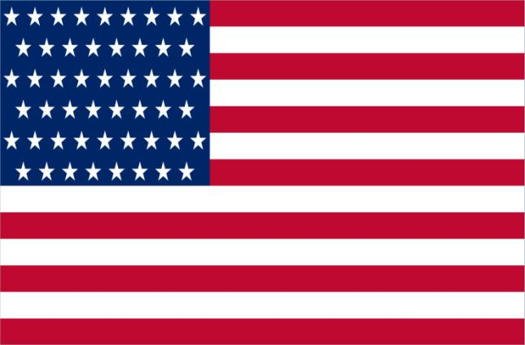
The American flag
13 stripes
(7 red and 6 white)
50 stars

Slide 8
by Ksenia Albul
The Statue of Liberty

Slide 9
“The Statue of Liberty”

Slide 10
New words:
A torch – факел
A tablet – дощечка
Adoption – принятие
Design – дизайн
Bearing – здесь на которой высечена

Slide 11
The Statue of Liberty

Slide 12
It stands on Liberty Island in New York.

Slide 13
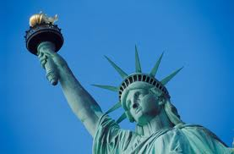
It represents a woman holding a torch in her raised right hand.

Slide 14
In her left hand the woman has a tablet bearing the adoption date of the Declaration of Independence (July 4, 1776).

Slide 15
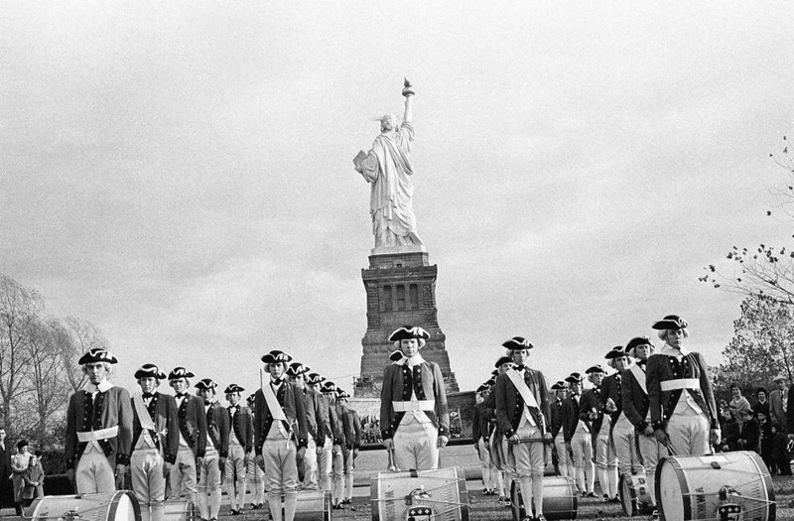
The people of France gave the Statue to the people of the United States in 1886 as a symbol of friendship.

Slide 16
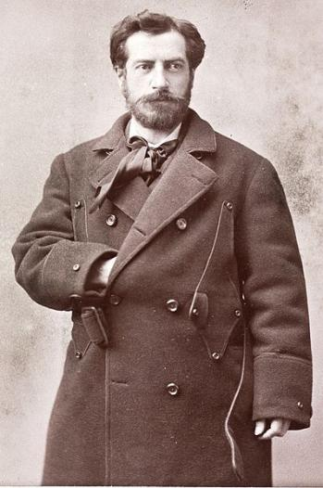
The French sculptor Frederic Auguste Bartholdi designed the sculpture.

Slide 17
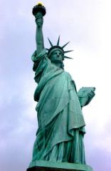
Tasks to the text
1. The statue of liberty is situated in __________________
2. It presents a __________
3. The Statue has _________ in the right hand.
4. The Statue has _________ in the left hand.
5. This monument was presented to Americans
as a _______.
6. The sculptor of the Statue is __________.

Slide 18
by Alexander Savkin and Maxim Yurchenko
American symbols

Slide 19
New words:
Toward– вперед
Salute - салют
Verses - стихи
A lawyer - адвокат
Anthem – гимн
John Stafford Smith
Francis Scott Key

Slide 20
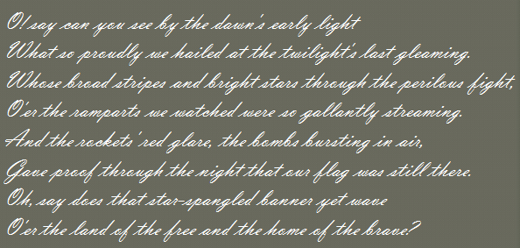
In 1931, the famous song, The Star-Spangled Banner, became the National Anthem of the USA.

Slide 21
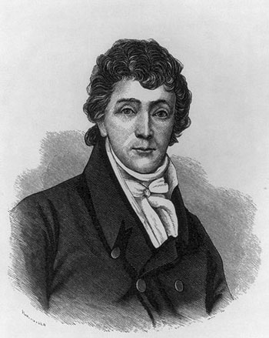
The verses were written by Francis Scott Key, a lawyer in Baltimore.

Slide 22
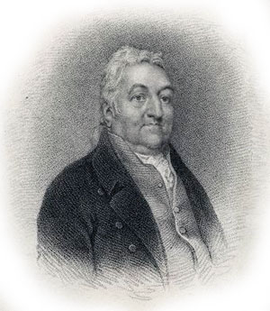
John Stafford Smith was the author of the music for the anthem.

Slide 23
Answer the questions, please:
What is the name of the national song?
When did the “Star-Spangled Banner” become the national song?
Who is the author of the verses of the Star-Spangled Banner?

Slide 24
The Eagle became the official national symbol of the country in 1782.

Slide 25
It has an olive branch (a symbol of peace) and arrows (a symbol of strength)
an olive branch
arrows

Slide 26
Answer the following questions, please:
What bird became an official symbol of the United States of America?
What does it have?
Where can we see it?

Slide 27
The Pridnestrovian hymn

Slide 28
Audition
An official symbol | The monument to Suvorov | The Russian flag | The Statue of Liberty | The American flag | The Pridnestrovien flag | The Kremlin
Text №

Slide 29
Audition
An official symbol | The monument to Suvorov | The Russian flag | The Statue of Liberty | The American flag | The Pridnestrovien flag | The Kremlin
Text №

Slide 30
Audition
An official symbol | The monument to Suvorov | The Russian flag | The Statue of Liberty | The American flag | The Pridnestrovien flag | The Kremlin
Text № | 1 | 2 | 3 | 5 | 4 | -

Slide 31
WORDBUILDING SUFFIXES: PREFIX:
-er, -or, -tion, -ful un-
write – writer
collect – collector –collection
beauty – beautiful
kind – unkind

Slide 32
Liz usually _________ her house on Christmas herself. DECORATE
Her mother says Liz is a great ________. DECORATE
Her _________ is ________. DECORATE BEAUTY

Slide 33
Liz usually decorates her house on Christmas herself.
Her mother says Liz is a great ________. DECORATE
Her _________ is ________. DECORATE BEAUTY

Slide 34
Liz usually decorates her house on Christmas herself.
Her mother says Liz is a great decorator.
Her _________ is ________. DECORATE BEAUTY

Slide 35
Liz usually decorates her house on Christmas herself.
Her mother says Liz is a great decorator.
Her decoration is beautiful.

Slide 36
Test
1.Christopher Columbus was a great _____. DISCOVER
2. He _____ America in 1492. DISCOVER
3. Columbus had many ships and ______ with him. SAIL
4. The first ______ came to America in 1620. COLONY
5. Their life was full of danger. It was ______. EASY
6. Native Americans helped them a lot. Most Native Americans were very _____. PEACE

Slide 37
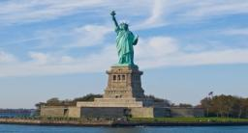
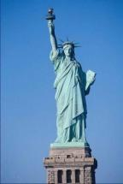
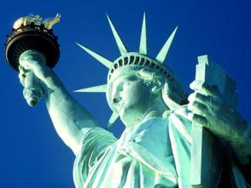
What new information have you learnt today?

Slide 38
Thank you for the lesson

