Slide 1
ROYAL RESIDENCES

Slide 2
Categories of Residences
Unoccupied Royal residences
Official Royal residences
Private Estates
Royal Yacht Britannia

Slide 3
Unoccupied Royal residences
owned by The Queen “in right of Crown”
open to the general public
Palace of Westminster, London The Tower of London Christ Church, Oxford Edinburgh Castle, Edinburgh Queen's House, Greenwich

Slide 4
The Tower of London
built to the order of William the Conqueror in 1078
a fortress
a prison
a royal palace

Slide 5
Kensington Palace
the birthplace and childhood home of Queen Victoria
today - offices and private apartments of a number of members of the Royal Family

Slide 6
Official Royal residences
family homes for members of the Royal Family
working buildings
meeting official guests
holding formal ceremonies
(Buckingham Palace, Windsor Castle)

Slide 7
Buckingham Palace
the official residence since 1837
has 775 rooms (52 Royal and guest bedrooms, 188 bedrooms for staff, 92 offices and 78 bathrooms)

Slide 10
Windsor Castle
the largest occupied
castle in the world
over 900 years old
a month over Easter
a week in June

Slide 13
Private Estates
owned by The Queen
used as holiday residences
(Balmoral Castle and Sandringham House)

Slide 14
Sandringham House
the private home of four generations of monarchs since 1862.
Christmas at Sandringham

Slide 15
Balmoral Castle
bought by Prince Albert for
Queen Victoria in 1852

Slide 16
covers about 20,000 hectares used for forestry and farming

Slide 17
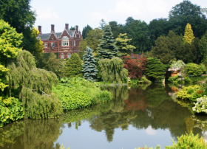
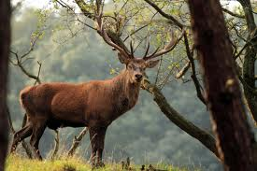
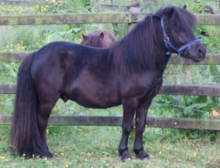
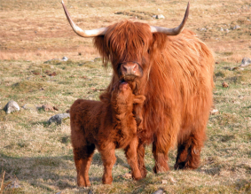
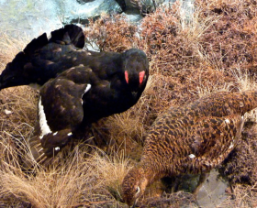
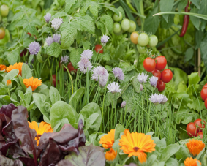
Includes:
herds of red deer (1,600)
Shetland ponies
Highland cattle (Balmoral fold)
grouse moors
salmon
85,000 people visit the castle and gardens each year
summer holiday period in August and
September

Slide 18
Birkhall Estate
private residence of the Prince of Wales
received by Prince Charles from the Queen Mum

Slide 19
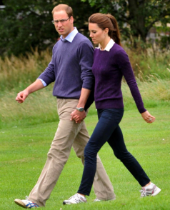
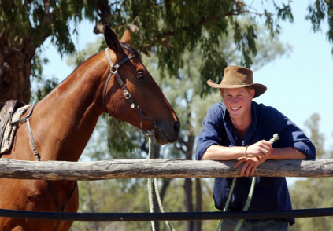
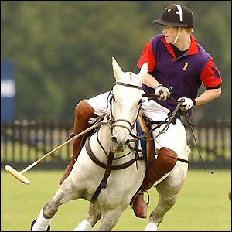
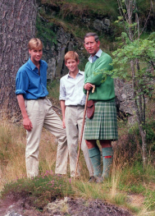
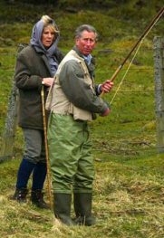
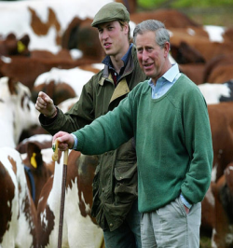
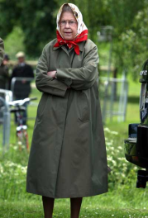
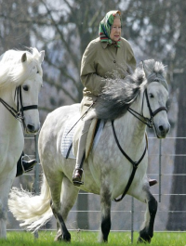
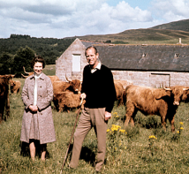
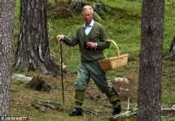
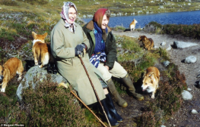
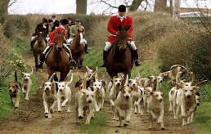

Slide 20
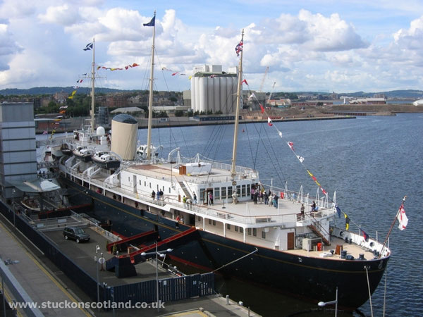
Royal Yacht Britannia
launched in 1953
served for 44 years
968 official voyages
decommissioned
In 1997

Slide 21
The End

