Slide 1
Формирование регулятивных УУД на уроках английского языка через различные виды деятельности
Учитель английского языка
Козлова Е.В.

Slide 2
Регулятивные УУД - это
Целеполагание
Планирование
Прогнозирование
Контроль
Коррекция
Оценка
Волевая саморегуляция

Slide 3
Целеполагание
Game “My English schoolbag”. Draw a big school bag on the board. Put the strips of paper in the form of a daisy on the table. Ask a pupil to take one strip, read it aloud and follow the instructions. Stick the strip on the picture of a school bag. Tell pupils that there’s some more space in the school bag. Ask pupils to add topics they’d like to learn to the school bag. Write them on the board.

Slide 4
Прогнозирование
Pupils must talk much during the lesson how has it increased in comparison with the beginning of the school year.

Slide 5
Контроль
After progress work ask pupils to open their books and check their answers. Make sure pupils have checked their work correctly. Let pupils count and find their scores in the evaluation boxes. Ask pupils if they’re happy with their results.

Slide 6
Лингвострановедческий справочник
Bristol - Бристоль- промышленный город и международный порт на юго-западе Англии
Harry Potter -Гарри Поттер- ребенок-волшебник , герой популярных детских книг Дж. К. Роулинг.

Slide 7
Project’’ My Dream Clothes”
Imagine you have 5000 roubles to buy new clothes. What would you like to have? Why?

Slide 8
Виды заданий
Big wild animals live in the city. They live in the city zoo, where some zoo animals, like the polar bear and penguin, are from cold lands. Some of them, like the monkey and elephant are from hot lands.
Other animals, like the red fox, are from the forest near the city. In a good zoo, the animals have a lot of rooms where they can run, climb, and jump.
The zoo animals have got things they like. Monkeys have got trees where they can play and climb. Bears have got cool caves where they can stay on very hot days.
The animal cages are like little rooms. They have doors and the animals can go out. When it is sunny, an ani­mal can go out, but it can come in when it is cold and rainy.
A good zoo is a nice home for many of the animals. Zoo animals get nice food at the zoo. Many people work in the zoo. They look after the animals. They give food to the animals. They clean cages and caves.
People from other places can see wild animals in the zoo. Many people never go to the lands where the wild animals come from. And a city zoo brings the wild animals to the people.

Slide 9
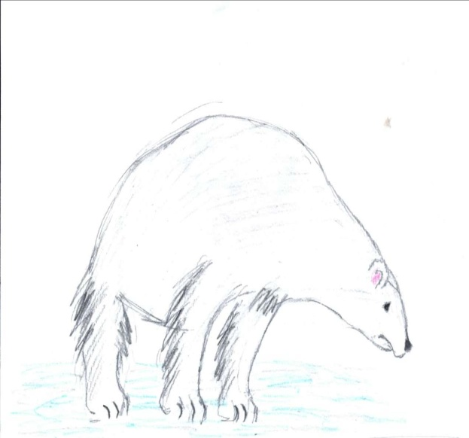
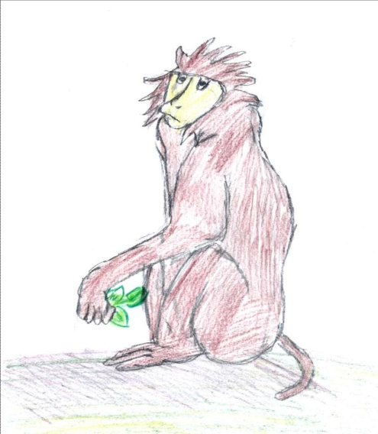
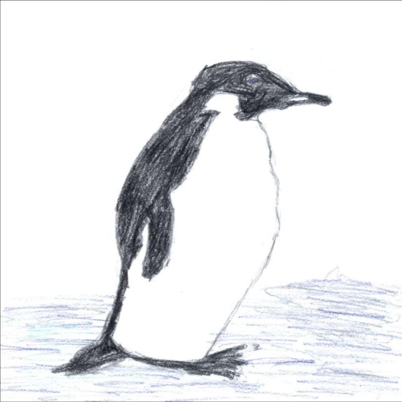
Рисунки учащихся к данным текстам

Slide 10
Использование сюжетных картинок
It is spring now. March, April and May are spring months. It is cool or warm in spring. The weather is fine.
It is summer. June, July and August are summer months. It is hot in summer. It is usually sunny.
It is autumn. September, October and November are autumn months. It is cool in autumn. It is often foggy. It is sometimes stormy. It is often rainy in autumn.
It is winter. December, January and February are winter months. It is sometimes snowy in winter. Trees and roads are white, too. In winter the
days are short.

Slide 11
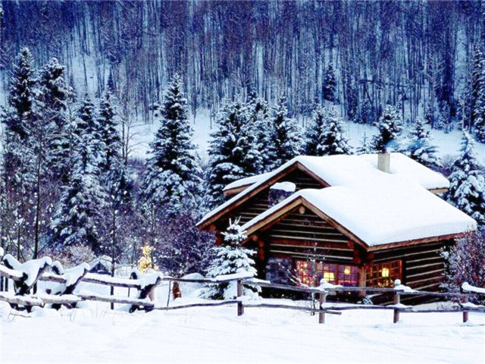
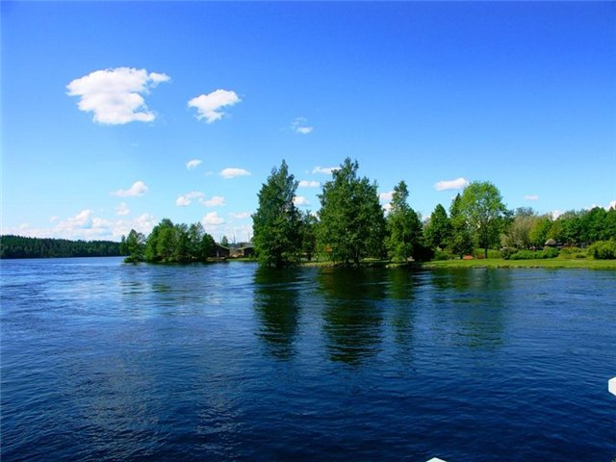
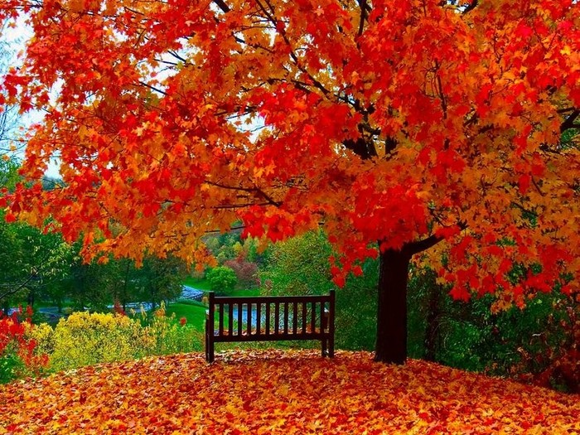
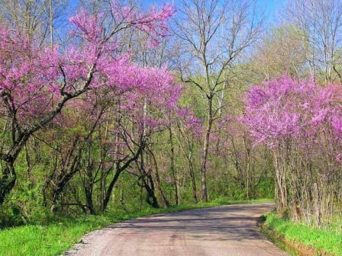
Расположение в логическом порядке

Slide 12
« Ищу ошибку»
Dimas 10.
Hes got a pet parrot.
He doesn’t look like me.
Whats her hobby?

