Slide 1
What is the theme of our lesson?
Watch this video and answer the question!
http://www.youtube.com/watch?v=Xsl3Erw7QWE
What are the main aspects we’ discuss?

Slide 2
The 17th of October Classwork
Anti-social behaviour

Slide 3
Phonetic Practice
http://quizlet.com/28182361/anti-social-behaviour-flash-cards/

Slide 4
Answer the questions
1. What is anti-social behaviour?
2. Could you give the examples of anti-social behaviour?
3. What kinds of anti-social behaviour do the pictures (Ex.126,p.40) represent?
4. What kind of person can conduct in such a way ?
5. What are the reasons for anti-social behaviour?

Slide 5
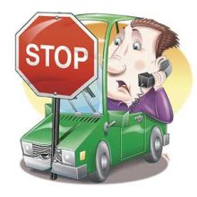
Listen to the text and do the tasks
Reasons against using mobiles while driving | Reasons for using mobiles while driving | Actions to prevent people from using mobiles while driving

Slide 6
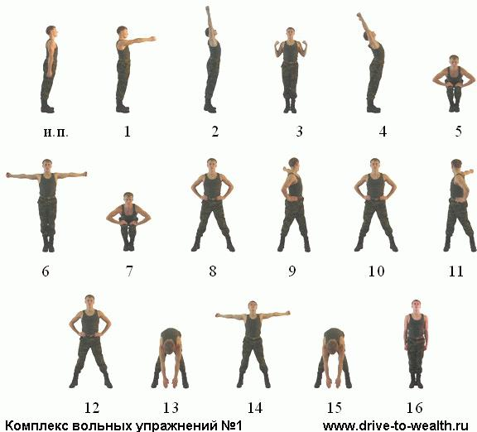
Have the rest!

Slide 7
Speaking Practice
I. Answer the questions in pairs
1.Do you think that heavy fines and other legal measures would stop anti-social behaviour?
II. Present your point of view
2. What can be done to prevent the anti-social behaviour?

Slide 8
Self-preparation task
Ex.7, р.23 WB

Slide 9
Summing up…
What have you already been informed about?
What have you learned from our lesson?
What would you like to know?

