Slide 1
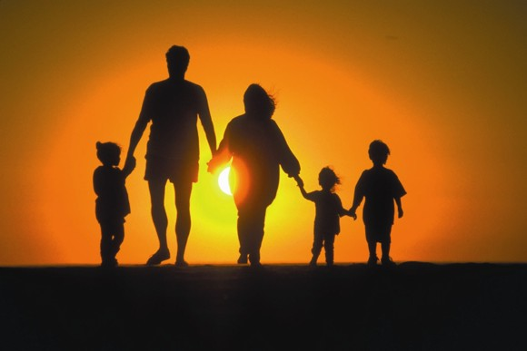
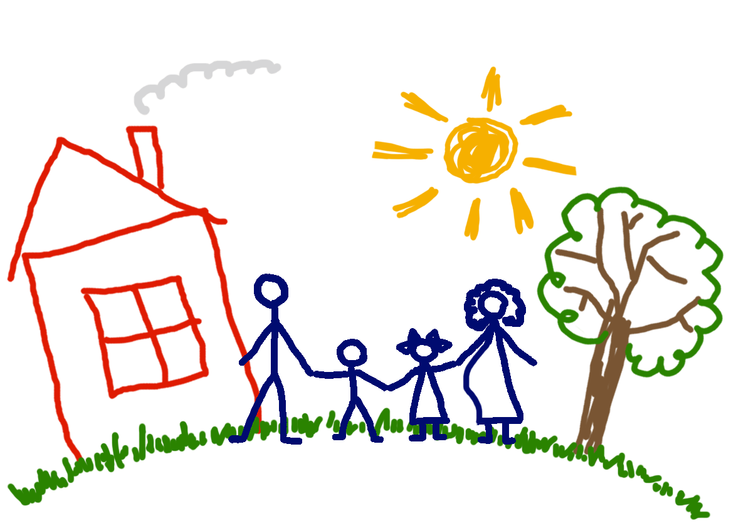
Family
Father, mother,
Sister, brother
Hand in hand
With one another…

Slide 2
Some words
Sociable Clever
Rude Naughty
Polite Friendly
Obedient Shy

Slide 3
Some words
Stupid Noisy
Brave Athletic
Quiet Loving
Curious Kind

Slide 4
Some words
Independent Responsible
Intelligent Creative
Talkative Well
Untidy Happy

Slide 5
Family
Hospitable. This family likes to invite the guests and spend their time with them
Caring A mother and a father care about their children.
Loving In this family everybody loves each other.
Traditional This family has traditional things such as spending their time in the nature, at sports, arranging family parties.
International His mother is German and his father is English.
Doing things together This family does all the things together.

Slide 6
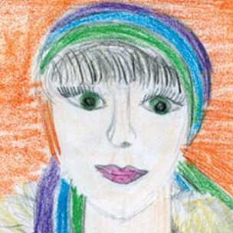
MY DEAR MOTHER!!
Mom is such a special word
The loveliest I've ever heard
These words to you, above all the rest,
Mom, you're so special,
You are simply the best!

Slide 7
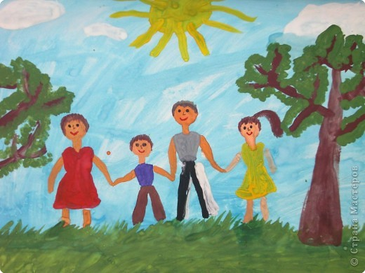
My family☺☺
My happy family!!!

