Slide 1
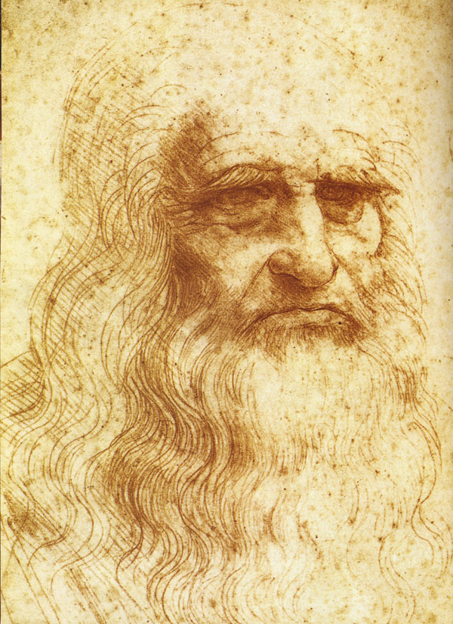
Leonardo da Vinci
The great man

Slide 2
His life and art
Leonardo was painter, sculptor, musician, mathematician, engineer, inventor, writer. He was born on April 15, 1452 in the region of Florence . Leonardo was educated in the studio of the renowned Florentine painter, Verrocchio. He worked in Rome, Milan , Bologna, Venice. He is widely considered to be one of the greatest painters of all time. The Mona Lisa is his works. This is a half-length portrait of a woman. The Mona Lisa is believed to have been painted between 1503 and 1506, although Leonardo may have continued working on it as late as 1517.Among his works, The Last Supper the most reproduced religious paintings of all time . Also Leonardo’s drawing of Vitruvian Man is also regarded as a cultural icon.

Slide 3
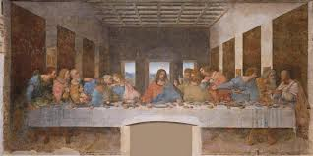
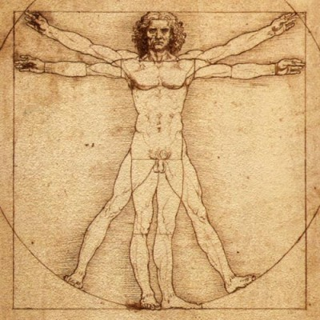
His paintings
The Last Supper
The Mona Lisa
Vitruvian Man

Slide 4
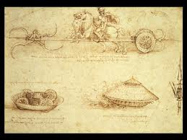
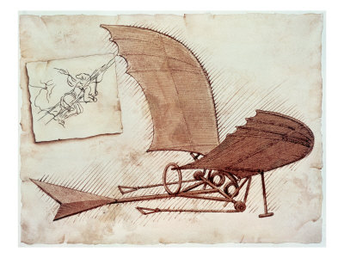
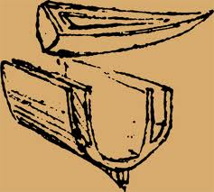
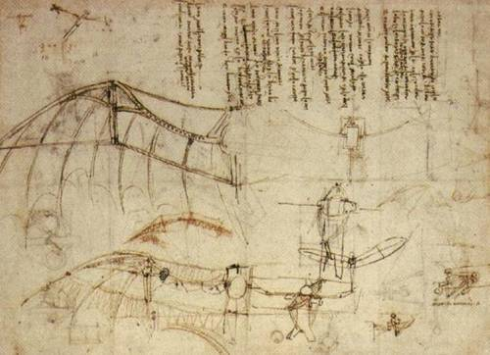
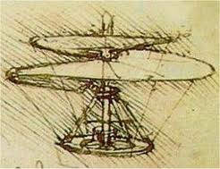
Inventors of the great man
Leonardo da Vinci conceptualized flying machines, a tank, double hull, parachute.

Slide 5
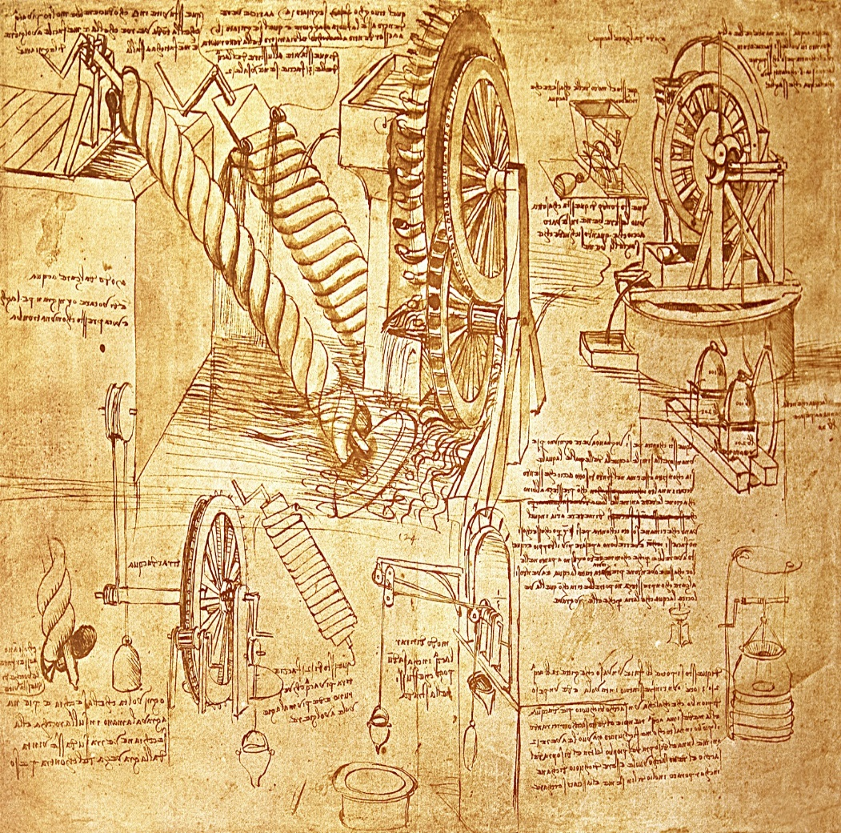
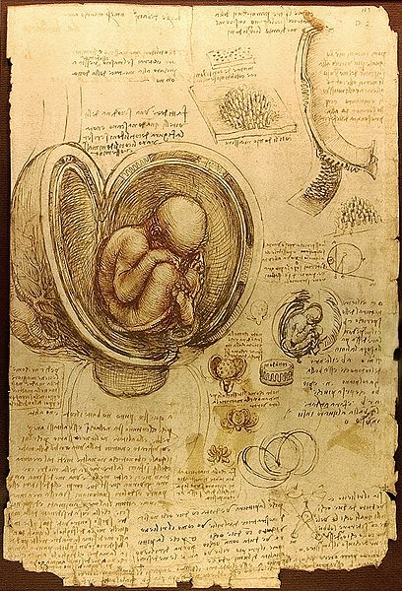
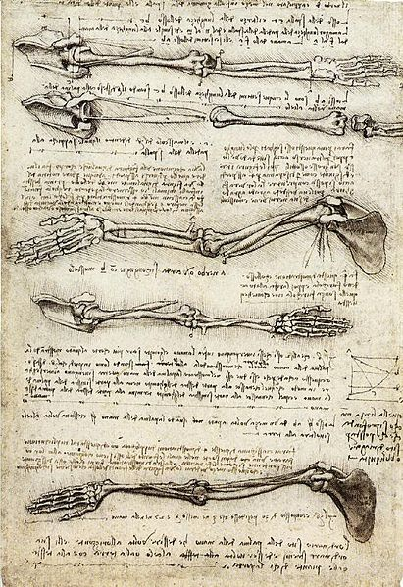
Discoveries
He made important discoveries in anatomy, civil engineering, optics, hydrodynamics.

Slide 6
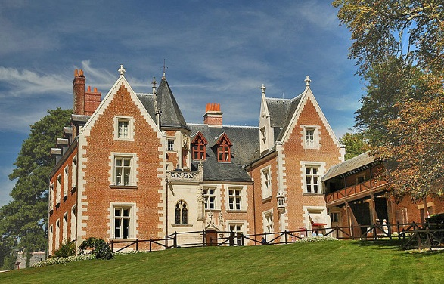
Leonardo da Vinci was died on May 2, 1519 at Clos Luce

