Slide 1
PASSIVE VOICE
Подготовил учитель английского языка МОУ Гимназия 46 Демышева Н.В.
п. Малаховка
2013г.

Slide 2
Приложение 1
SHAKE
SHOOK
SHAKEN
DRINK
DRANK
DRUNK

Slide 3
BRING
BROUGHT
BROUGHT
FLY
FLEW
FLOWN
HOLD
HELD
HELD
BEAT
BEAT
BEATEN

Slide 4
HIDE
HID
HIDDEN
DIG
DUG
DUG
SPEND
SPENT
SPENT
DRIVE
DROVE
DRIVEN

Slide 5
COST
COST
COST
SPEAK
SPOKE
SPOKEN
BECOME
BECAME
BECOME
GROW
GREW
GROWN

Slide 6
FEEL
FELT
FELT
WRITE
WROTE
WRITTEN
DO
DID
DONE

Slide 7
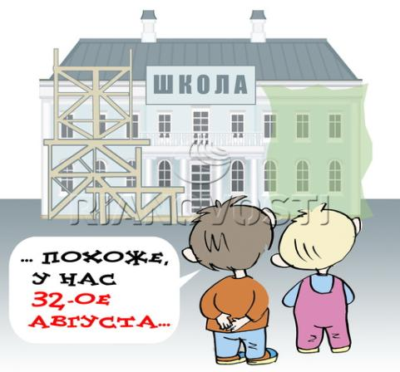
Приложение 2
In 2005

Slide 8
Yesterday

Slide 9
At the moment

Slide 10
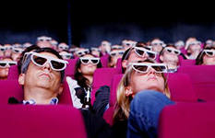
Every evening

Slide 11
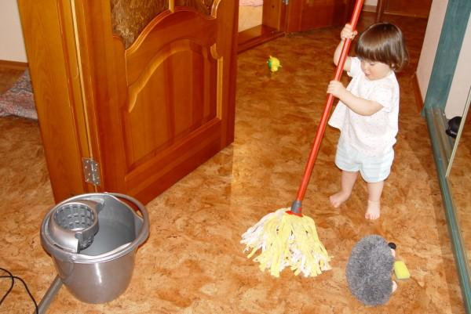
When the boy came home

Slide 12
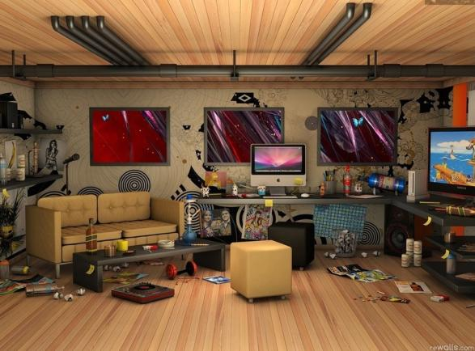
Tomorrow

Slide 13
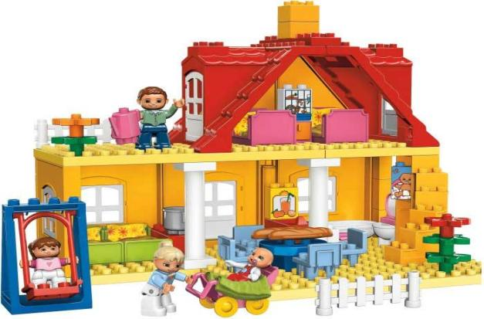
Last week

Slide 14
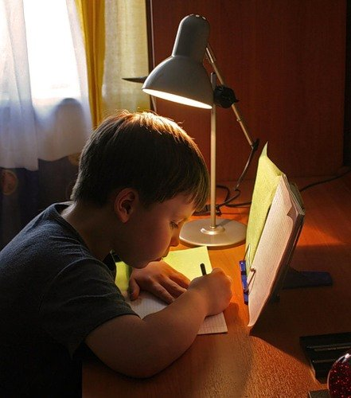
Every day

Slide 15
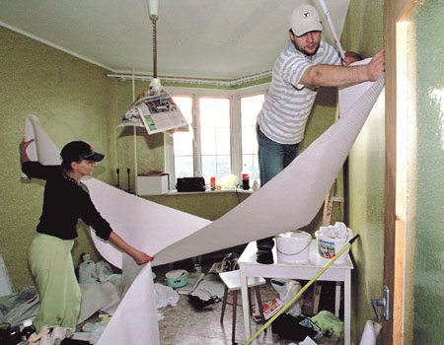
In two months

Slide 16
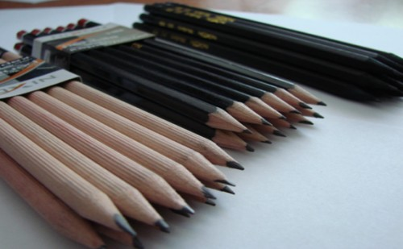
Next Friday

Slide 17
Приложение 3
1. America was discovered in 1492,
wasn`t it?
Yes, it was. America was discovered in 1492
2. All dictionaries are always made in two languages,
aren`t they?
No, they are not. The dictionaries are not always made in two languages.
3. The English language is taught in all schools of Russia,
isn`t it?
No, it is not. The English language is not taught in all schools of Russia.

Slide 18
4. Two apples are given to you every day,
aren`t they?
Yes, they are. Two apples are given to me every day.
5. Kate is being asked now,
isn`t she?
No, she is not. Kate is not being asked now.
6. Grapes are not grown in the North,
are they?
No, they are not. They are not grown in the North.

Slide 19
7. Your homework must be done every day,
mustn`t it?
Yes, it must. My homework must be done every day.
8. People in hospitals should be visited,
shouldn`t they?
Yes, they should. People in hospitals should be visited.
9. English idioms are not easily memorized,
are they?
No, they aren`t. English idioms are not easily memorized.

Slide 20
10. Jazz was not created in the United States,
was it?
Yes, it was. Jazz was created in the United States.

Slide 21
PASSIVE VOICE IN
ENGLISH PROVERB
The devil is not so black
Rome was not built
What is done
Better untaught
Marriages are made
Easily earned money
is quickly spent
in a day
cannot be done
as he is painted
in heaven
than ill-taught

