Slide 1
Welcome to
“Poem party”

Slide 2
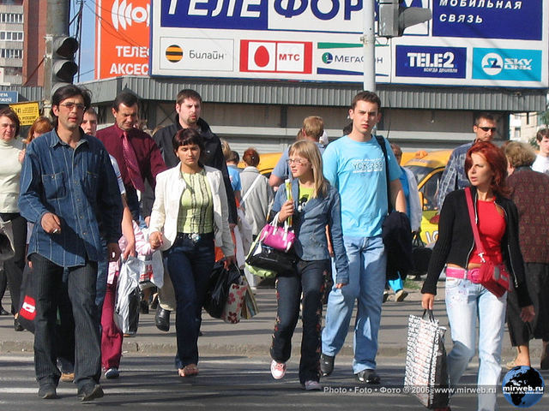
“Sing a Song of People”

Slide 3
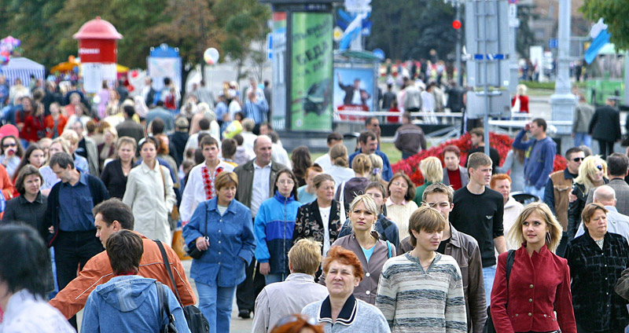

Slide 4
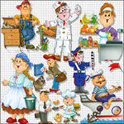
“Professions”

Slide 6
“We Have Fun with Our Friends”

Slide 7
“Going Shopping”

Slide 8
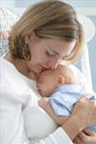
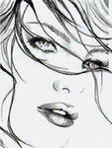
“A Lovely Face”

Slide 9
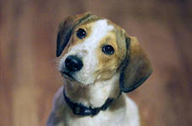
“My Dog Chewed Up My Homework “

Slide 10
“My Sister's Always on the Phone”

Slide 11
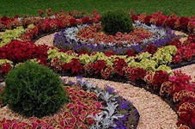
“Bed in Summer”

Slide 12
“Twinkle, Twinkle, Little Star!”

Slide 13
“My Motherland”

Slide 14
“Yours and Mine”

Slide 15
“Seasons of the day”

Slide 16
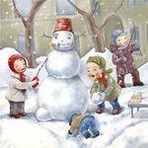
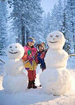
“Winter pleasures”

Slide 17
“The Wood of Flowers”

Slide 18
“Autumn”

Slide 19
“Winter”

Slide 20
“What have they done to the seas”

Slide 21
“I shot an Arrow into the Air”

Slide 22
“Falling snow”

Slide 23
Thank You for Attention!
Good Bye!!!

