Slide 1
Your
future
career
Teacher:
Levadnaya I.V.

Slide 2
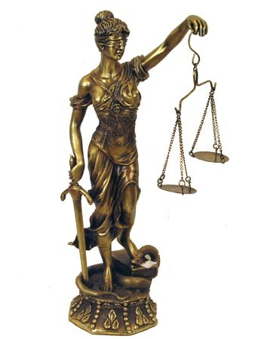
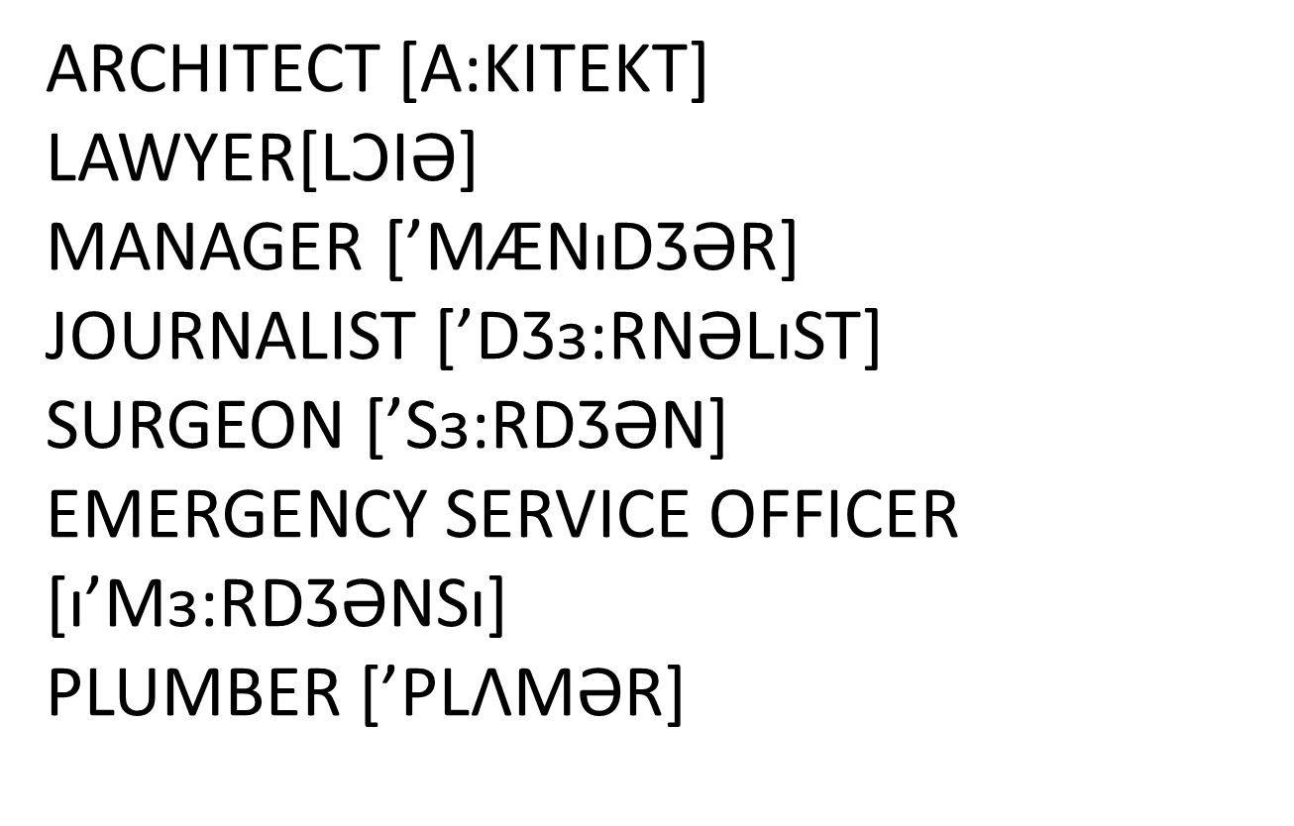
Listen and repeat:

Slide 3
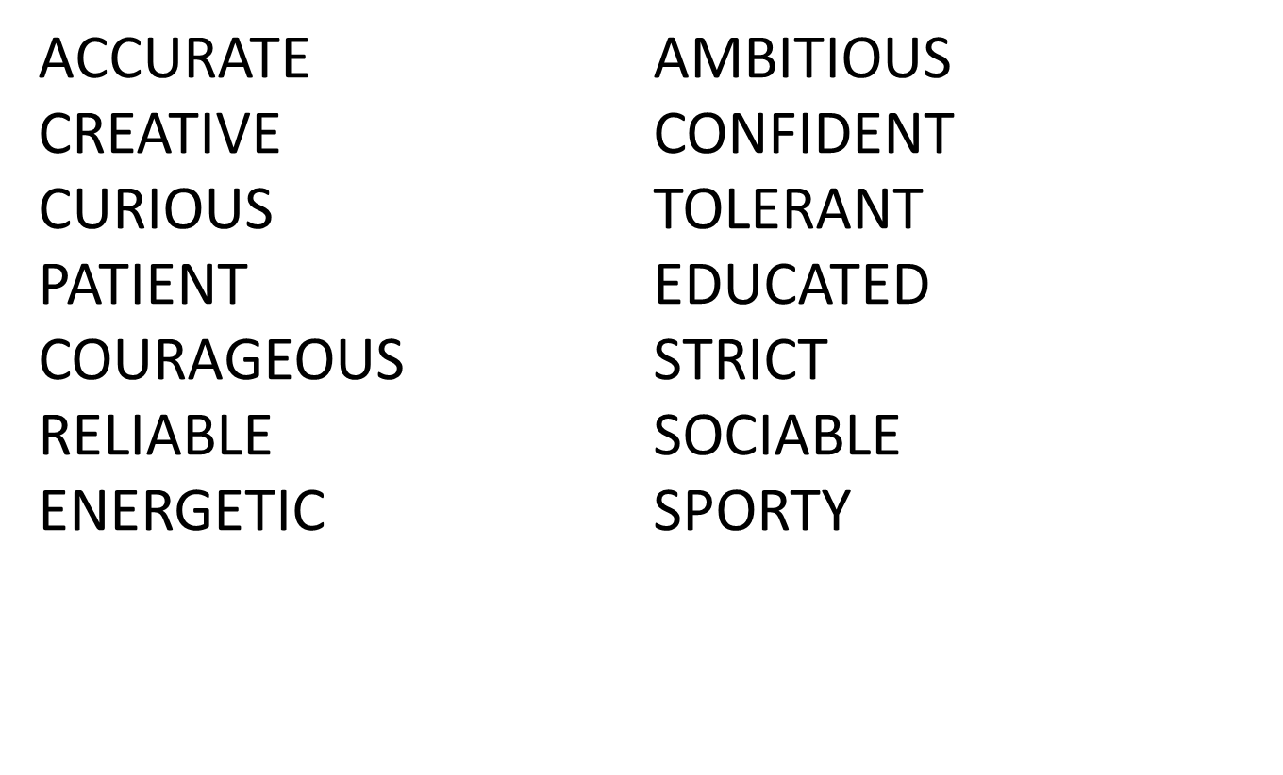

Slide 4
a:You are helpful/patient/generous. Your ideal
job is doctor, nurse, teacher, social worker
b: You are reliable/organized/logical/careful. You can work with machines, plants, animals.
c: You are emotional/creative/flexible. You can be a journalist, designer, artist.
d: You are strong/confident/motivated. You are a natural leader you can be a good manager

Slide 5
PROVERBS:
No gain without pain
Repetition is the mother of learning
The work shows the workman
Rome was not built in a day

