Slide 1
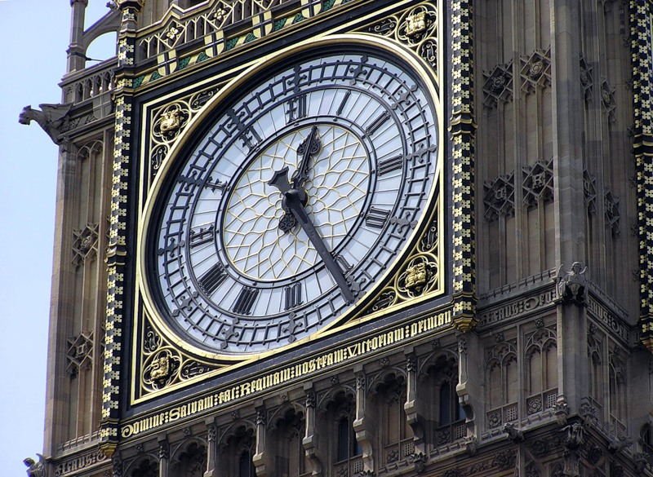

Slide 2
Big Ben

Slide 3
Big Ben

Slide 4
Red Square

Slide 5
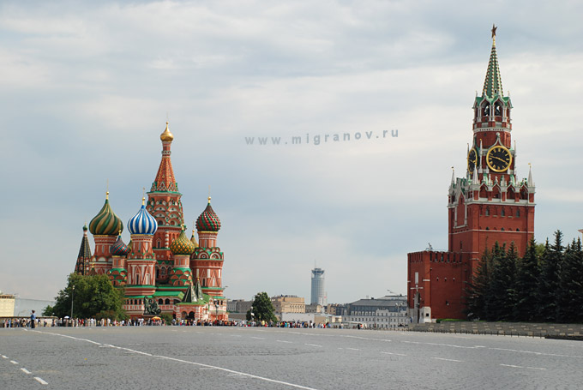
Red Square
Notes:
Red Square

Slide 6
The Moscow Kremlin

Slide 7
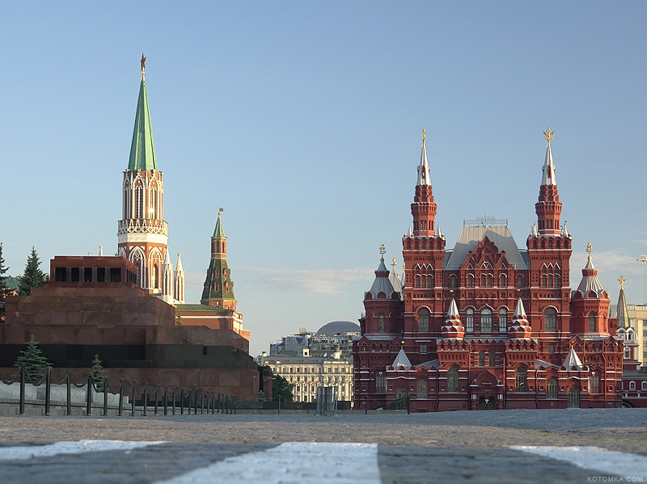
The Moscow Kremlin

Slide 8
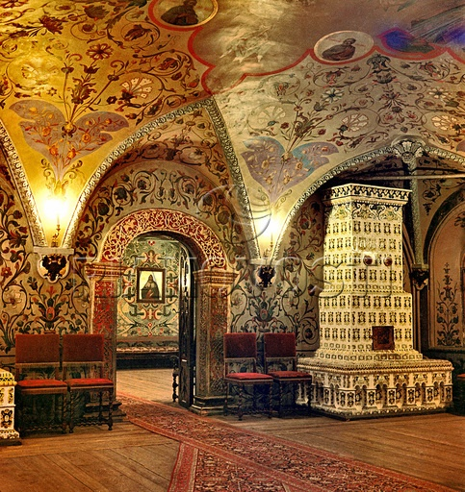
The Kremlin (inside)

Slide 9
Moscow

Slide 10
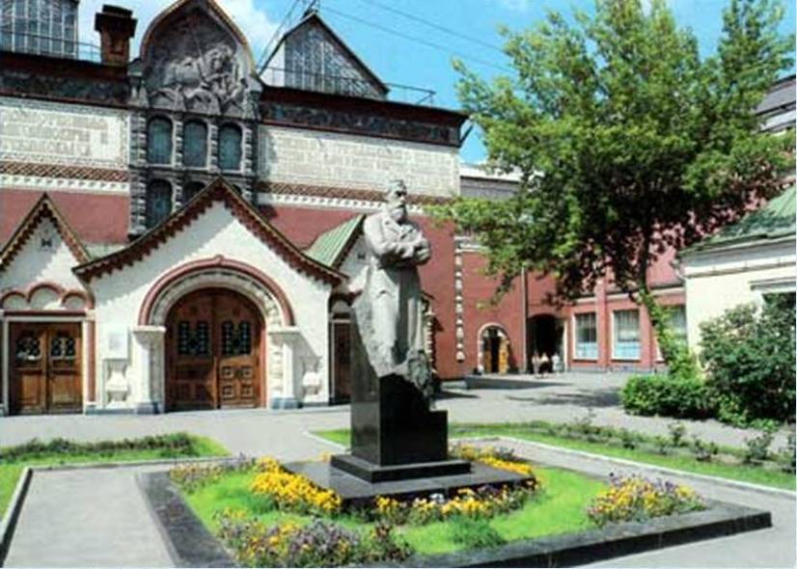
The State Tretyakov Gallery

Slide 11
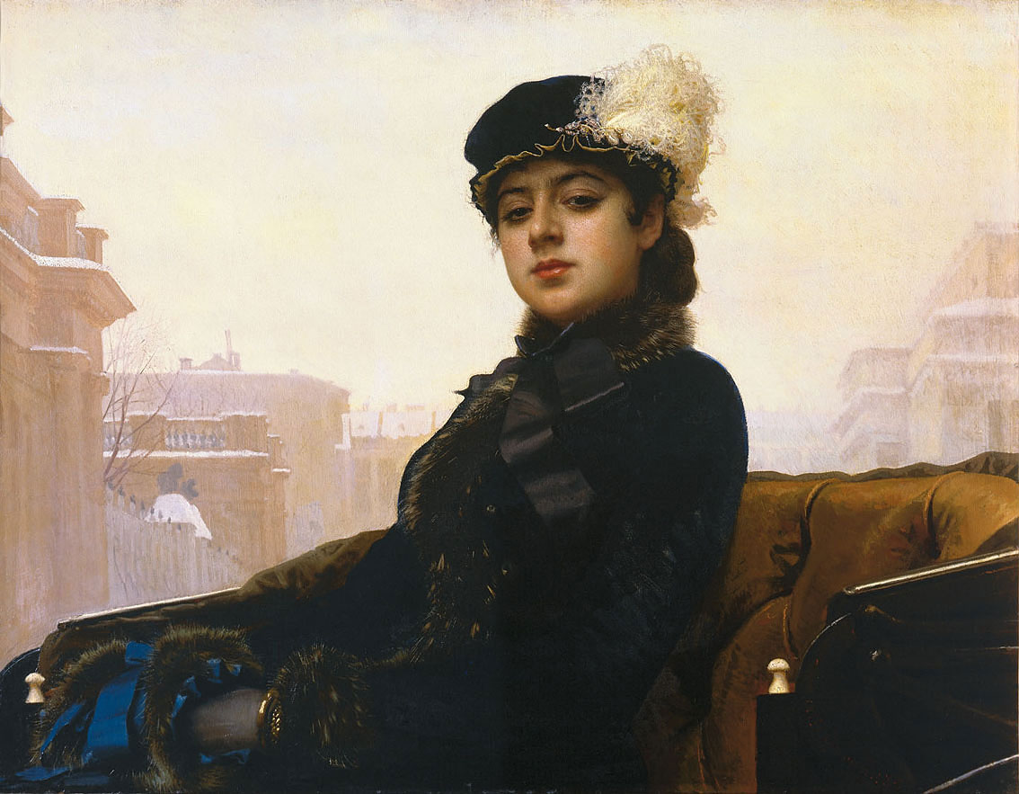

Slide 12
