Slide 1
OXBRIDGE
Oxford and
CAMBRIDGE

Slide 2
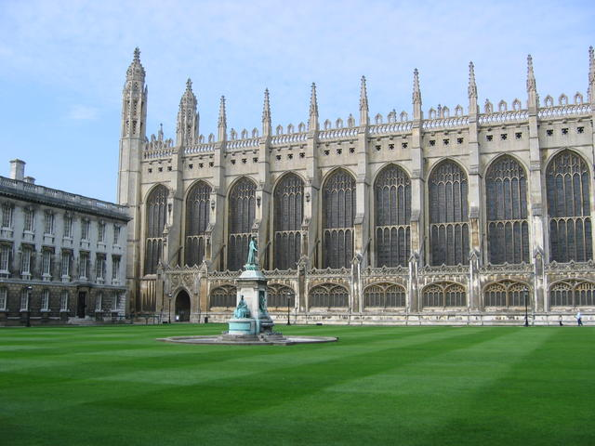
Oxford and Cambridge are the most prestigious universities in Great Britain.
Oxford is the oldest. Nobody knows for sure when it was founded but teaching
was already going on there by the early 12th century.

Slide 3
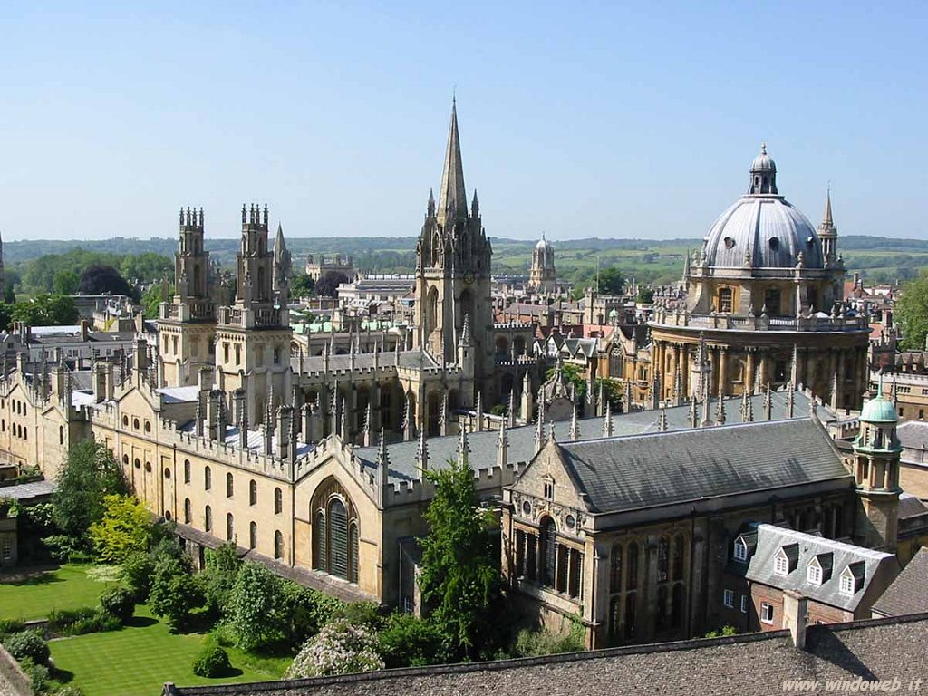
The beautiful views of Oxford's “dreaming spires” have become iconic indeed. It was Matthew Arnold, the 19thcentury poet, who called Oxford “that sweet city with its dreaming spires”.

Slide 4
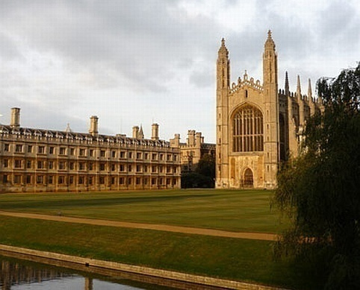
The chapel of King’s College, Cambridge is the most famous symbol of
both the city and the university.

Slide 5
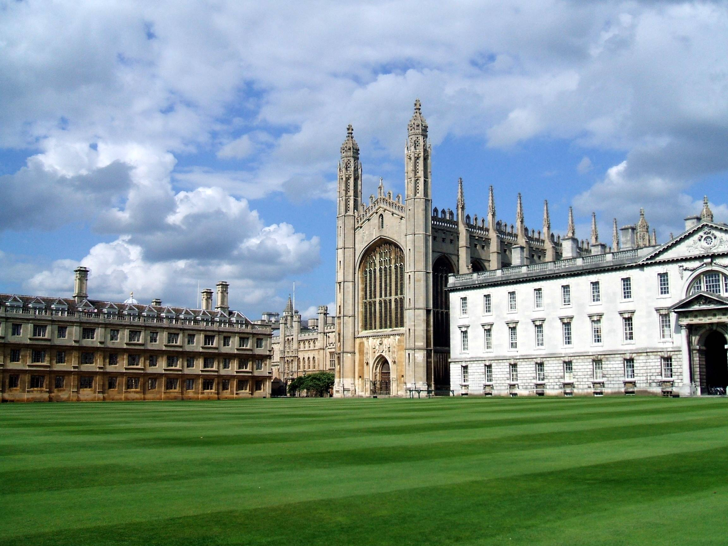

Slide 6
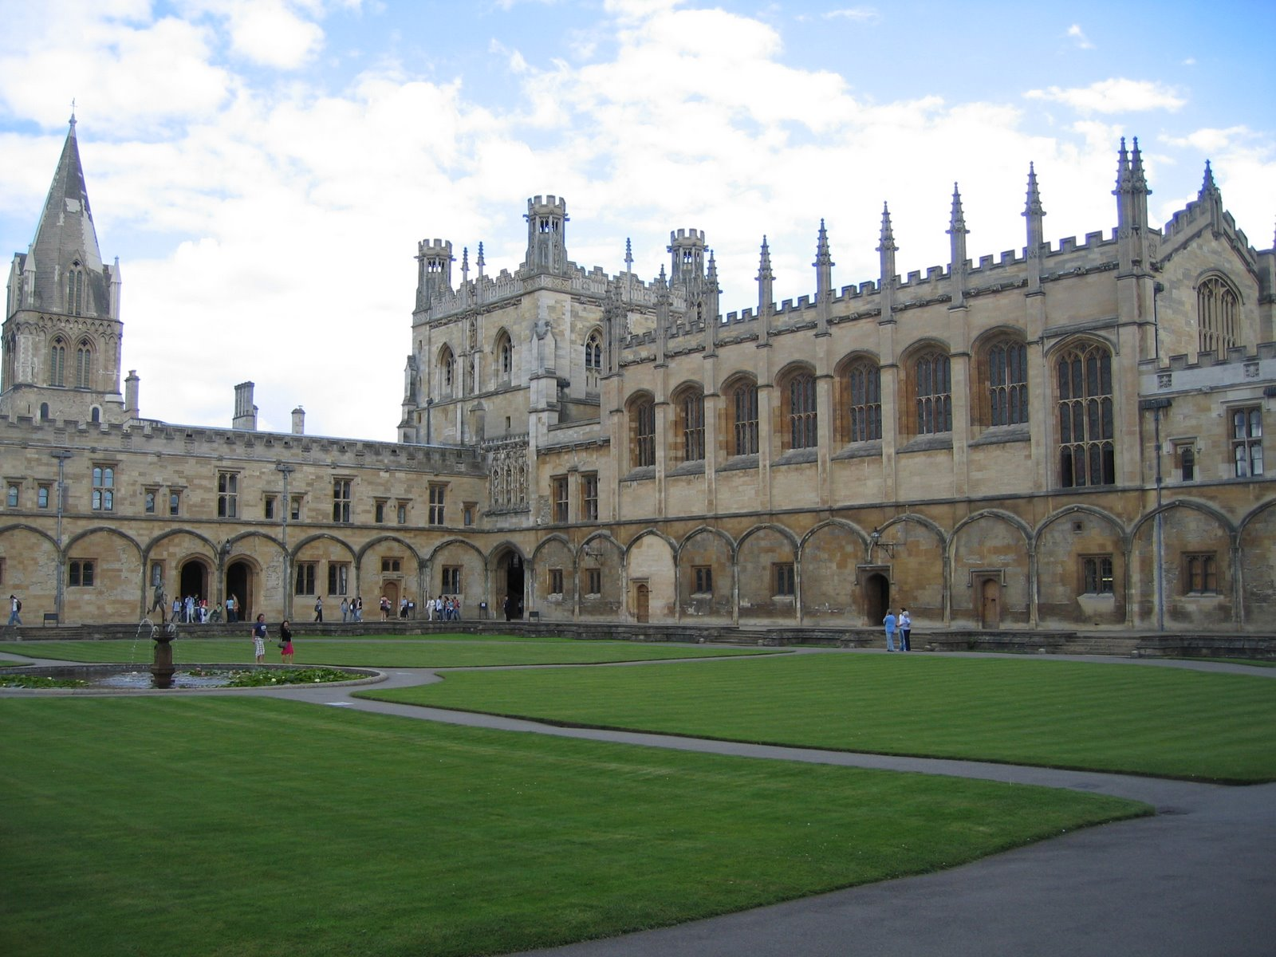
The word Oxbridge was invented by William Thackeray the author of “Vanity Fair”.

Slide 7
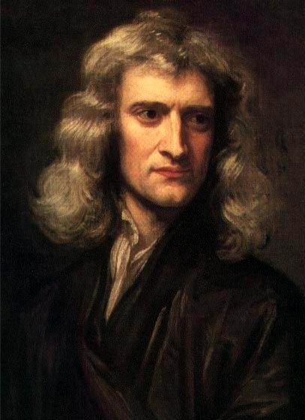
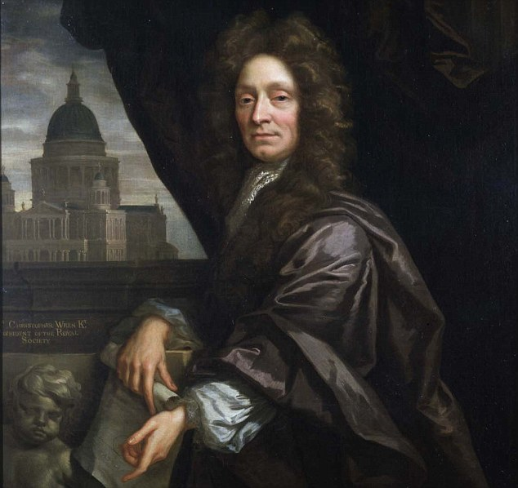
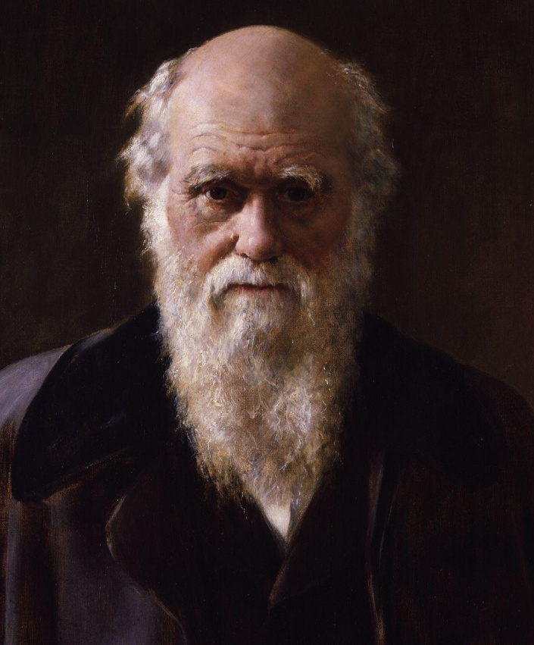
Many great names are connected with Oxford – Isaac Newton, Sir Christopher Wren, Charles Darwin.

Slide 8
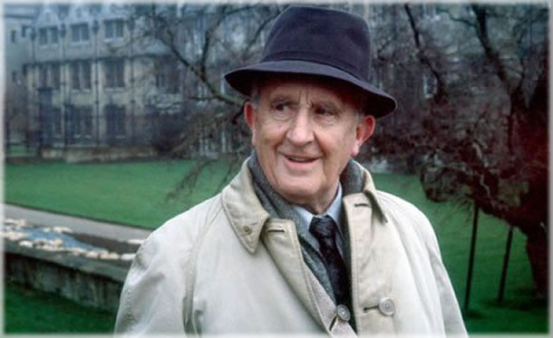
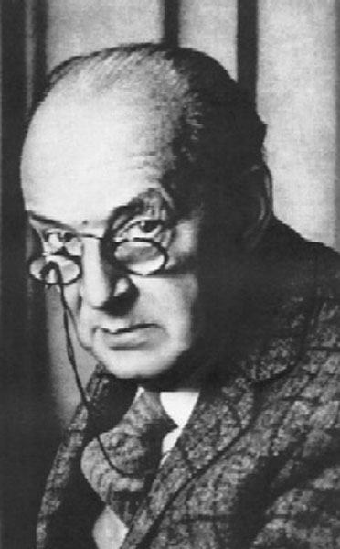
J.R.R. Tolkien – the author of ”The Lord of Rings”
Vladimir Nabokov

Slide 9
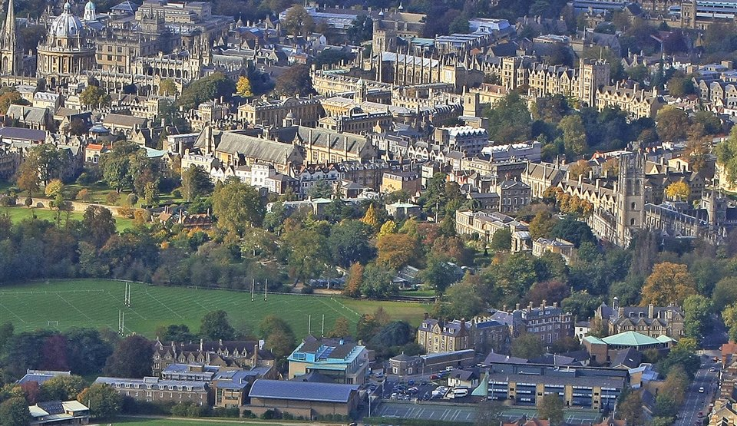
There isn’t really any university at Oxford or Cambridge. The “University” is just an administrative body that organizes lectures, arranges exams, gives degrees.

Slide 10
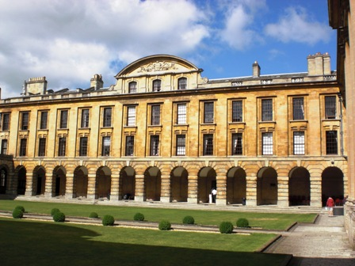
Each college has its name, its coat of arms and its own building , including a chapel, a library, a dining hall and rooms for students to live in. Each college has its own character and its own traditions.

Slide 11
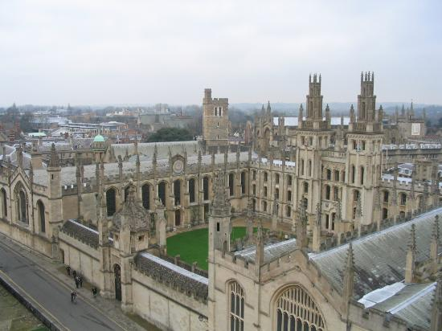
All colleges buildings are often arranged round a square of grass. They are called “quarts” in Oxford and “courts” in Cambridge.

Slide 12
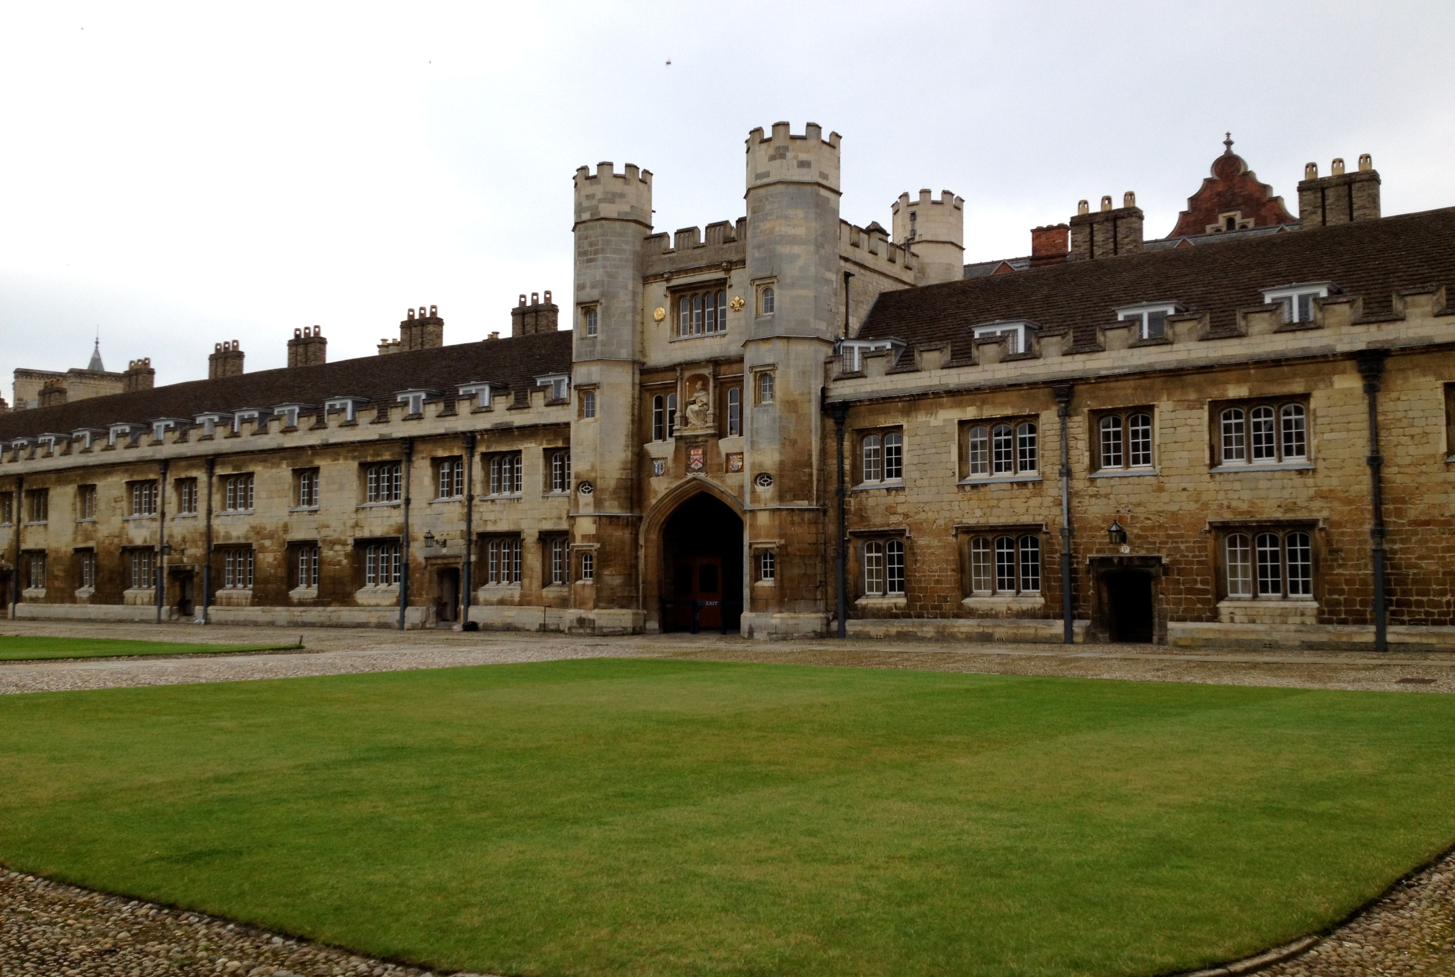
Only Trinity College, Cambridge gave the world 31 Nobel Prize winners.

Slide 13
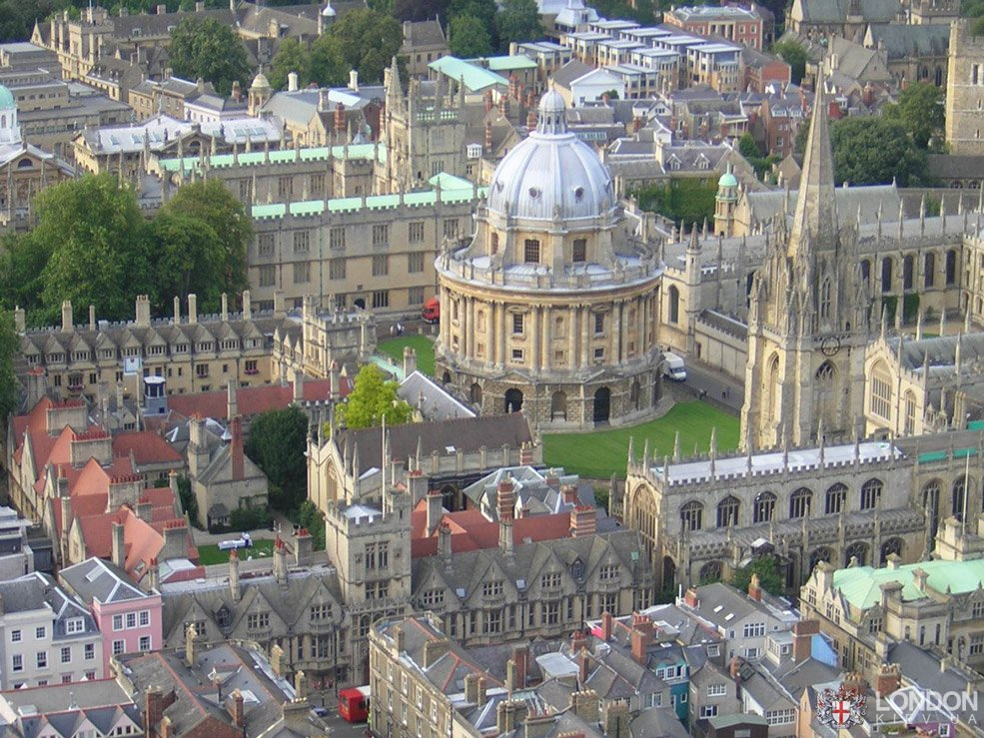
The Bodleian Library is the main research library of Oxford, known to Oxford scholars as “Bodley” or “Bod”. The library got its name after Sir Thomas Bodley.

Slide 14
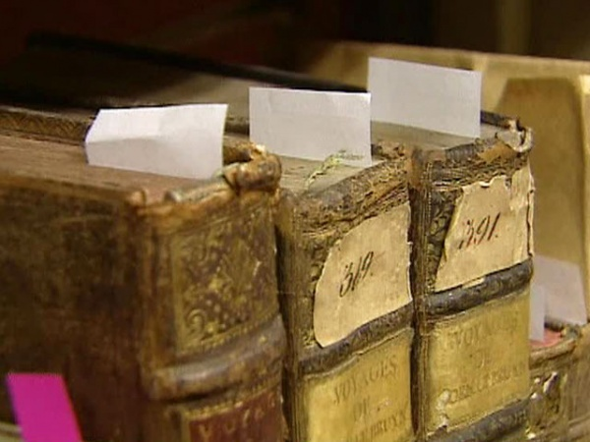
Thomas Bodley was famous for his collection of manuscripts
which he gifted to the library.

Slide 15
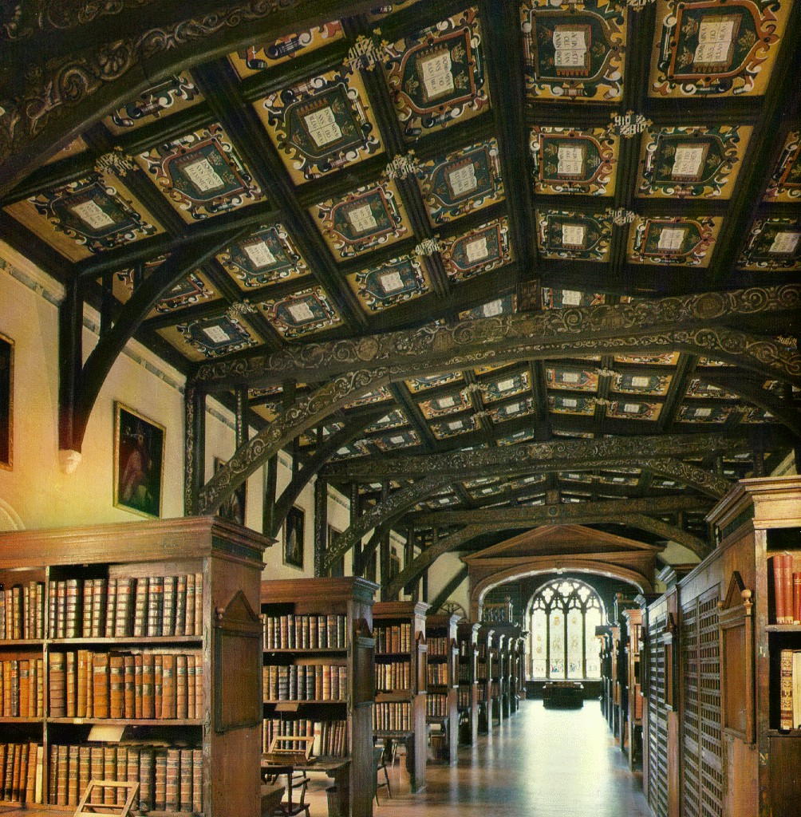

Slide 16
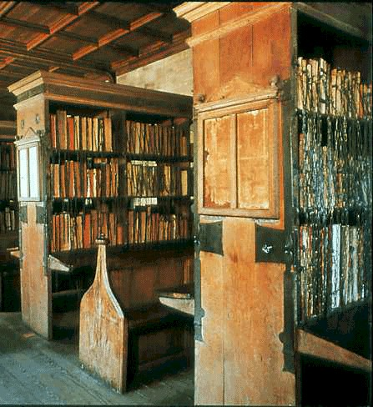
In the medieval library of Merton College, Oxford you can see chained books – just as they were in 13th century.

Slide 17
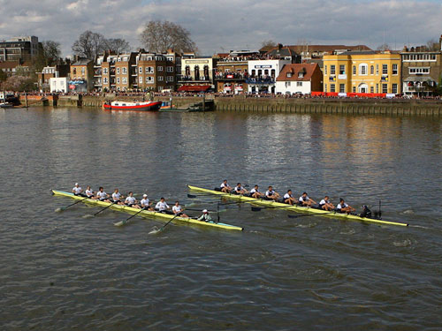
Sport is a very important part of Oxbridge life. The most famous competition between the two universities is the Boat Race, a rowing race which takes place every year on the River Thames.

Slide 18
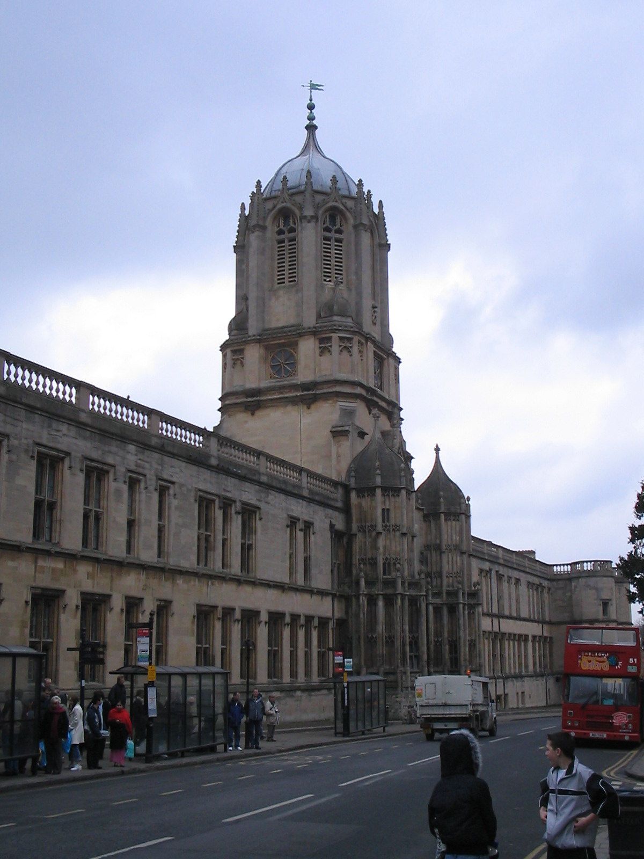
Every college has got and keeps to its old tradition. The bell in the Great Tom tower rings 101 times at 9 o’clock every night for the first 101 students of Christ Church College, Oxford.

Slide 19
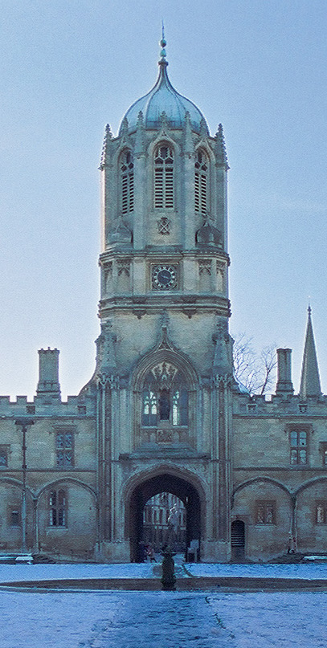
The Great Tom tower was designed by Sir Christopher Wren

Slide 20
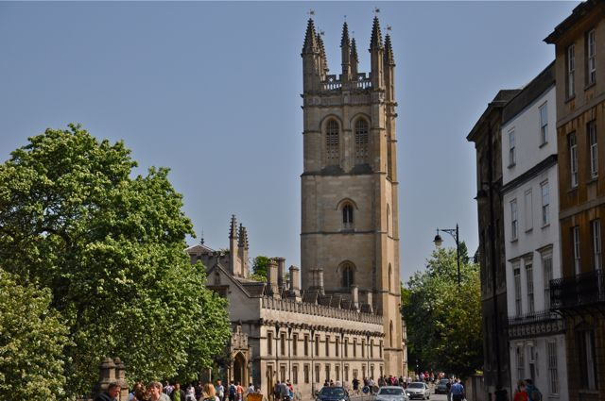
Magdalen College, Oxford.

Slide 21
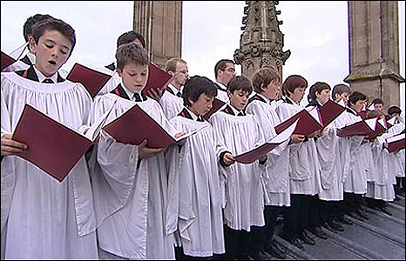
Every year at sunrise on May morning the choir of Magdalen College gather on the top of Magdalen Tower to sing a Latin hymn.

Slide 22
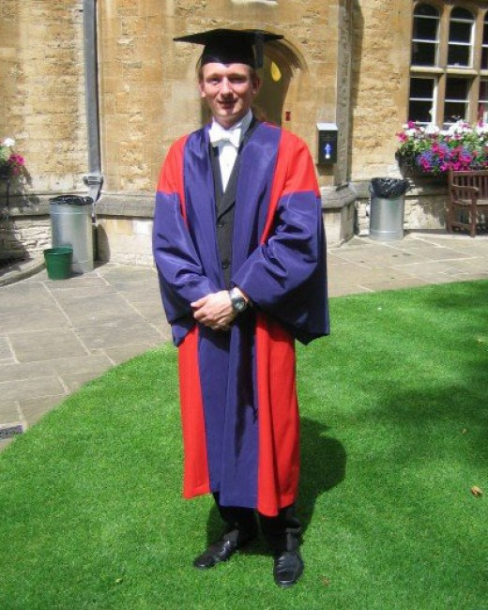
There is a very old tradition to
wear full academic dress going
to the exams

Slide 23
These students are happily-looking after passing their exams

Slide 24
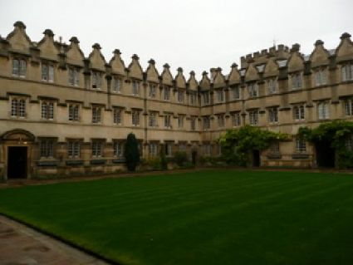
Each year about 26 000 potential students go for interviews at Oxbridge but only
25 % are successful.

