Slide 1
☺ WELCOME TO OUR LESSON ☺

Slide 2
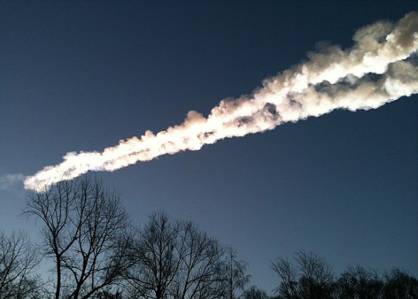
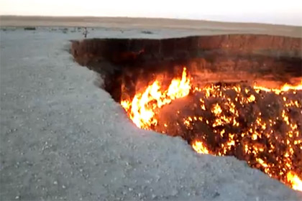
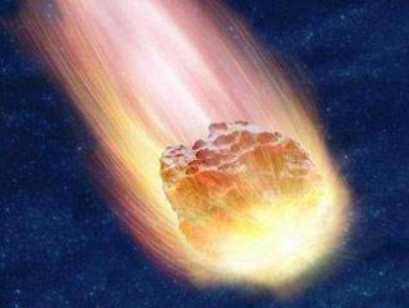
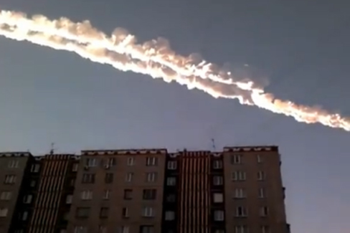
15.02.2013. Chelyabinsk.

Slide 3
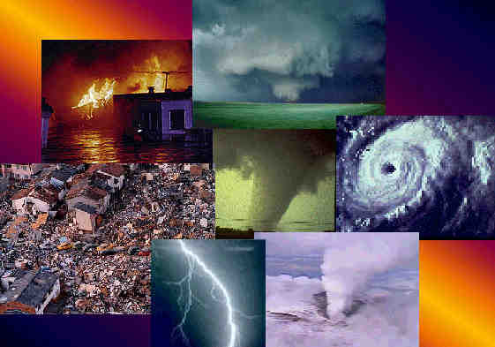
Our theme: _______________
http://svoe.tv/video/9105/

Slide 4
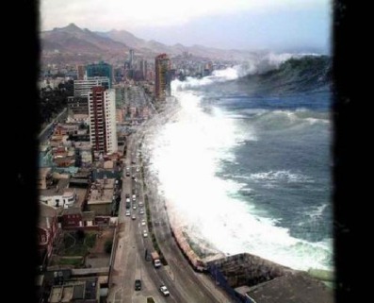
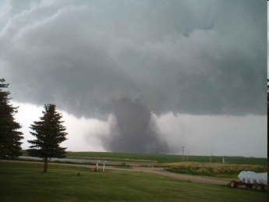
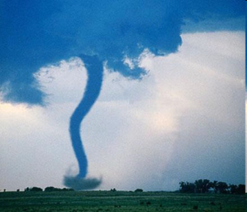
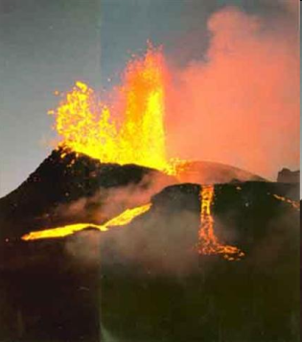
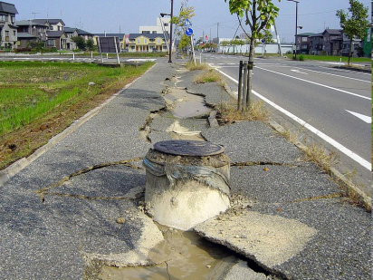
Natural disasters

Slide 5
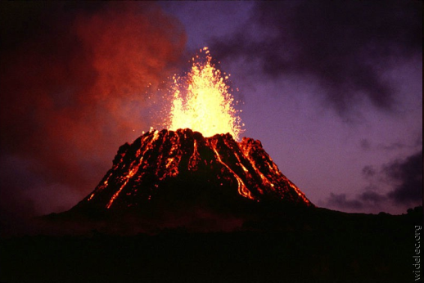
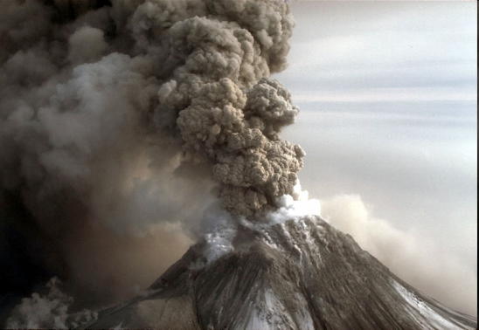
VOLCANO eruption

Slide 6
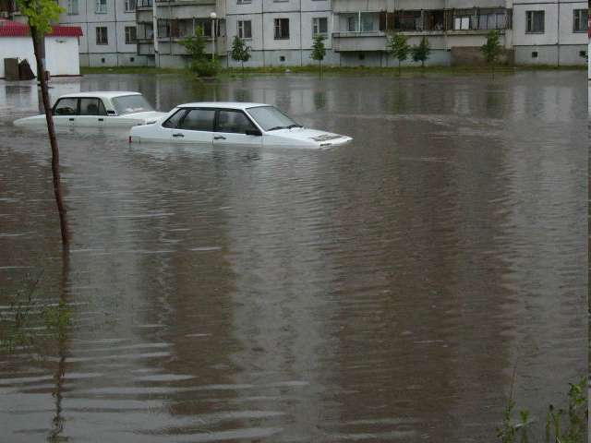
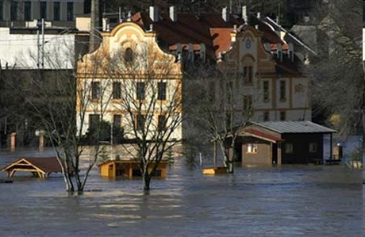
flood

Slide 7
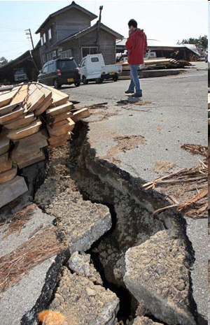
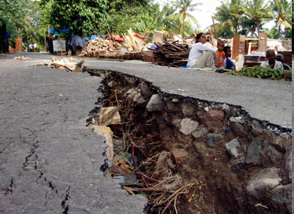
earthquake

Slide 8
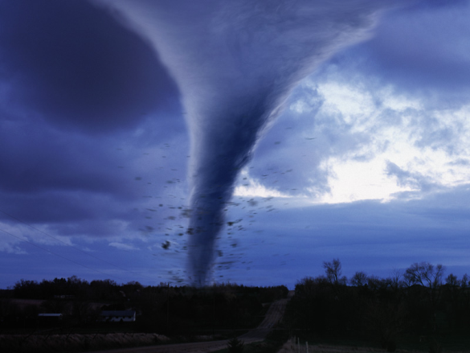
TORNADO

Slide 9
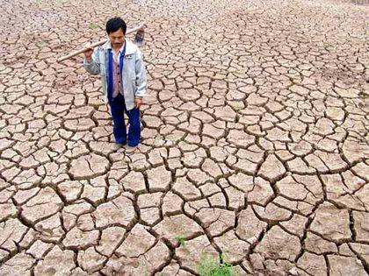
DROUGHT

Slide 10
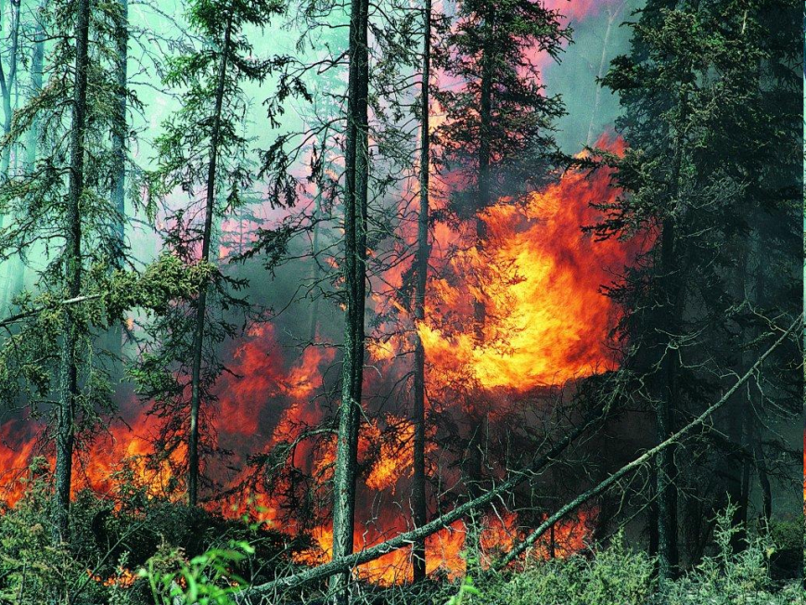
Forest fire

Slide 11
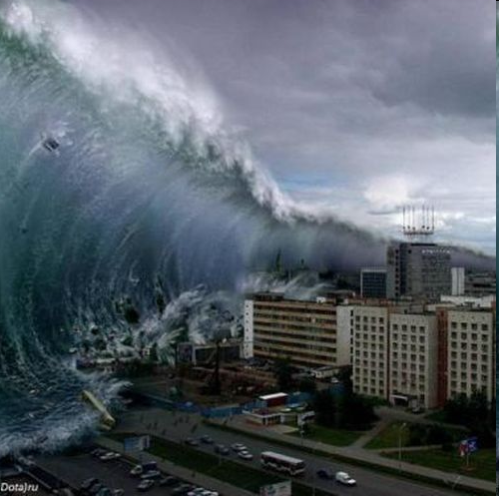
tsunami

Slide 12
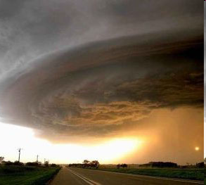
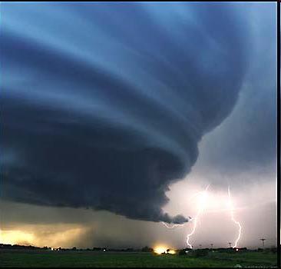
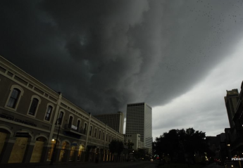
hurricane

Slide 13
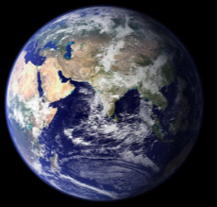
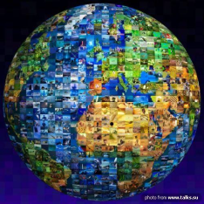
OUR FRAGILE PLANET

Slide 14
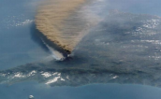
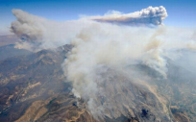
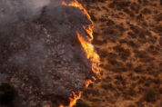
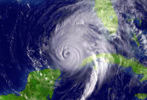
VOCABULARY OF THE LESSON
Damage
Destroy
Break
Ruin
Hurt
Pain
Global warming
Expand
Spread
Widespread
Dry
Cover
Greenhouse effect
Homeless people
Heat
Water level
Melting ice
Violent wind
Great speed
Dark clouds
Thunder
Bright flashes
Funnel
Twist
Shaking ground
Earth’s plates
Die
Kill
Lava
Ash
Crater
Destruction
Rocks
Smoke
Awful
Terrible

Slide 15
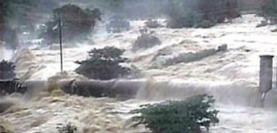
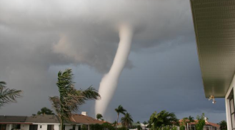
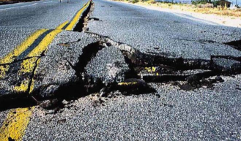
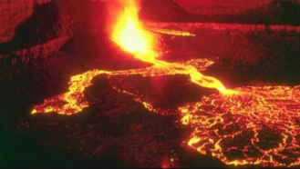

Slide 16
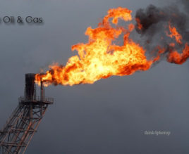
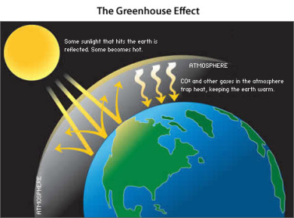
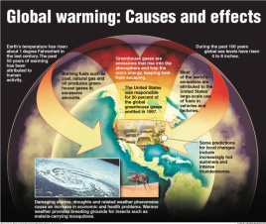
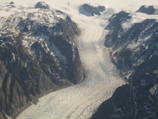
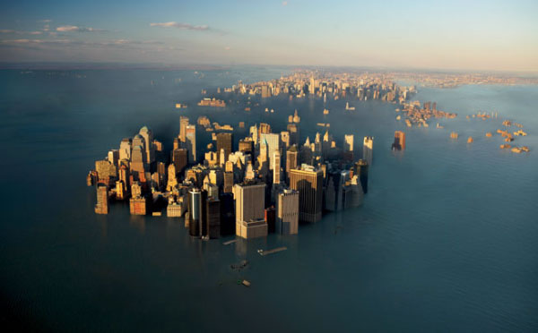
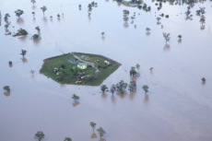
FLOODS

Slide 17
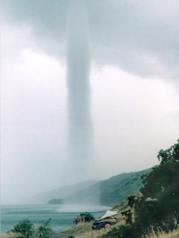
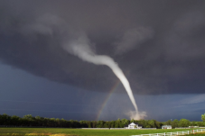
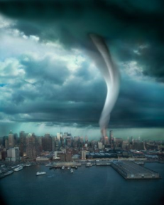
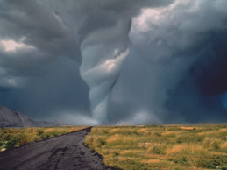
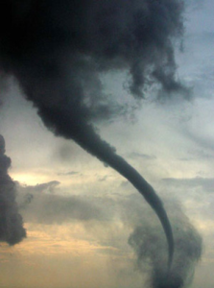
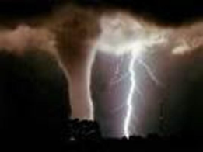
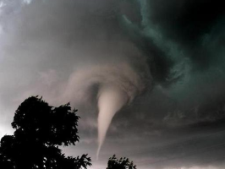
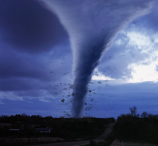
TORNADOES

Slide 18
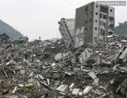
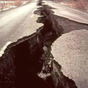
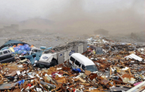
EARTHQUAKES

Slide 19
VOLCANOES

Slide 20
VESUVIUS, 79 AD.
1944

Slide 21
Listen and number the pictures in the correct order

Slide 22
EARTHQUAKE
Homeless people
Damaged buildings and cars
Destroyed buildings and cars
Hurt people
Dead bodies
Shaken ground
Crying people

Slide 23
Flood
Homeless people
Damaged buildings and cars
Much water everywhere
Alarm signals
Swimming people
Outage
Hurt or dead people
Shortage of food

Slide 24
Drought
Shortage of water and food
Damaged farmland
Destroyed harvest
Ill people
Overheating
Increase in prices
Poor agricultural situation

Slide 25
FIRE
Burnt trees
Smoke
Destroyed plants
Dead animals and insects
Diseases of lungs

Slide 26
VOLCANO
Ash everywhere
Smoke
Burnt ground, grass and plants
Broken equipment, machines
Fire
Diseases of lungs
Poisonous gases

Slide 27
LEAFLET
Thin booklet
Bright titles
Attractive pictures
Short and informative sentences

Slide 28
Helpful sites:
http://www.culture.mchs.gov.ru/
http://survincity.ru/
http://survhelp.ru/cataclysm/
http://www.rescue01.gov.by/
http://chtodelat.net/
http://www.vigivanie.com/
http://shkolazhizni.ru/
http://www.ludoedoff.ru/
http://www.daslife.ru/
http://znayuvse.ru/
http://mail.propogodu.ru/
http://oko-planet.su/
Gymnasium 1748 Vertical
Moscow, 2013
ATTENTION!
NATURAL DISASTERS
The leaflet was made by:
Germanovich E.A.
Ulyana Ostanina
Nancy Platonova
Irina Alekseeva
Lidia Seryegova
Kirpita Karina
God helps those who help themselves.
Trouble is the beginning of disaster.
All is well that ends well.
Every cloud has a silver lining.
Adversity is a good teacher.
It never rains but it pours.
Foolish fear doubles danger.
Misfortunes never come alone.
Man proposes, God disposes.

Slide 29
ATTENTION!!! NATURAL DISASTERS: where to go and what to do.
FLOODS
FIRES
EARTHQUAKES

Slide 30
Natural disasters: where to go and what to do
Stay upstairs or on the roof
Alert (signal)
Don’t panic
Keep your balance
Save your energy
Call “rescue service”
Don’t let oxygen get in
Cover yourself with a wet blanket
Try to leave the house
Creep
Stand in the doorway
Stay far from windows
Listen to the radio news
Don’t use lift
Don’t use matches
Take all necessary things (documents, money, photos) out of the house
Move along the walls
Take off heavy boots and clothes
Turn off gas and electricity
Turn off water
Close doors and windows
Don’t go to the balcony
Don’t run

