Slide 1
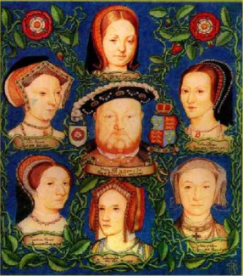
Henry VIII AND HIS WIVES

Slide 2
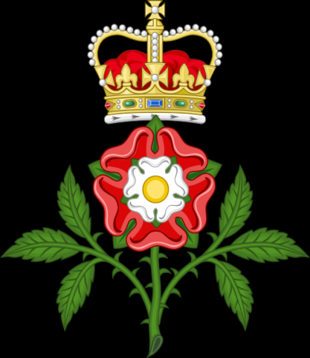
It is portrayed as a dual roses, made in the «natural», proper colors: white flower on top of scarlet, and divided into four red and white sectors. Name and origin of the logo associated with the circumstances of the English Royal Tudor dynasty.
In an effort to combine all the English Royal dynasties, Henry Tudor married the daughter of Edward IV Elizabeth. After marriage Henry adopted a new logo from the red rose of Lancaster and the white rose of York.

Slide 3
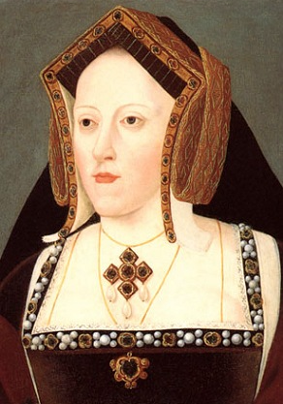
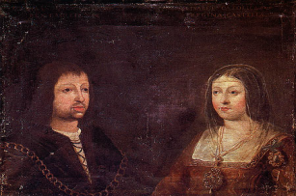
the first wife Catherine of Aragon
Catherine of Aragon (1485-1536).
Daughter of Ferdinand II of Aragon and Isabella I of Castile. She was given in marriage to Arthur, the elder brother of Henry VIII. Having become a widow. Henry VIII married Catherine immediately after accession to the throne in 1509. The first years of marriage were happy, but all the children of young spouses or were born dead or dying in infancy. The only surviving child was Maria (1516-1558).

Slide 4
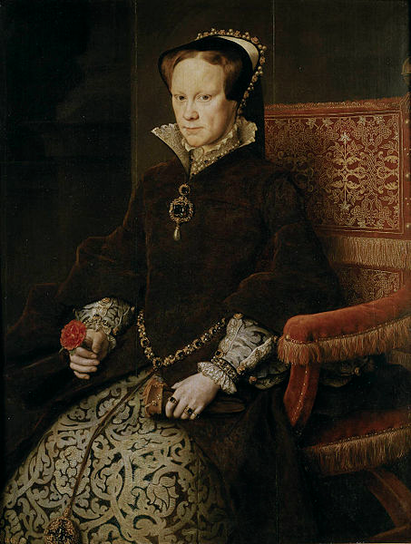
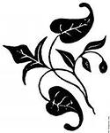
Mary I Tudor (1516-1558) the first crowned Queen of England from 1553, the eldest daughter of Henry VIII by his marriage to Catherine of Aragon. Also known as Bloody Mary, Maria Catholic.

Slide 5
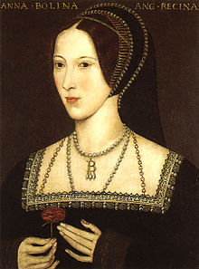
Anna Boleyn (1507 - 1536) It was the beginning of a disconnection of the English Church from Rome and the creation of the Anglican Church. Anna became the wife of Henry in January 1533 and was crowned on 1 June 1533, and in September of the same year, gave birth to their daughter Elizabeth, instead of the expected king's son. Subsequent pregnancies ended unsuccessfully. Anna lost the love of a spouse and was accused of adultery and beheaded at the tower of London in May 1536

Slide 6
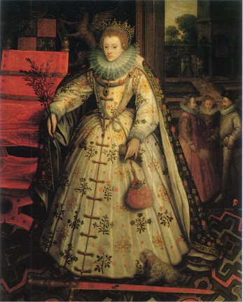
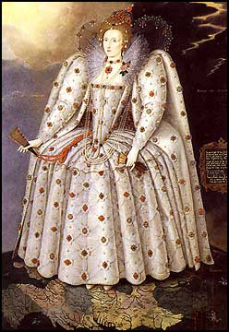
Elizabeth I- the Queen of England and Queen of Ireland from November 17, 1558, the last of the Tudor dynasty. The youngest daughter of Henry VIII and his second wife Anne Boleyn

Slide 7
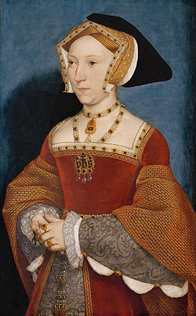
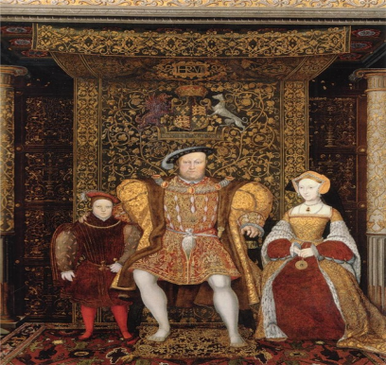
Jane Seymour (1508 - 1537) was a maid of Anne Boleyn. Henry married her in a week after the execution of the previous wife. Soon died of delivery tremens. Mother's only son of Henry Edward VI. In honor of the birth of Prince gun in the tower gave two thousand shots.

Slide 8
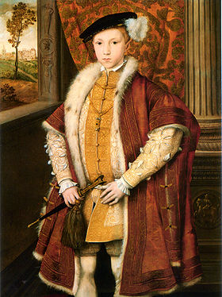
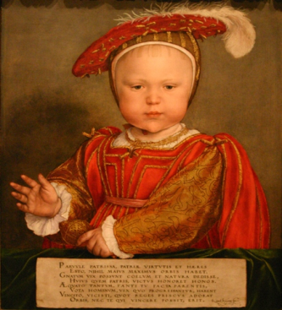
Edward VI ( October 12, 1537 - 6 July 1553) - king of England and Ireland from 28 January 1547, son of Henry VIII.

Slide 9
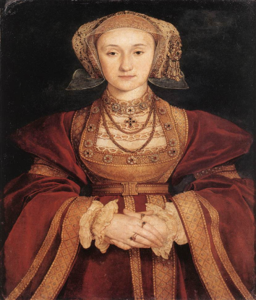
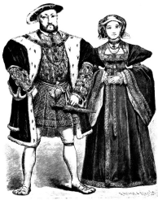
Anna of Cleves (1515-1557). Although the marriage was concluded in January 1540, Henry immediately began looking for a way to get rid of the hated wife. In the end of June, 1540, the marriage was annulled; the occasion was previously existing engagement of Anna with the Duke. In addition, Henry said that the actual marriage relations between him and Anna did not happen. Anna remained in England as the «sister of the king». The marriage was arranged by Thomas Cromwell, for which he lost his head.

Slide 10
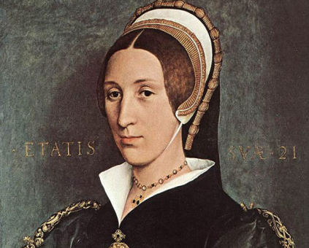
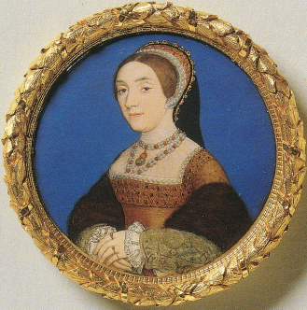
Catherine Howard (1521-1542) Niece of the powerful Duke of Norfolk, a cousin of Anne Boleyn. Henry married her in July 1540 by passionate love. It soon became clear that Catherine had a lover before marriage and had an affair with Henry's personal page Thomas. The guilty were executed, after which 13 February 1542 ascended the scaffold the Queen herself.

Slide 11
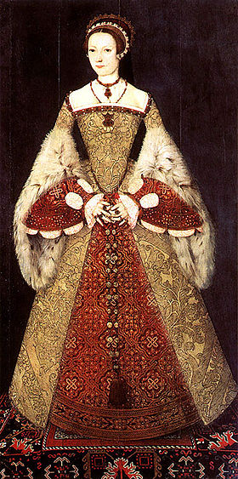
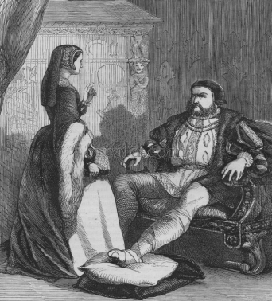
Catherine Parr (1512 - 1548) By the time of marriage with Henry (1543) already twice-widowed. She was a convinced protestant and did a lot for the new turn of Henry to Protestantism. After the death of Henry she married Thomas Seymour, the brother of Jane Seymour.

Slide 12
