Slide 1
Транспортировка
серной кислоты
Выполнил
Сыпков Дмитрий, ученик 11 класса А
МБОУ «СОШ № 81»

Slide 2
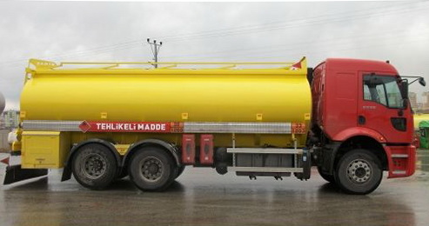
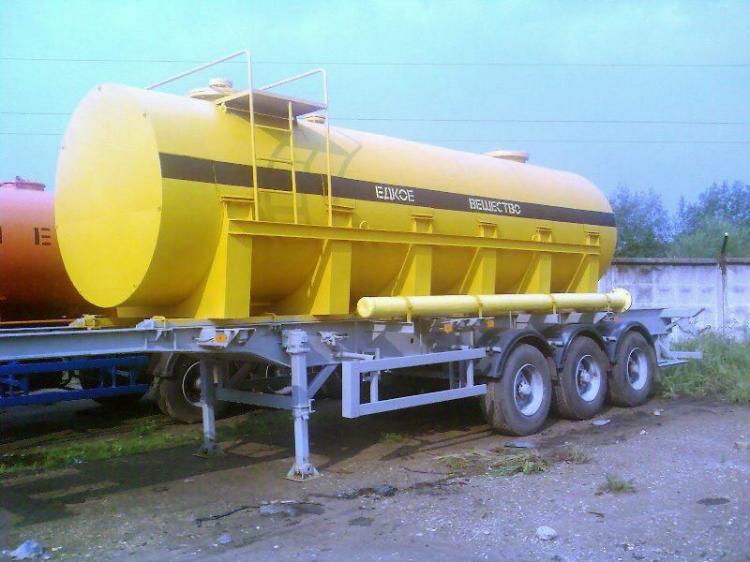
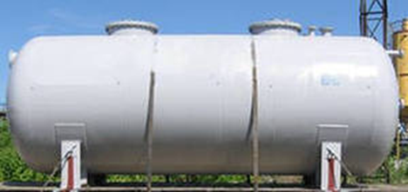
Транспортировка серной кислоты.

Slide 3
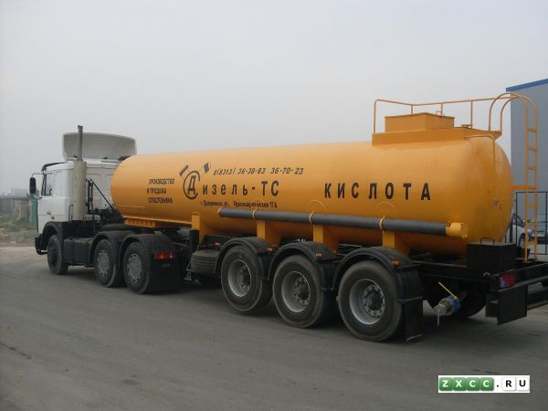
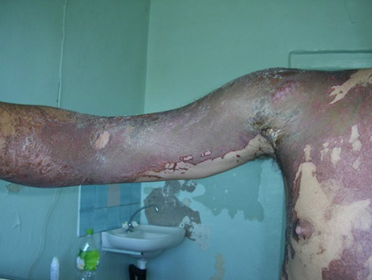
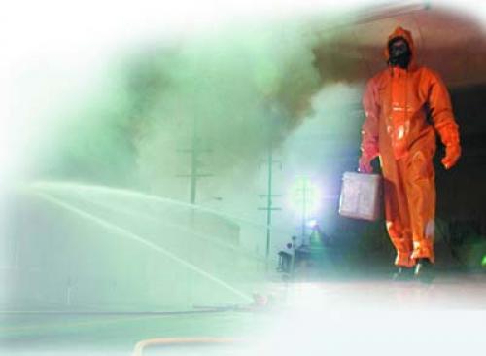
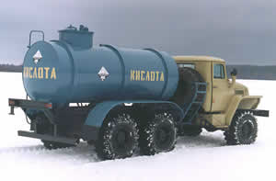

Slide 4
Электронные источники:
1.http://images.yandex.ru/yandsearch?p=3&text=%D1%82%D1%80%D0%B0%D0%BD%D1%81%D0%BF%D0%BE%D1%80%D1%82%D0%B8%D1%80%D0%BE%D0%B2%D0%BA%D0%B0%20%D1%81%D0%B5%D1%80%D0%BD%D0%BE%D0%B9%20%D0%BA%D0%B8%D1%81%D0%BB%D0%BE%D1%82%D1%8B&pos=117&uinfo=sw-1230-sh-634-fw-1005-fh-448-pd-1&rpt=simage&img_url=http%3A%2F%2Fwww.biznes-portal.com%2Fimages%2FGOODS%2F889446_33144.JPG
2. http://images.yandex.ru/yandsearch?p=2&text=%D1%82%D1%80%D0%B0%D0%BD%D1%81%D0%BF%D0%BE%D1%80%D1%82%D0%B8%D1%80%D0%BE%D0%B2%D0%BA%D0%B0%20%D1%81%D0%B5%D1%80%D0%BD%D0%BE%D0%B9%20%D0%BA%D0%B8%D1%81%D0%BB%D0%BE%D1%82%D1%8B&pos=89&uinfo=sw-1230-sh-634-fw-1005-fh-448-pd-1&rpt=simage&img_url=http%3A%2F%2Fblog.oup.com%2Fwp-content%2Fuploads%2F2011%2F12%2Fbeer2.jpg
3. http://images.yandex.ru/yandsearch?p=3&text=%D1%82%D1%80%D0%B0%D0%BD%D1%81%D0%BF%D0%BE%D1%80%D1%82%D0%B8%D1%80%D0%BE%D0%B2%D0%BA%D0%B0%20%D1%81%D0%B5%D1%80%D0%BD%D0%BE%D0%B9%20%D0%BA%D0%B8%D1%81%D0%BB%D0%BE%D1%82%D1%8B&pos=99&uinfo=sw-1230-sh-634-fw-1005-fh-448-pd-1&rpt=simage&img_url=http%3A%2F%2Fpenza.pen.raise.ru%2Firesize.php%3Ffile%3D%2Fpics%2Fused%2F4958975.jpg%26w%3D352%26h%3D352
4. http://images.yandex.ru/yandsearch?p=12&text=%D1%82%D1%80%D0%B0%D0%BD%D1%81%D0%BF%D0%BE%D1%80%D1%82%D0%B8%D1%80%D0%BE%D0%B2%D0%BA%D0%B0%20%D1%81%D0%B5%D1%80%D0%BD%D0%BE%D0%B9%20%D0%BA%D0%B8%D1%81%D0%BB%D0%BE%D1%82%D1%8B&pos=383&uinfo=sw-1230-sh-634-fw-1005-fh-448-pd-1&rpt=simage&img_url=http%3A%2F%2Fneftegaz.ru%2Fpictures%2F1157754.jpg
5. http://images.yandex.ru/yandsearch?p=24&text=%D1%82%D1%80%D0%B0%D0%BD%D1%81%D0%BF%D0%BE%D1%80%D1%82%D0%B8%D1%80%D0%BE%D0%B2%D0%BA%D0%B0%20%D1%81%D0%B5%D1%80%D0%BD%D0%BE%D0%B9%20%D0%BA%D0%B8%D1%81%D0%BB%D0%BE%D1%82%D1%8B&pos=743&uinfo=sw-1230-sh-634-fw-1005-fh-448-pd-1&rpt=simage&img_url=http%3A%2F%2Fura.ru%2Fupload%2F2%281841%29.jpg
6. http://images.yandex.ru/yandsearch?p=26&text=%D1%82%D1%80%D0%B0%D0%BD%D1%81%D0%BF%D0%BE%D1%80%D1%82%D0%B8%D1%80%D0%BE%D0%B2%D0%BA%D0%B0%20%D1%81%D0%B5%D1%80%D0%BD%D0%BE%D0%B9%20%D0%BA%D0%B8%D1%81%D0%BB%D0%BE%D1%82%D1%8B&pos=784&uinfo=sw-1230-sh-634-fw-1005-fh-448-pd-1&rpt=simage&img_url=http%3A%2F%2Fstatic.newsland.ru%2Fnews_images%2F124%2F124532.jpg

