Slide 1
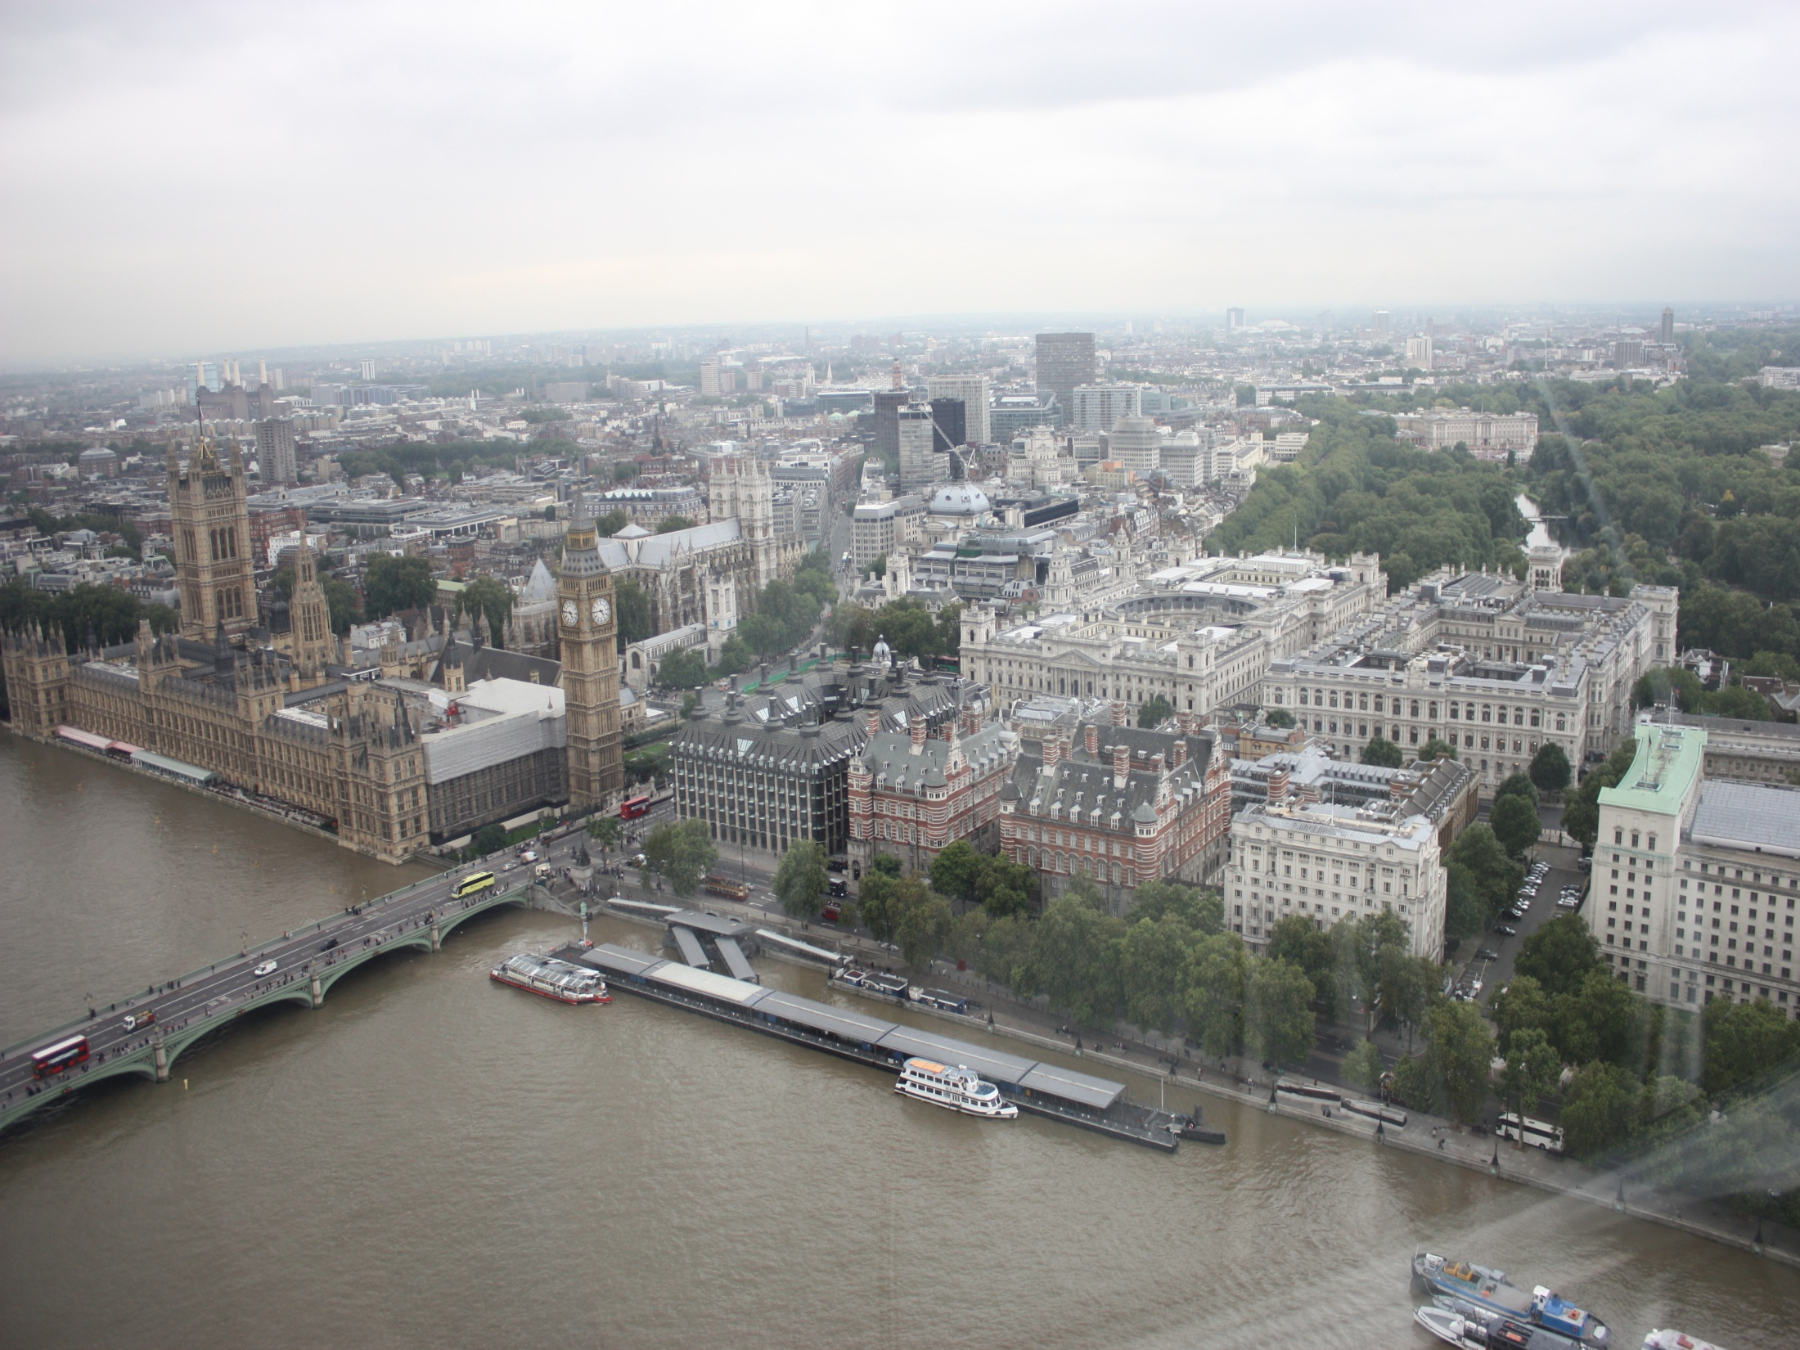
London - the Capital of the UK

Slide 2
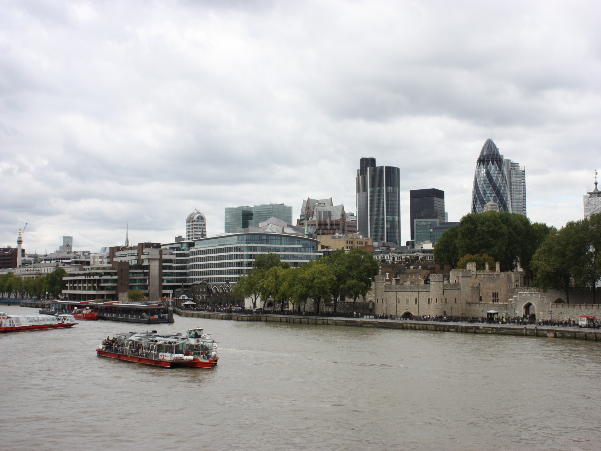
About, London, you my dream!
All life I wish to see you,
As a cloudy, crude cyclone
Install in a city a life, hope and love!
Your art through a fog veil
Rushes into other countries …
Yes, also it is the truth!!!
Football, poetry and Rock in Roll
Are present around …

Slide 3
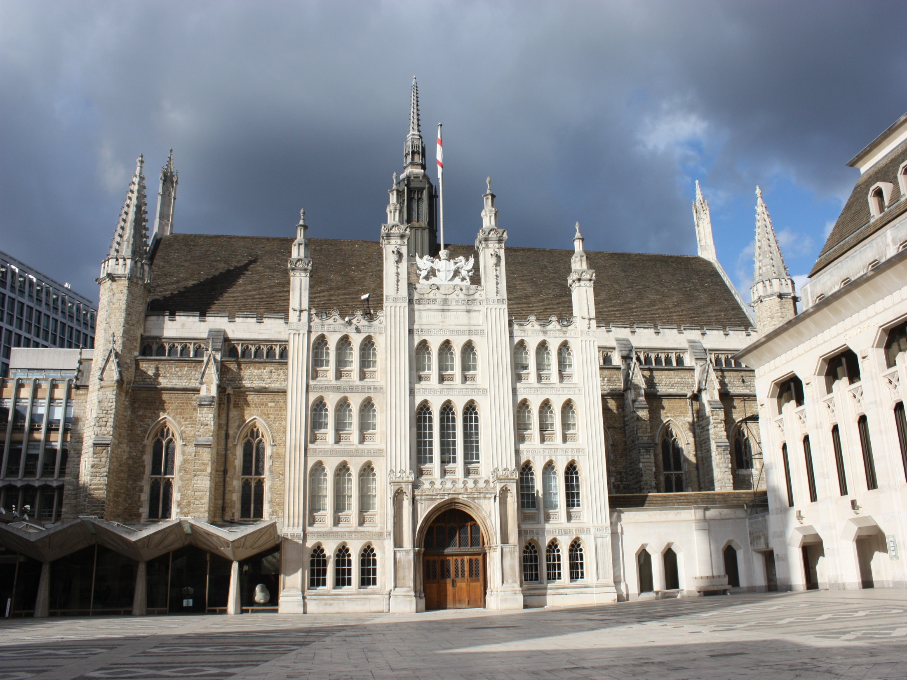
О, Лондон, ты моя мечта!
Всю жизнь хочу увидеть я тебя,
Как пасмурный, сырой циклон
Вселяет в город жизнь, надежду и любовь!
Твое искусство сквозь пелену тумана
Врывается в другие страны…
Да, и это правда!!!
Футбол, поэзия и Rock in Roll
Присутствуют кругом…

Slide 4
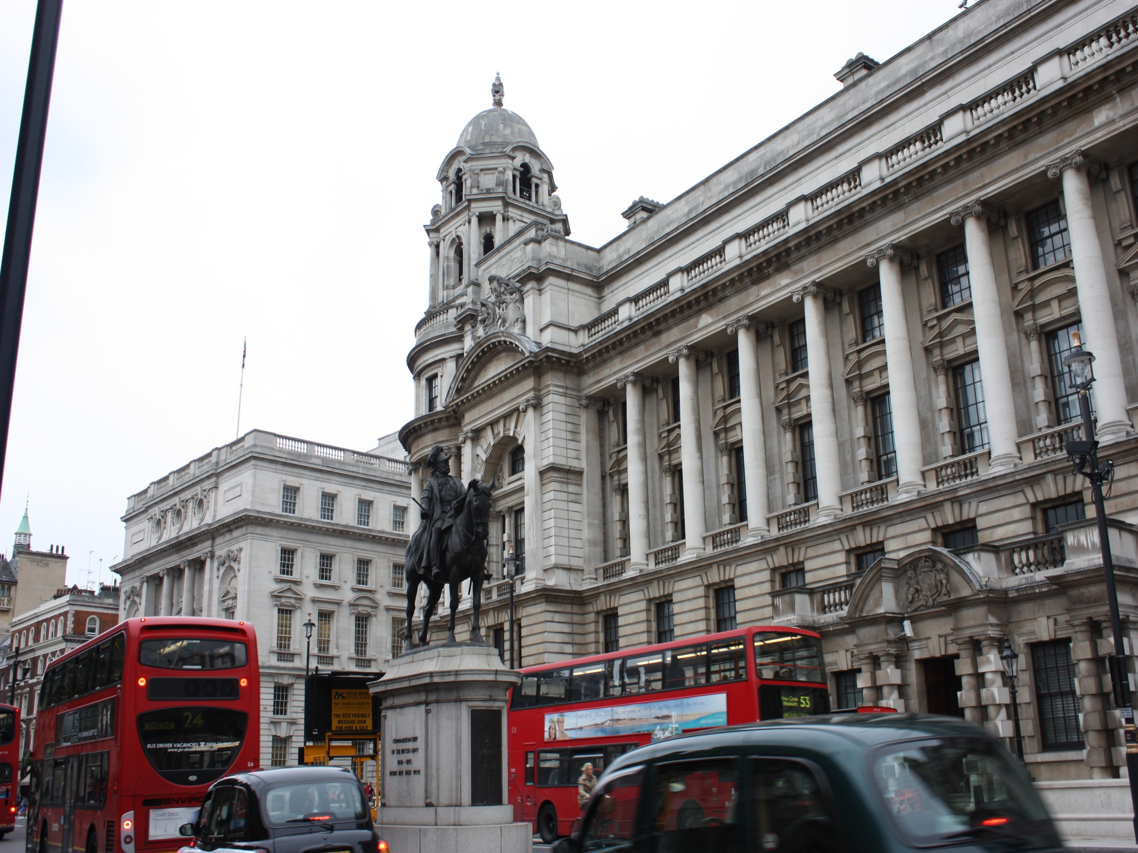
Match the two halves
1. The city became extremely ...
2. The Great Fire...
In the 19th century England was at...
4. When the Queen is in residence ...
5. The Tower of London used to be ...
a) the height of her power.
b) the Houses of Parliament.
the Royal Standard is flown.
prosperous in the 16th century.
e) destroyed the whole of the City.

Slide 5
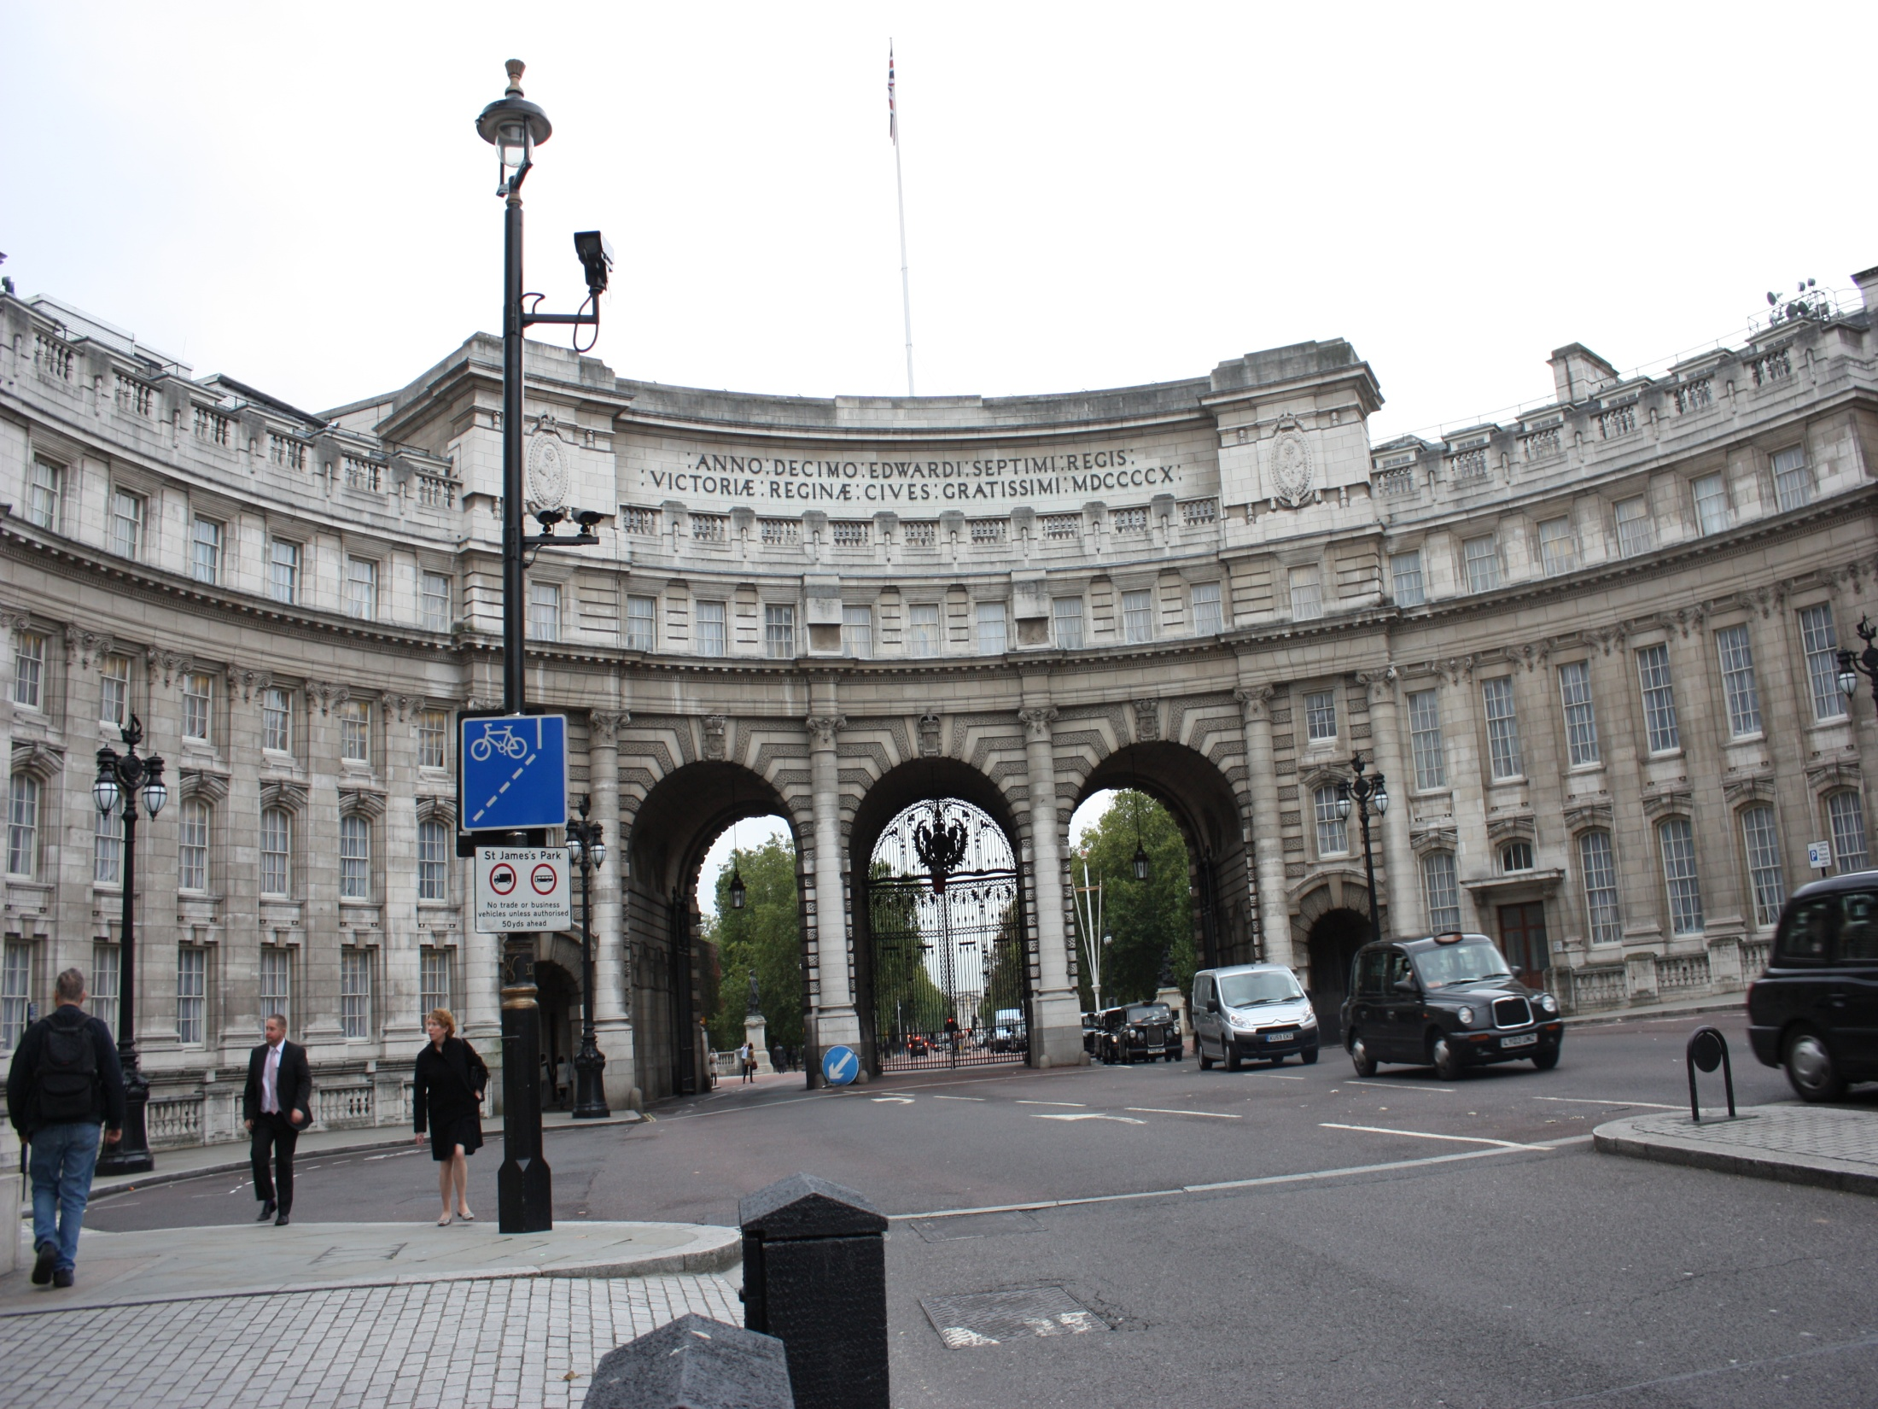
London is divided into
parts questions | The City | The West End | Westminster | The East End
What is it?
famous institutions / buildings

Slide 6
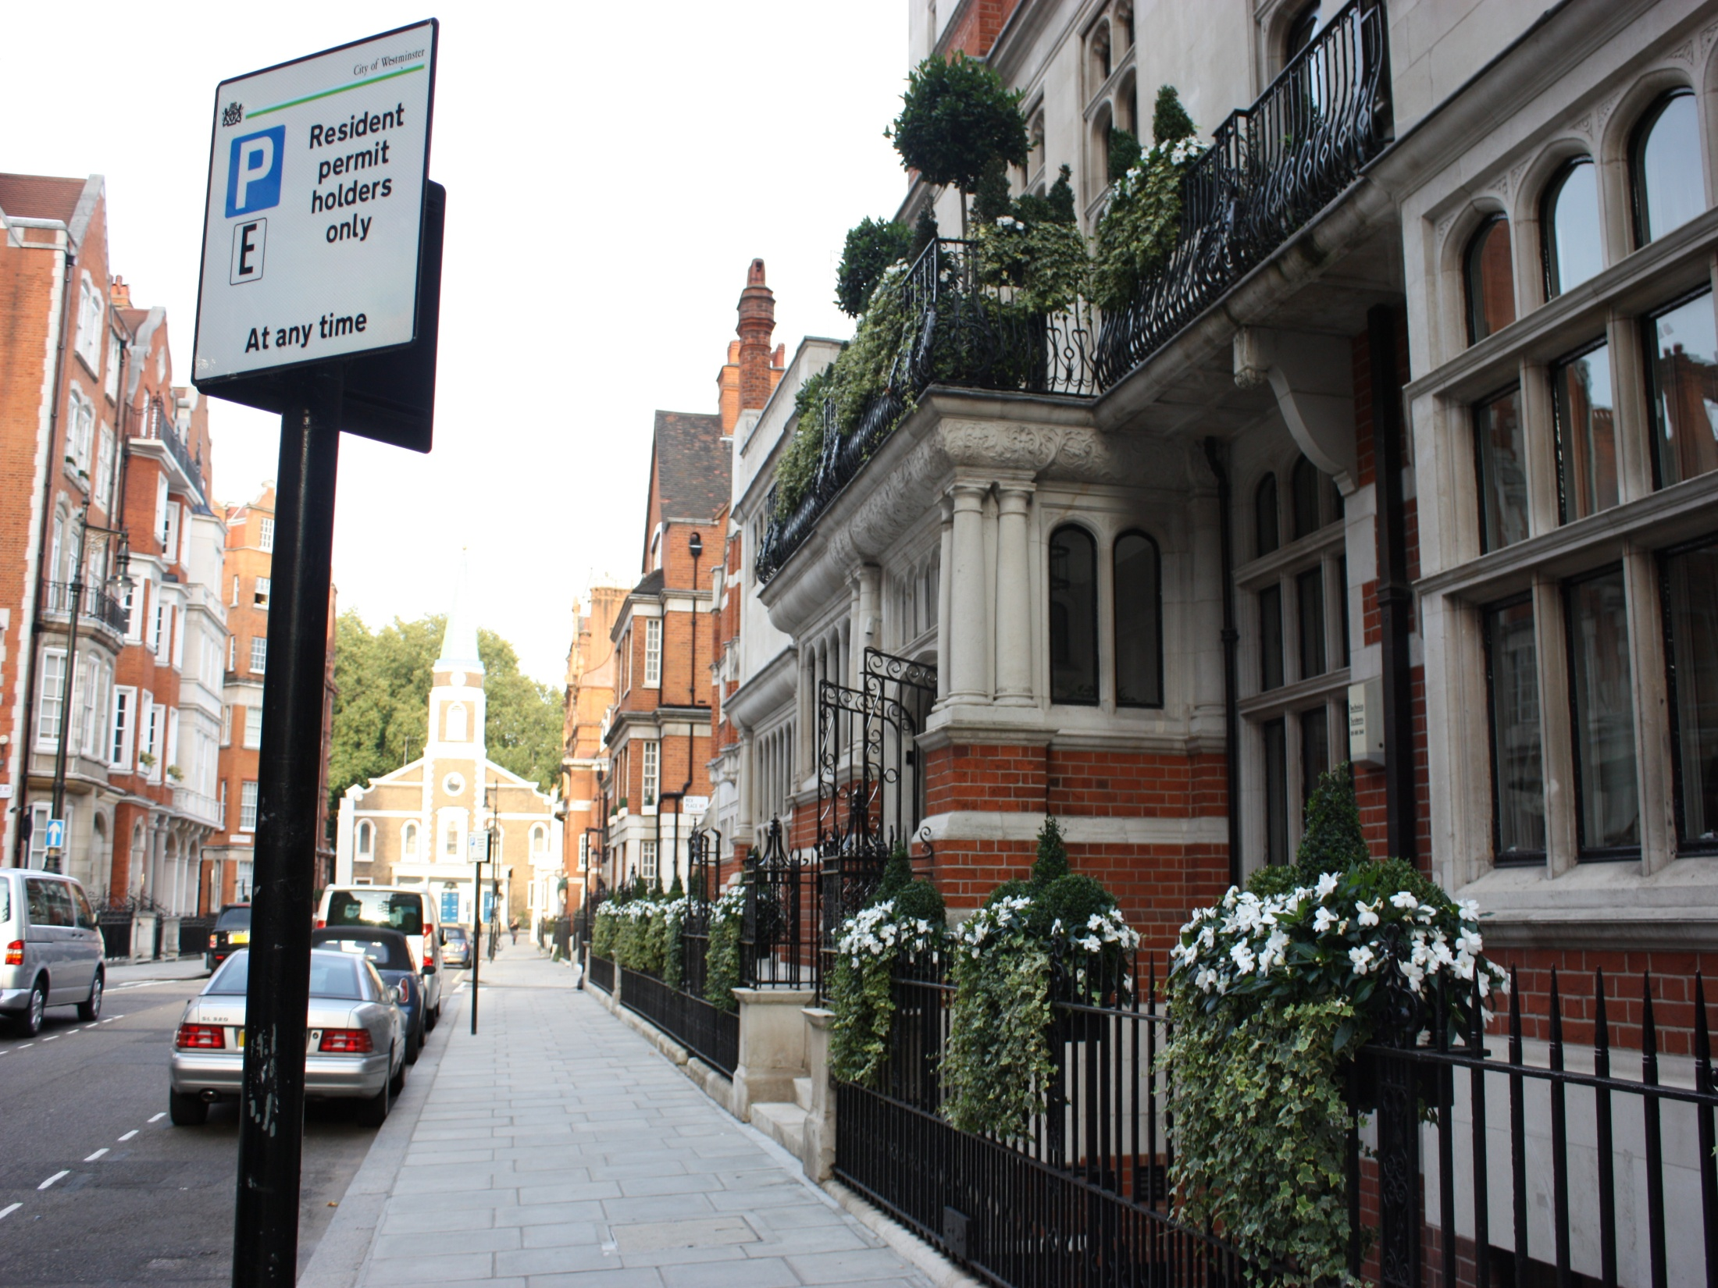
  Home work:
words;
p.29 ex.6 (WB);
p.63 ex.9 (SB)

