Slide 1
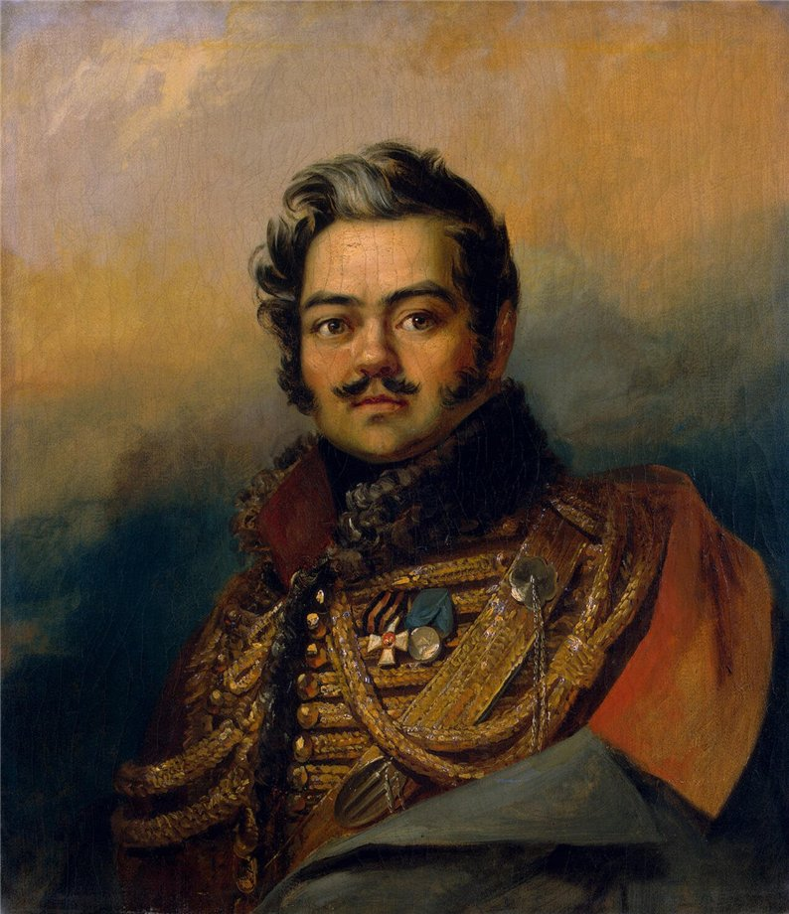
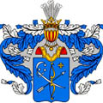
Denis Vasilyevich Davydov
was born in 1785 in Moscow
True
False
Model: I think
In my opinion (По моему мнению)
To my mind
it’s true/ it’s false

Slide 2
Denis Vasilyevich Davydov
was born in 1784 in Moscow

Slide 3
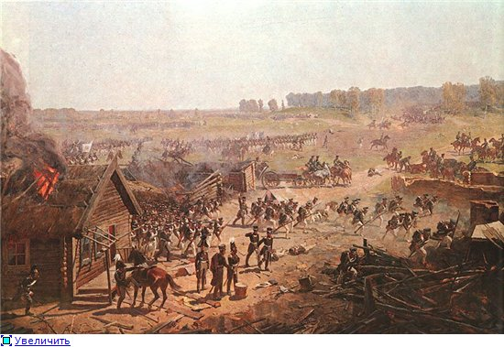
He was from a noble family, who owned the village of Borodino
True
False
Model: I think
In my opinion (По моему мнению)
To my mind
it’s true/ it’s false

Slide 4
Denis Vasilyevich Davydov
was born in 1784 in Moscow
He was from a noble family, who owned the village of Borodino

Slide 5
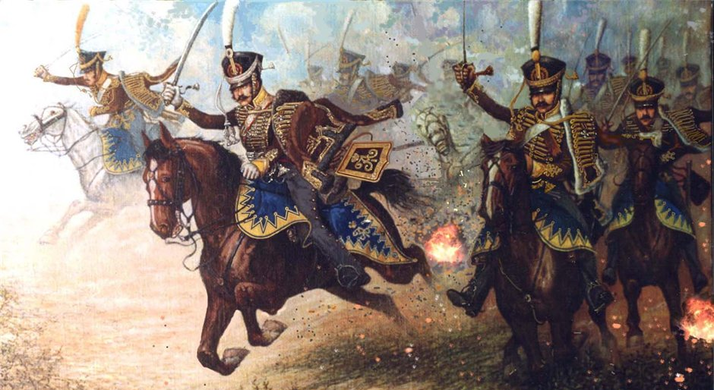
He was famous
as a soldier-poet and guerrilla leader
of the Great Patriotic War
True
False
Model: I think
In my opinion (По моему мнению)
To my mind
it’s true/ it’s false

Slide 6
Denis Vasilyevich Davydov
was born in 1784 in Moscow
He was from a noble family, who owned the village of Borodino
He was famous as a soldier-poet and guerrilla leader of the Patriotic War of 1812

Slide 7
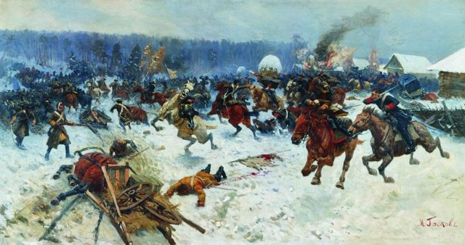
His guerrillas’ attacks were very successful
True
False
Model: I think
In my opinion (По моему мнению)
To my mind
it’s true/ it’s false

Slide 8
Denis Vasilyevich Davydov
was born in 1784 in Moscow
He was from a noble family, who owned the village of Borodino
He was famous as a soldier-poet and guerrilla leader of the Patriotic War of 1812
His guerrillas’ attacks were very successful

Slide 9
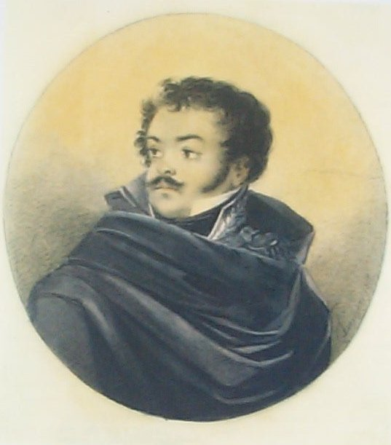
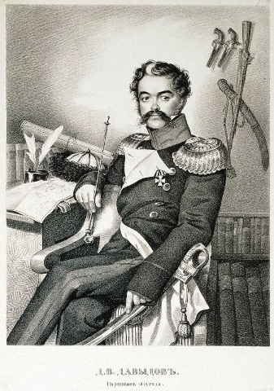
After he had got fame as a talented poet, he became one of the most popular men in the country
True
False
Model: I think
In my opinion (По моему мнению)
To my mind
it’s true/ it’s false

Slide 10
Denis Vasilyevich Davydov
was born in 1784 in Moscow
He was from a noble family, who owned the village of Borodino
He was famous as a soldier-poet and guerrilla leader of the Patriotic War of 1812
His guerrillas’ attacks were very successful
After he had got fame as a brave guerrilla leader, he became one of the most popular men in the country

Slide 11
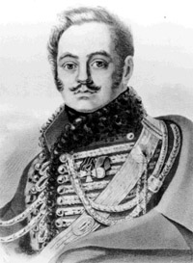
He invented a specific genre –
a hussar-poetry
True
False
Model: I think
In my opinion (По моему мнению)
To my mind
it’s true/ it’s false

Slide 12
Denis Vasilyevich Davydov
was born in 1784 in Moscow
He was from a noble family, who owned the village of Borodino
He was famous as a soldier-poet and guerrilla leader of the Patriotic War of 1812
His guerrillas’ attacks were very successful
After he had got fame as a brave guerrilla leader, he became one of the most popular men in the country
He invented a specific genre – a hussar-poetry

Slide 13
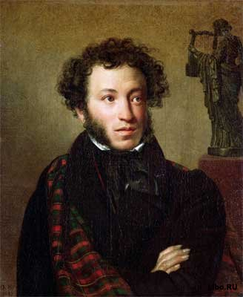
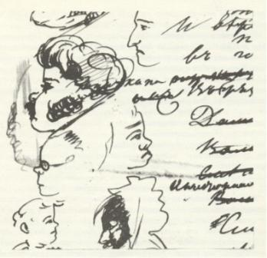
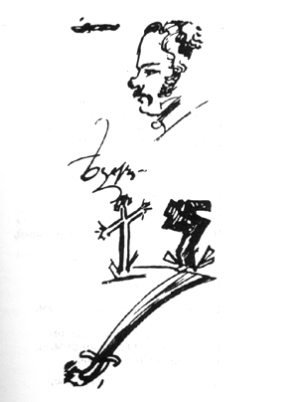
A.S. Pushkin used to say that Davydov had showed him the way to be brave
True
False
Model: I think
In my opinion (По моему мнению)
To my mind
it’s true/ it’s false

Slide 14
Denis Vasilyevich Davydov was born in 1784 in Moscow
He was from a noble family, who owned the village of Borodino
He was famous as a soldier-poet and guerrilla leader of the Patriotic War of 1812
His guerrillas’ attacks were very successful
After he had got fame as a brave guerrilla leader, he became one of the most popular men in the country
He invented a specific genre – a hussar-poetry
A.S. Pushkin used to say that Davydov had showed him the way to be original

Slide 15
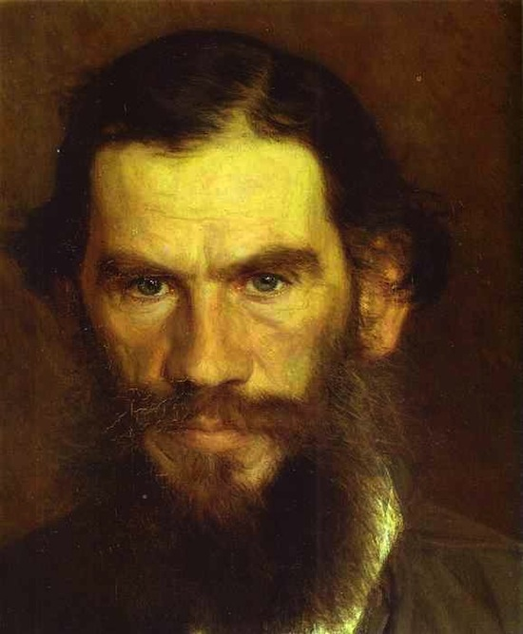
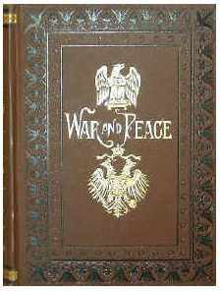
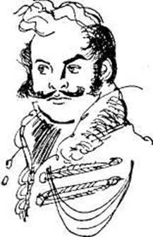
Leo Tolstoy described him as Vasily Denisov in his novel “War and Peace”
True
False
Model: I think
In my opinion (По моему мнению)
To my mind
it’s true/ it’s false

Slide 16
Denis Vasilyevich Davydov was born in 1784 in Moscow
He was from a noble family, who owned the village of Borodino
He was famous as a soldier-poet and guerrilla leader of the Patriotic War of 1812
His guerrillas’ attacks were very successful
After he had got fame as a brave guerrilla leader, he became one of the most popular men in the country
He invented a specific genre – a hussar-poetry
A.S. Pushkin used to say that Davydov had showed him the way to be original
Leo Tolstoy described him as Vasily Denisov in his novel “War and Peace”

Slide 17
Denis Vasilyevich Davydov was born in 1784 in Moscow
He was from a noble family, who owned the village of Borodino
He was famous as a soldier-poet and guerrilla leader of the Patriotic War of 1812
His guerrillas’ attacks were very successful
After he had got fame as a brave guerrilla leader, he became one of the most popular men in the country
He invented a specific genre – a hussar-poetry
A.S. Pushkin used to say that Davydov had showed him the way to be original
Leo Tolstoy described him as Vasily Denisov in his novel “War and Peace”
Denis Davydov died in 1839

