Slide 1
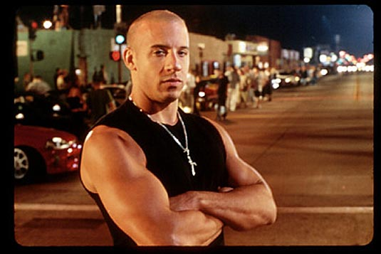
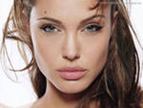
My role model is…

Slide 2
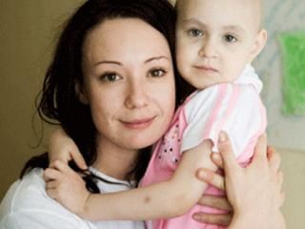
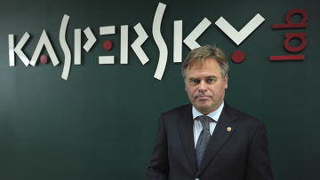
What do you know about them?
is a founder of the most succesful
IT-company
in Russia
Chulpan Khamatova
Sergey Solnechnikov
is a brave officer who saved young soldiers at the cost of his own life
is a very talented actress who is famous for her charitable foundation and was nominated for the Nobel Peace Prize
Eugene Kaspersky

Slide 3
Words and expressions
(repeat all together – in group – one pupil in the group)
talented
brave
successful
noble
a soldier
a hussar
a poet
a guerrilla=a partisan
a leader
a hero
a patriot
the Patriotic War of 1812
a genre
poetry
a genre of poetry
a specific genre
a hussar poetry
a talented poet
a brave soldier
a soldier-poet
a noble hussar
a successful poet
a guerrilla leader
a hero of the Patriotic War of 1812
I think/ I guess/ To my mind, a role model is

Slide 4
Guess: Who will we speak about?
He was a brave soldier and a talented poet.
He was a noble hussar.
He was a successful guerrilla leader.
He invented a genre of poetry - hussar poetry.
He was a hero of the Patriotic War of 1812

Slide 5
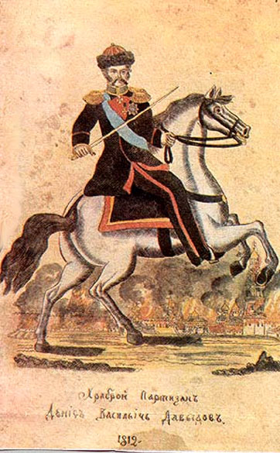
Denis Davydov 14 (27) July 1784 – 22 April (4 May) 1839
Is he a role model?

Slide 6
Let’s play “True or false?” Work in groups on the laptops
Game rules:
One from your group must read the statement
The other must say, if it’s true or false.
The third and the fourth must read the right answer
N.B.Click on or if you see

Slide 7
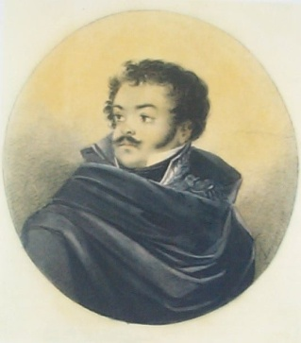
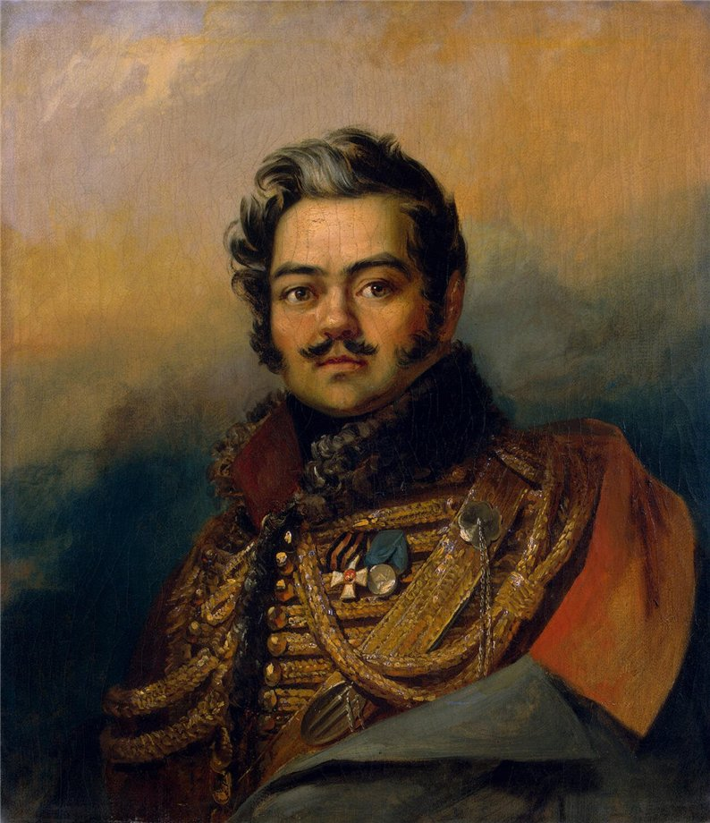
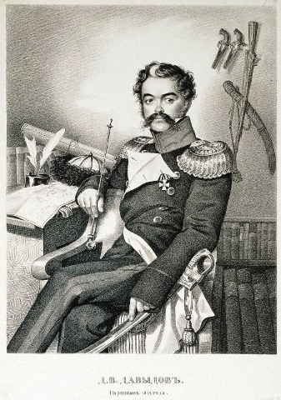
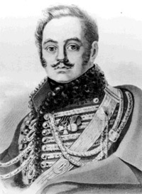
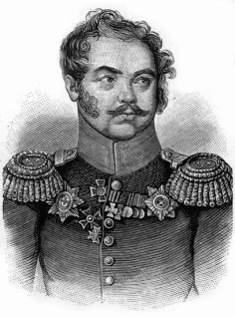
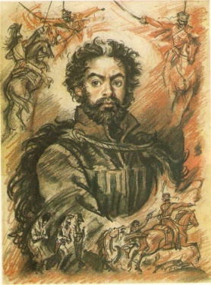
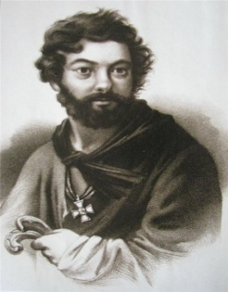
Follow the portraits ONLY WITH YOUR EYES

Slide 8
Fill in the gaps and listen to the song written on Davydov’s verses
A.S. Pushkin
1784
1839
guerrillas
guerrilla leader
hussar-poetry
noble
the Patriotic War
soldier-poet
“War and Peace”
Denis Vasilyevich Davydov was born in _____ in Moscow.
He was from a ______ family, who owned the village of Borodino.
He was famous as a ____________ and guerrilla leader of ____________________of 1812.
His _________’ attacks were very successful.
After he had got fame as a brave _______________, he became one of the most popular men in the country.
He invented a specific genre – a ______________ .
_____________ used to say that Davydov had showed him the way to be original.
Leo Tolstoy described him as Vasily Denisov in his novel _____________ .
Denis Davydov died in _______ .

Slide 9
Try to tell about Denis Davydov!
D.Davydov
was born…
was famous as…
Guerrillas’ attacks were …
became one of the
invented a specific genre - …
died in …

Slide 10
Why can Denis Davydov be a role model?
D.Davydov can be a role model because
was famous as…
became
inveted a specific genre - …
was a…
was …
loved ….

Slide 11
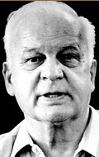
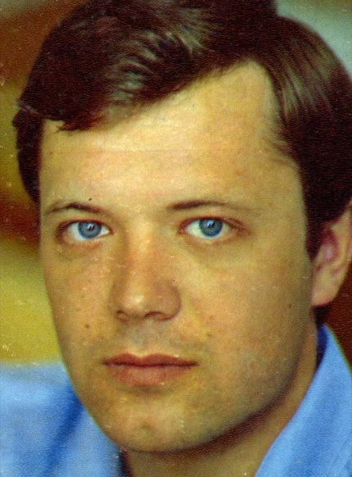
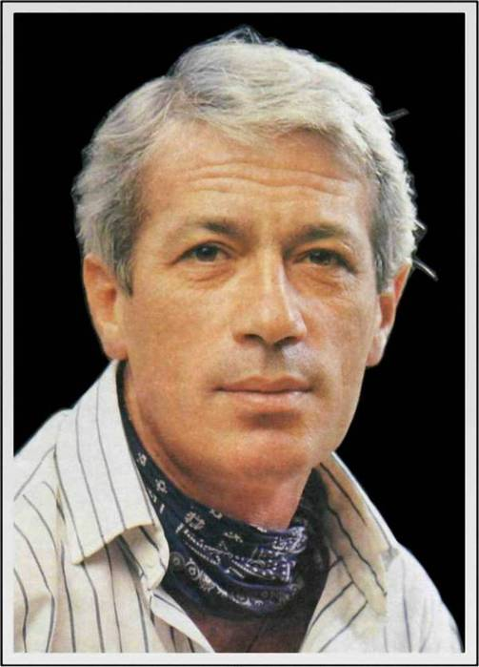
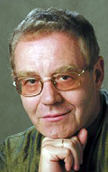
“The Squadron of Flying Hussars” (1980)
Andrey Rostotsky, actor, played D.Davydov
Stanislav Rostotsky, director
Alexander Zhurbin, composer
Alexander Khochinsky, actor, performed songs

Slide 12
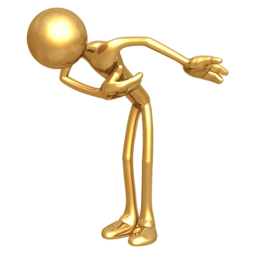
Thank you for your work!

