Slide 1
Do you know English -speaking countries?

Slide 2
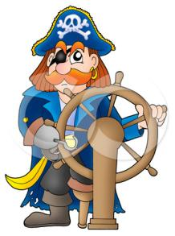
I. The captains’ competition
5 questions for the first captain:
1. What is the nickname of British flag?
2. What is the national Scottish costume called?
3. What is the nickname of a guest who comes on New Year’s morning first?
4. What’s the color of London taxies?
5. Who can you see on the top of the column on Trafalgar Square in London?

Slide 3
5 questions for the second captain:
1. Who lived in Sherwood Forest?
2. What do many children usually say when they knock on their neighbours’ door on Halloween?
3. What’s the colour of double-deckers in London?
4. What is the nickname of the American flag?
5. What person in London has the address 10, Downing Street?

Slide 4
II. Proverbs and idioms
1. To beat the air a) век живи – век учись
2. Score twice before you cut once b) любопытной Варваре на базаре нос оторвали
3. Better late than never c) все хорошо, что хорошо кончается
4. East or West – home is best d) в гостях хорошо, а дома лучше
5. My home is my castle e) мой дом - моя крепость
6. Live and learn f) толочь воду в ступе
7. All’s well that ends well g) лучше поздно, чем никогда
8. Curiosity killed the cat h) семь раз отмерь - один раз отрежь
9. As hungry as a hunter i) делу – время, а потехе - час
10. Rome was not built in a day j) о вкусах не спорят
11. A friend in need is a friend indeed k) друг познается в беде
12. Business before pleasure l) голоден как волк
13. Tastes differ m) Москва не сразу строилась
14. To be on the tip of one’s tongue n) вертится на языке
15.Keep one’s fingers crossed o) надеяться на удачу

Slide 5
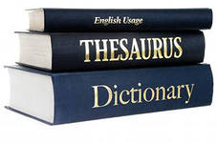
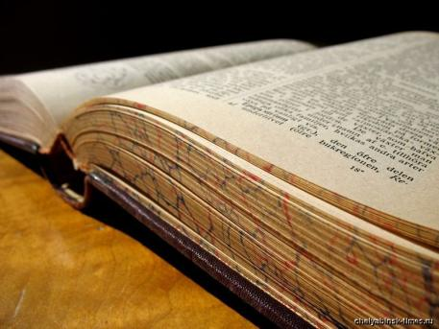
III. The English Literature.

Slide 6
IV. Riddles.

Slide 7
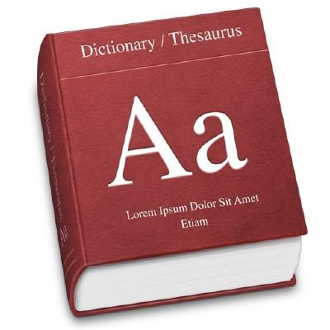
V. Lexical

Slide 8
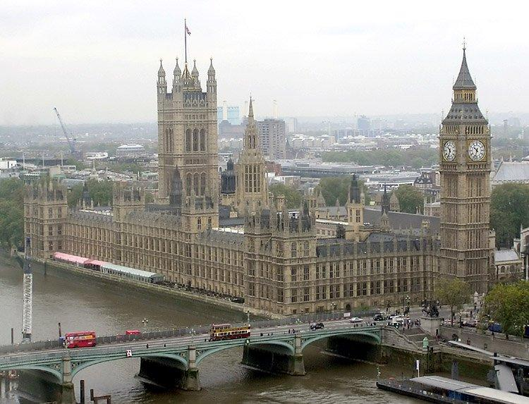
VI. Quiz: “Do you know Britain?”

Slide 9
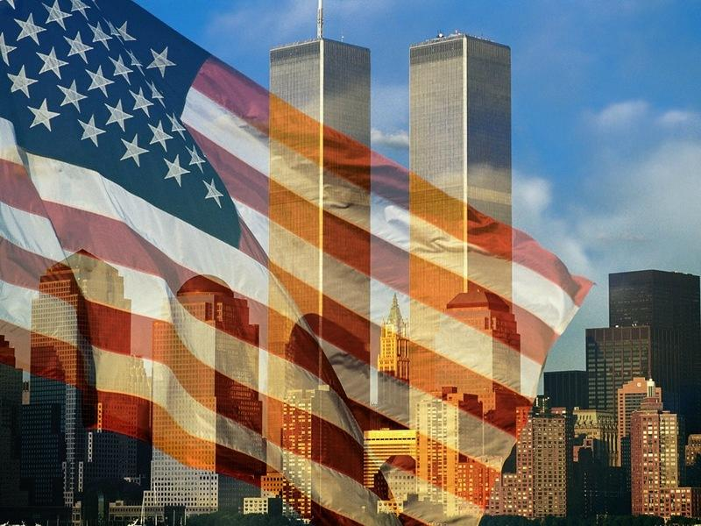
VII. Quiz: “Do you know the USA?”

Slide 10
VIII. “ The comb”
a | l | p | h | a | b | e | t

Slide 11
Thank you for your work!

