Slide 1
Modern subcultures
Teacher – Teplyakova N.B.

Slide 2
Fans of different styles of music have there own subcultures.
What does this mean?
This means that people listening different styles of music, have different preferences in clothes, colors, assessors and even they have different manners.

Slide 3
There are many groupings (subcultures) that have interests different from those of the mainstream culture.
A particular cultural grouping is a way for young people to express their individuality.

Slide 4
The most popular currents now is:
Rappers
Rockers (Goths, Emo, Punks, etc.)
Pop culture
Clubbers (Tecktonik dancers, Ravers etc.)
Gamers
Anime fans (Cosplayers, Otaku)

Slide 5
Rappers

Slide 6
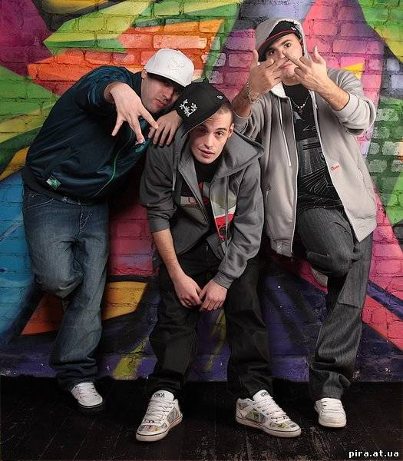
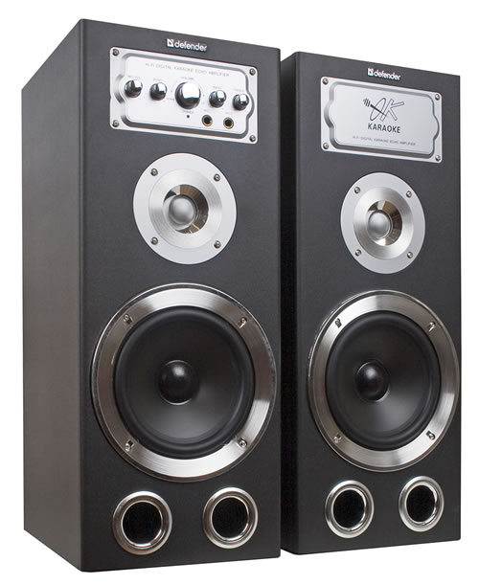
The stereotypical rapper are someone who: wears particular clothing, such as sportswear, white trainers and baseball caps,
fake gold jewellery – in particular big earrings for women, and gold sovereign rings and large gold (or fake gold) chains for men.

Slide 7
Rapping can be delivered over a beat or without accompaniment.
Stylistically, rap occupies a gray area among speech, prose, poetry, and song.

Slide 8
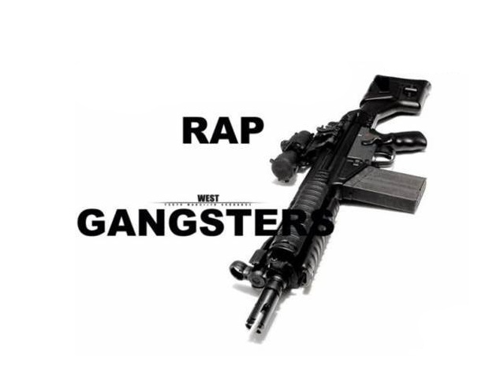
Rapping is the rhythmic spoken delivery of rhymes, wordplay, and poetry.
Rapping is a primary ingredient in hip hop music.

Slide 9
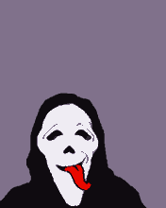
Goths

Slide 10
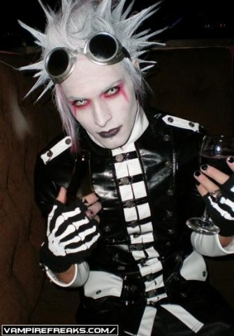
Typical gothic fashion includes dyed black hair, dark eyeliner, black fingernails, black period styled clothing; Goths may or may not have piercing.

Slide 11
The allure for goths of dark mysterious and morbid imagery and mood lies in the same tradition of Romanticism’s gothic novel.

Slide 12
Another central element of the gothic is a deliberate sense of camp theatricality and self-dramatization.

Slide 13
Violence and hate do not form elements of goth ideology. Rather, the ideology is formed in part by recognition, identification and grief over societal and personal evils that the mainstream culture wishes to ignore or forget.

Slide 14
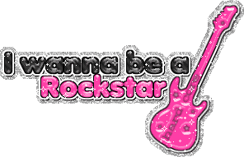
Emo

Slide 15
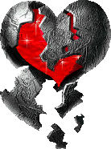
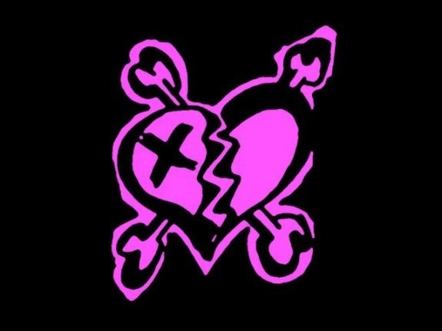
The symbols of emo are square of black and pink colors and broken heart.
Shelfed belts and black wristbands are common accessories in emo fashion.
Black converse sneakers and skate shoes are popularly worn among them.

Slide 16
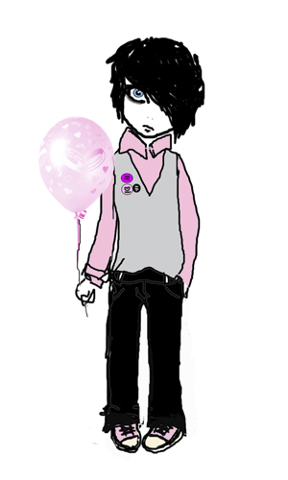
The emo fashion is also recognized for its hairstyles. Popular looks include long side-swept bangs, sometimes covering one or both eyes.

Slide 17
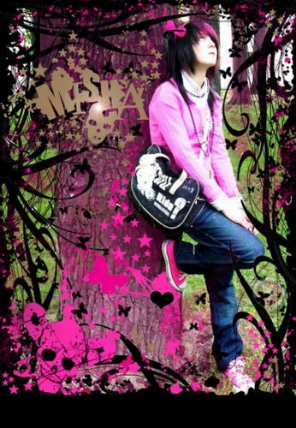
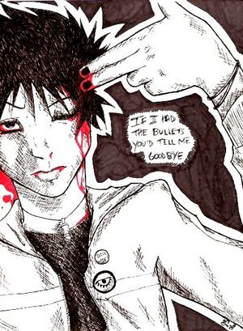
Also popular is hair that is straightened and dyed black or bright color such as blue, pink, red or bleached blond.

Slide 18
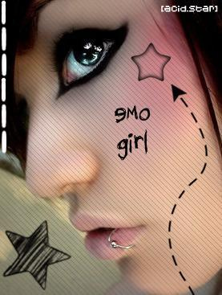
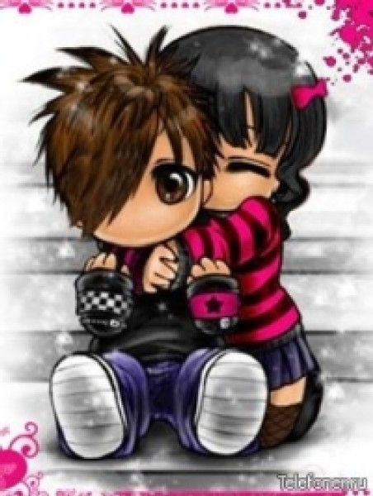
People hate emo, because they view they as suicidal, cry babies or just week. That’s not what emo is.
Emo kids are usually shy, quiet and very sentensive.
They are not all suicidal and they do not slit their wrist!

Slide 20
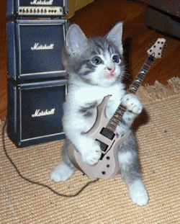
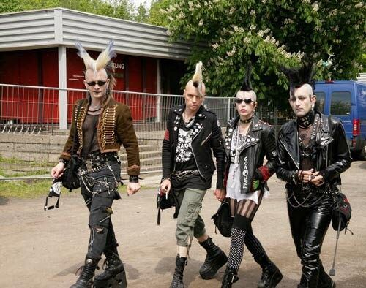
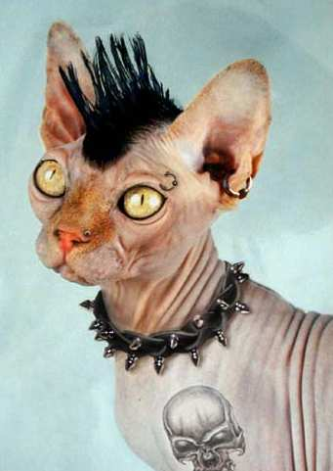
Punks seek to outrage others with the highly theatrical use of clothing, hairstyles, cosmetics, tattoos, jewelry and body modification.

Slide 21
Punks can come from any and all walks of life and economic classes. The subculture is predominantly men, with the exception of the riot girl movement.

Slide 22
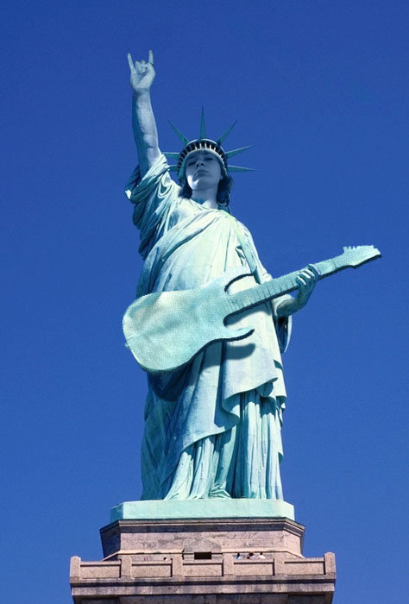
Notable trends in punk politics include nihilism, anarchism, socialism, anti-militarism, anti-capitalism, anti-racism, anti-nationalism, anti-homophobia, environmentalism, vegetarianism,
and animal rights.

Slide 23
Ravers

Slide 24
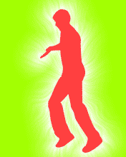
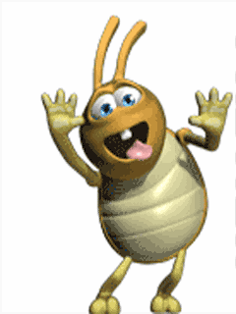
Raver is a word that has been used since the 1960s to describe people who are enthusiastic.

Slide 25
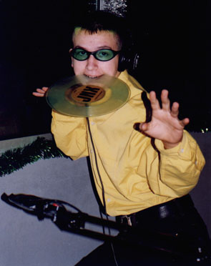
A raver does not necessarily have an out wardly defining appearance.
However, a Raver who belongs to the one of the sub-types can.

Slide 26
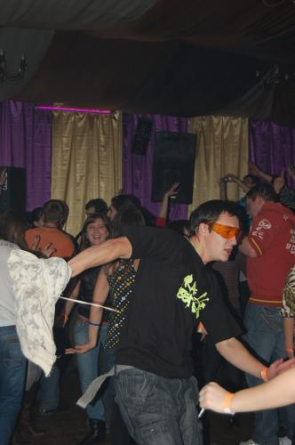
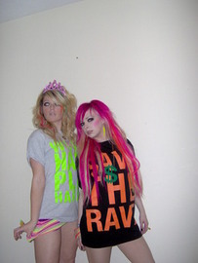
Raver music includes Trance, Dance, Hardcore, Techno, Psychedelic, Trance, Breakbeat, Jungle( or Drum and Bass), Electro, Dubstep and Happy Hardcore.

Slide 27
believe in:
Peace
Love
Freedom
Unity
Tolerance
Harmony
Expression
Respect

Slide 28
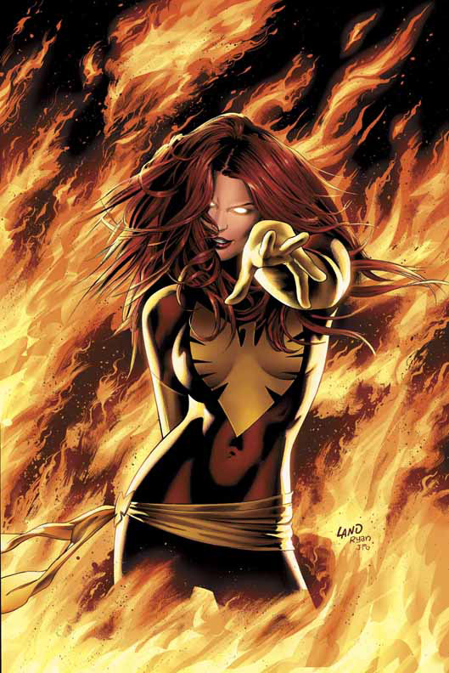
Tecktonik also called Electro Dance, is a frenetic and quickly French street dance which is typically performed to electro music.
The dance style emphasizes arm movements and focuses less on leg movements.

Slide 29
The creator of the tecktonik Cyril Blanc, artistic director of Mertopolis.
It started in the 2000s and originated from the Paris, mainly from the Metropolis night club.

Slide 30
Gamers

Slide 31
Gamers is players of video games.
While the term nominally includes those who do not necessarily consider themselves to be gamer, it is commonly used to identify those who spend much of their leisure time playing games.

Slide 32
There are many gamer communities around the world. Many of these take the form of web rings, discussion forums and other virtual communities.

Slide 33
Cosplayers
(Anime fans or Otaku)

Slide 34
Otaku is a derisive term used to refer to people with obsessive interests, particularly anime and manga.
Anime is hand-drawn and computer-animated cartoons.
Manga is Japanese comics.
Anime an abbreviated pronunciation in Japanese of “animation”.

Slide 35
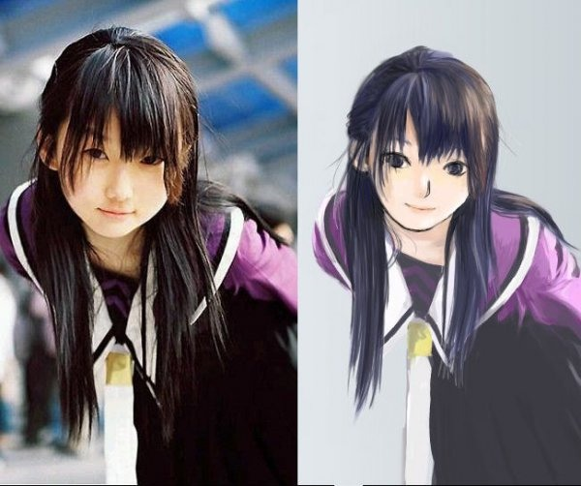
Cosplay, short for "costume play", is a fan labor type of performance art in which participants costumes and accessories to represent a specific character or idea. Characters are often drawn from popular fiction in Japan.

Slide 36
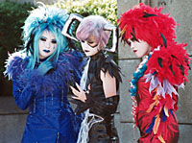
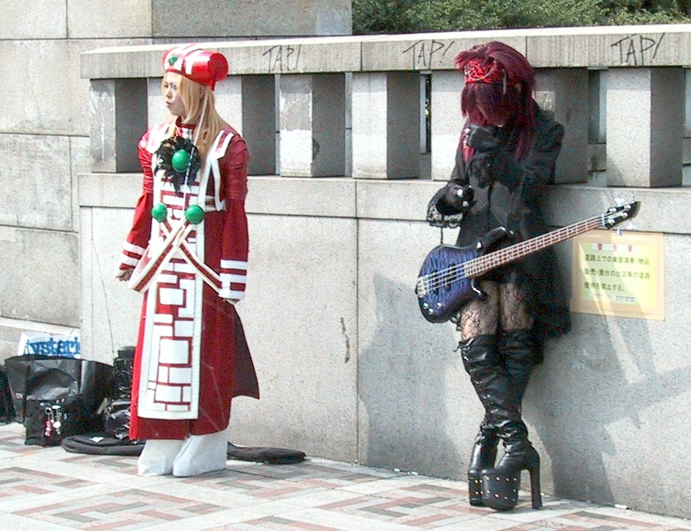
Favorite sources include manga, anime, tokusatsu, comic books, graphic novels, video games, hentai and fantasy movies.

Slide 37
End!

