Slide 1
«Урок-повторение изученного за год».

Slide 2
Read the words.
Find the words with the sounds [Λ], [ɔ],[ əu]
Read the words, which are the names of the countries and cities.
Clean, bed, London, milk, bus, Rome, run, Boston, Hollywood, America, can, India, China, home, Florida.

Slide 3
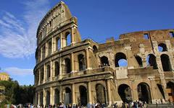
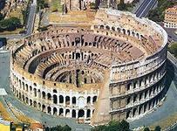
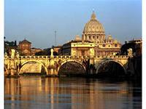
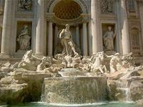
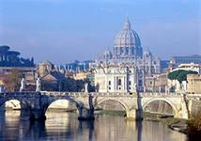
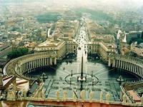
Rome

Slide 4
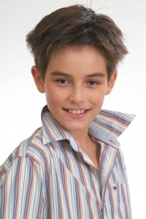
I am Ben. I am ten. I’m from Canada.
What is your name?
How old are you?
Where are you from?
How are you?
What’s the matter?

Slide 5
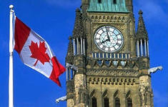
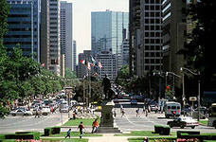
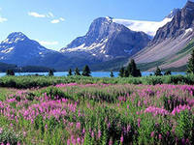
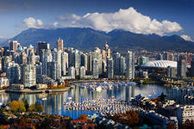
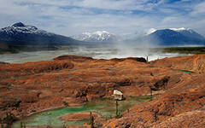
Canada

Slide 6
Guess and write 5 word-combinations with these words.
strong, tall, fat, girl, weak, boy, man, old, house, short, teacher, young, king, bank
Example: a strong boy.

Slide 7
Up, down Up, down Which is the way to London town? Where, where? Up in the air! Close your eyes And you are here!

Slide 8
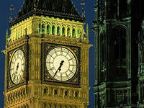
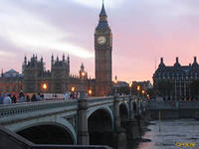
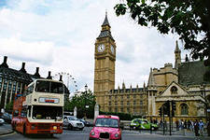
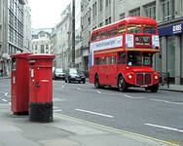
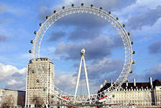
London

Slide 9
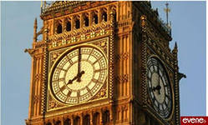
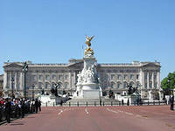
The sights of London
Big Ben
Buckingham Palace

Slide 10
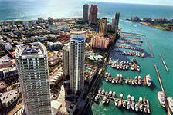
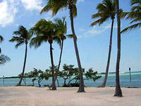
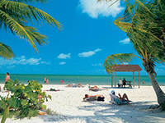
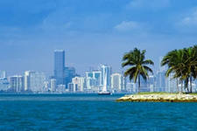
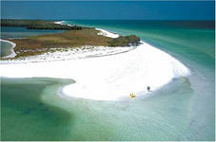
Florida

Slide 11
Dictation
Farmel, moose, giont, toll, rey, peint, toi, coyn, toun.

Slide 12
My sister is pupul. She have got cat. Her cat is grei. He is under the tables.

Slide 13
Good bye! Your pen friend Ben.

