Slide 3
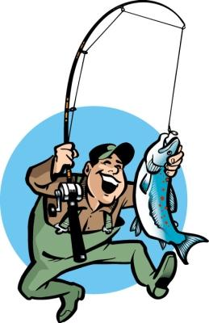
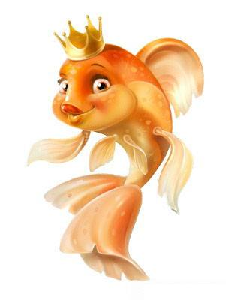
Fishy
business
Businessman
Fisherman

Slide 4
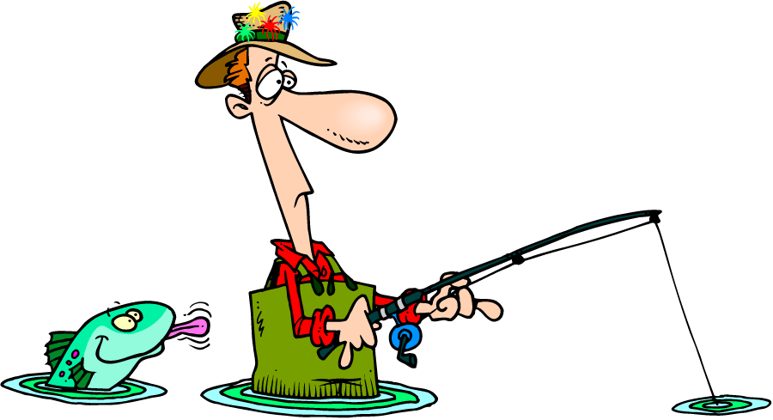
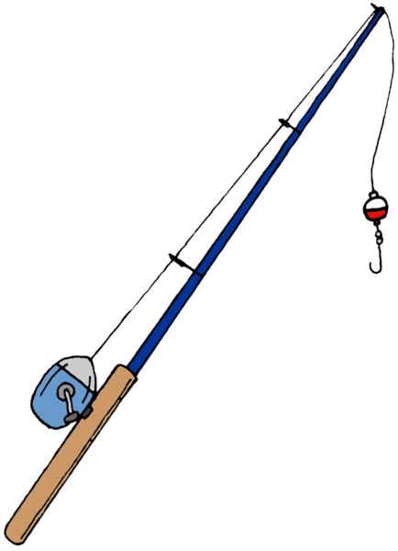
Brown and rainbow
Trout
Fishing
rod
Angler
Landing net
Bait

Slide 7
DYEING
BUSINESS
businessman
paint

Slide 8
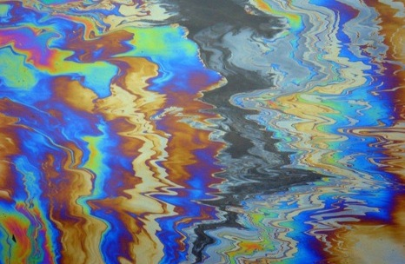
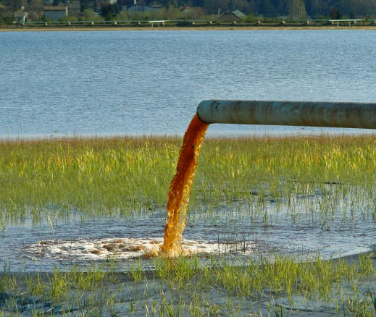
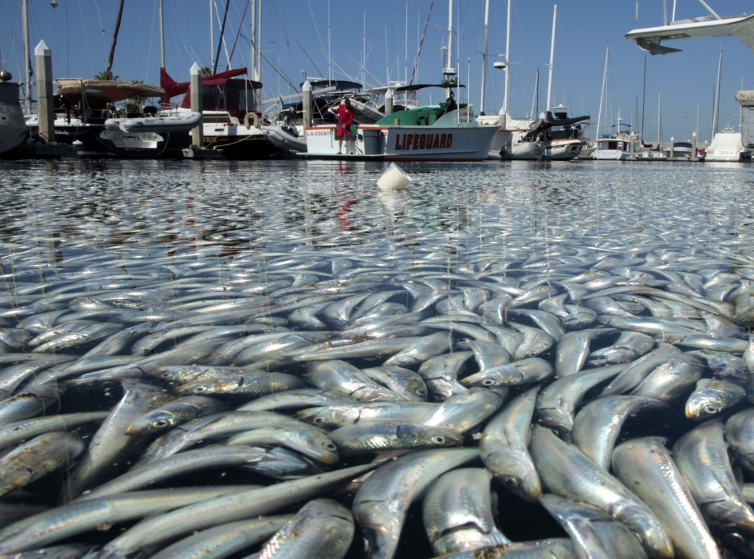

Slide 9
Witnessed the crime

Slide 10
STOP
IT!!!
Meeting!

Slide 11
But nobody believed…

Slide 12
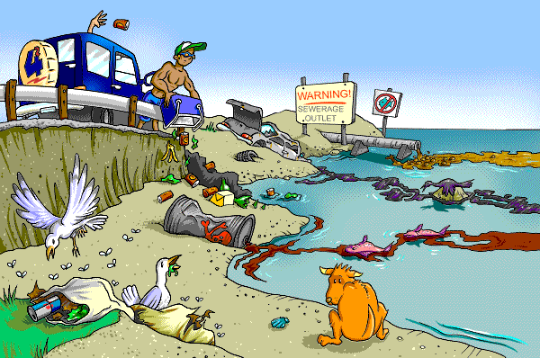

Slide 13
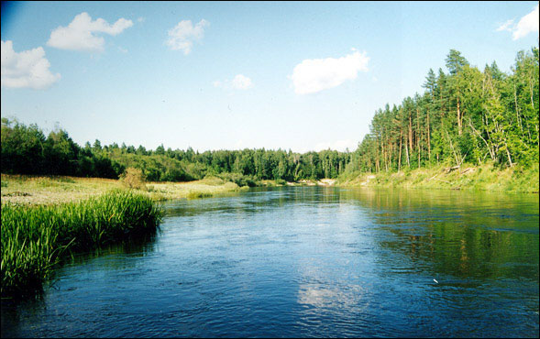
Nature reserve

Slide 14
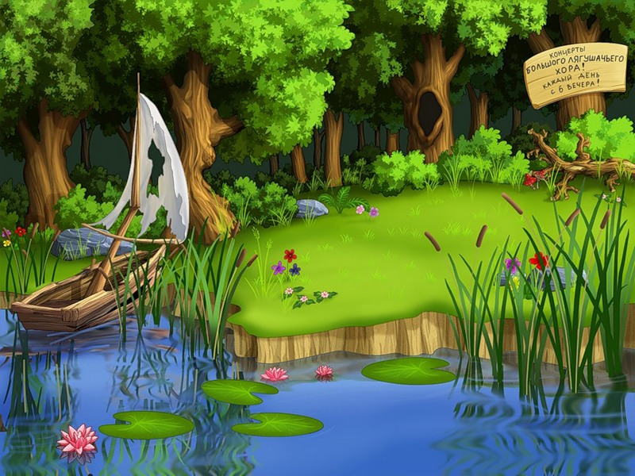
Wink!
I wink!

Slide 15
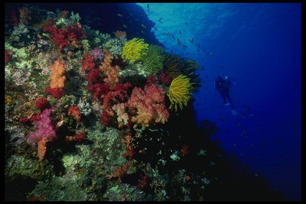
Swim!
We swim!

Slide 16
We
sing!
Sing!

