Slide 1
A magic trip to English Land

Slide 2
The first station is «Phonetic». станция «Фонетическая»:прочитайте звуки
[t] [p] [s] [d] [b] [i:] [o] [æ] [v] [ks]
[d] [r] [g] [z] [b] [ʤ] [ei] [e] [oi][f]

Slide 3
Прочитайте слова по транскрипции
[faiv],[tri:],[laik], [gri:n],[foks],[pig], [pen], [smo:l], [k æ t],[sili], [h æ pi]
[dog], [milk], [ʤi:ns], [sma:t], [kaind], [kæt], [breiv], [geim], [fʌni], [gri:n], [maʊs]

Slide 4
The second station is «English letters»
1) «Встань в алфавитном порядке».
2) «Покажи букву».

Slide 5
The third station is «Lexical». «Лексическая»
Pасшифруйте фразу
23.5. *12.15.22.5.* 5.14.7.12.9.19.8.
Use the code:1 A 2 B 3 C 4 D 5 E 6 F 7 G 8 H 9 I 10 J 11 K 12 L 13 M 14 N 15 O 16 P 17 Q 18 R 19 S 20 T 21 U 22 V 23 W 24 X 25 Y 26 Z

Slide 6
Answer: We love English

Slide 7
The forth station is «Riddles»
I am not small. I am not big. I can run, jump, climb. I like milk. I like mice. I live in the house
It is my friend. It is big and brave. It likes bones, soup, meat. It barks «bow-wow, bow-wow».
I am very little. I am green. I can jump. I can swim. I eat flies.I can croak

Slide 8
The fifth station is «Verbs»
Игра «Пантомима»:
Выполните команды учителя: go, run, jump, fly, swim, count from 1 to 10, count from10 to 1, sing, dance, write, read draw, climb, skip

Slide 9
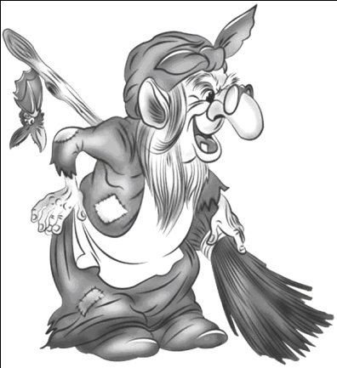
The sixth station is «Conversation».

Slide 10
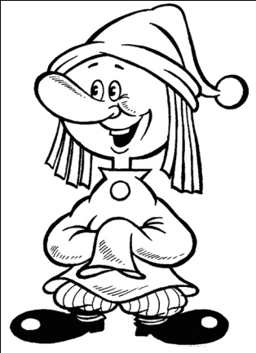

Slide 11
The seventh station is «Puzzle».
Соберите пазлы

Slide 13
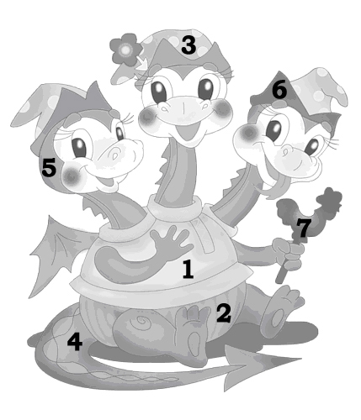
Рaint a dragon. What colour is the dragon? раскрасьте дракона.
1. Red
2. Brown 3.Yellow 4.Green 5.Orange 6. Blue 7.Pink

