Slide 1
SPORT
Where can we play sport games?

Slide 2
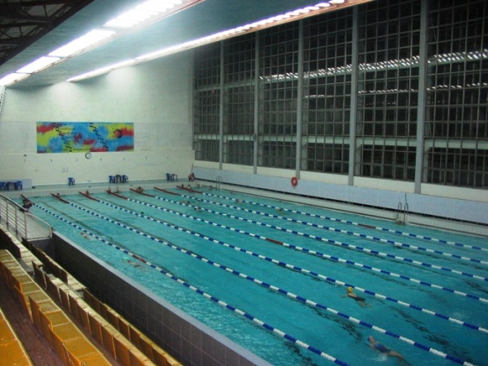
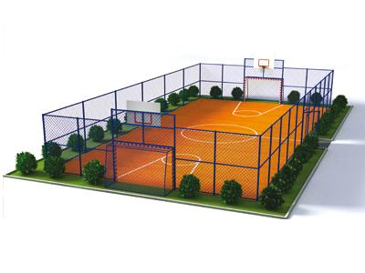
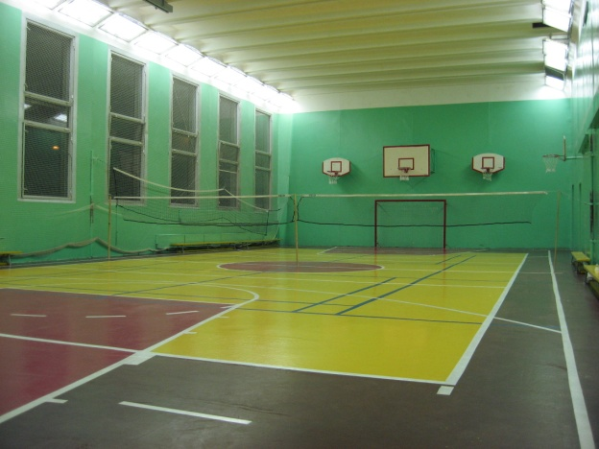
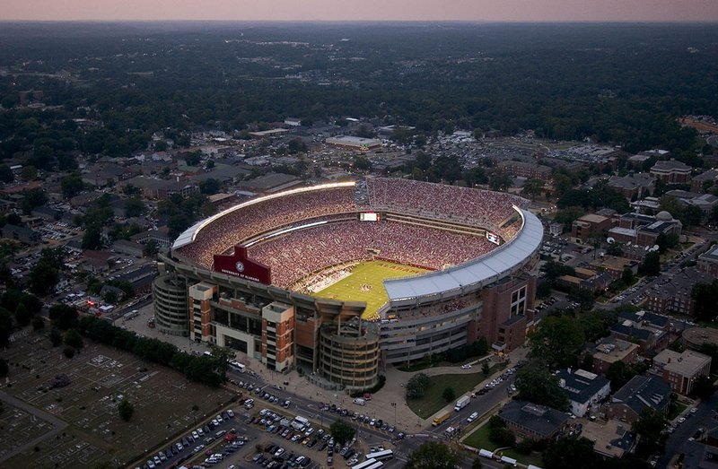

Slide 3
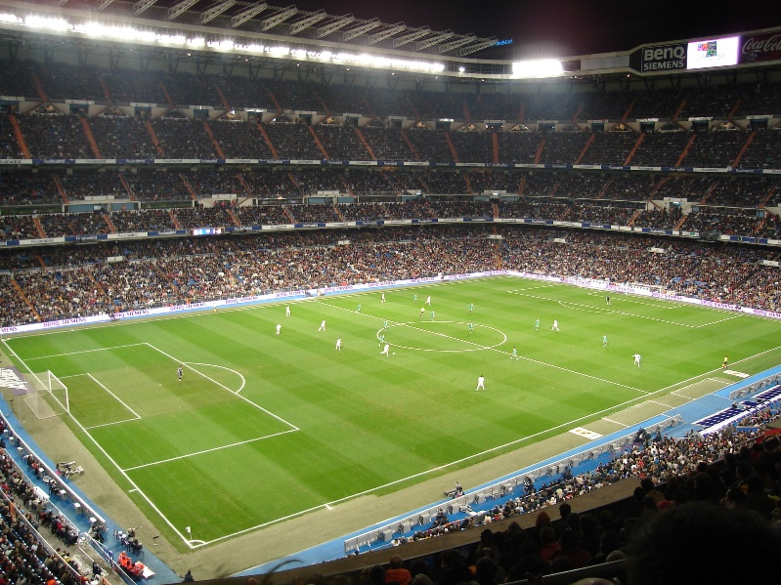
Stadium

Slide 4
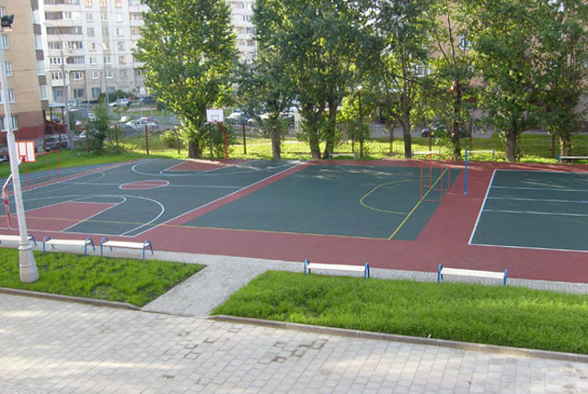
Sports ground

Slide 5
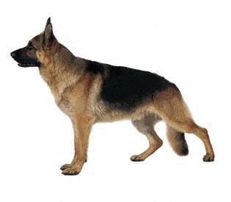

Slide 7
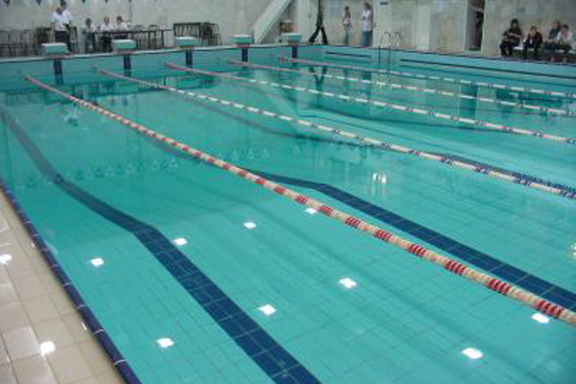
Swimming pool

Slide 8
Who can swim and who can’t?

Slide 9
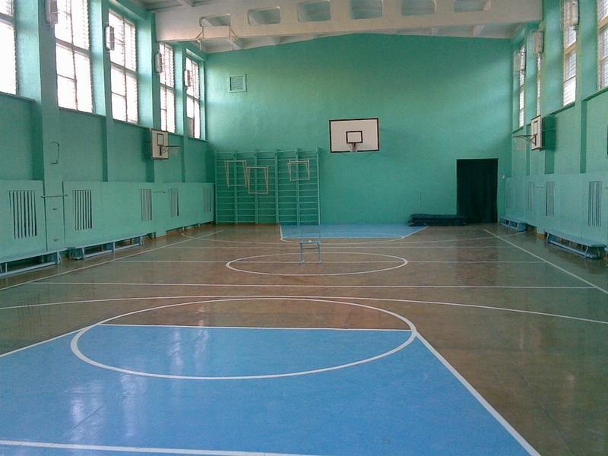
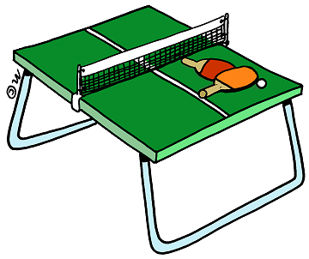
Gym

Slide 11
At the stadium
On the sports ground
To swim in the swimming pool
In the gym

Slide 13
HOME TASK
Ex. 2-4 p. 118 dictation

