Slide 1
The world is a book, and those who don`t travel read only one page St.Augustine

Slide 2
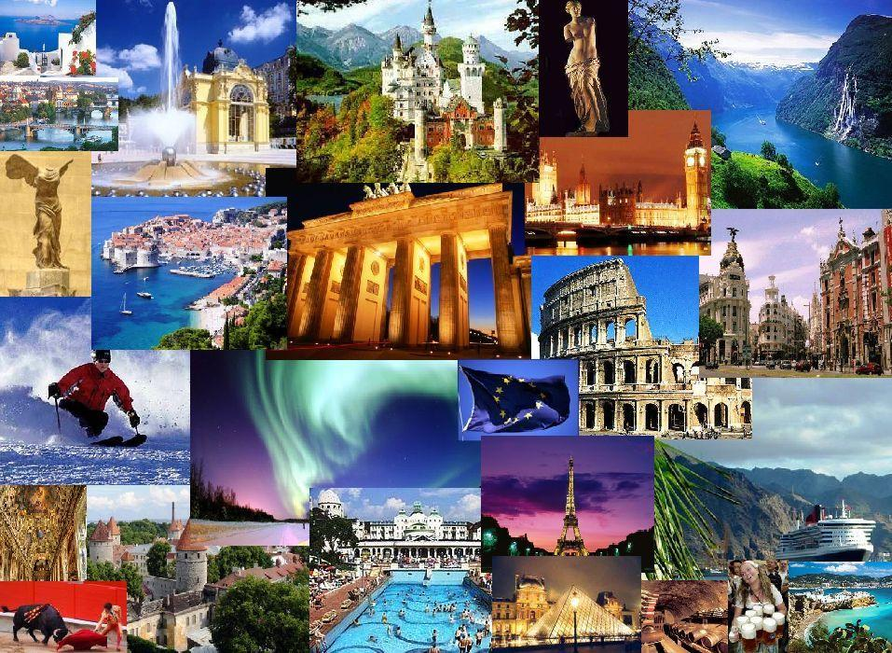
International travel has become cheaper and more convenient for many people.
Here are some types of holidays with a sense of adventure.

Slide 3
Sledding in Russia
Let`s escape to Yakutia in Russia. Here we can :
Drive a reindeer sled through the valley of the Lena River.
Meet the native Yakutian people.
Enjoy home-cooked meal
See all sorts of wildlife - wolves, foxes, elk and even ride the famous Yakut horses.

Slide 4
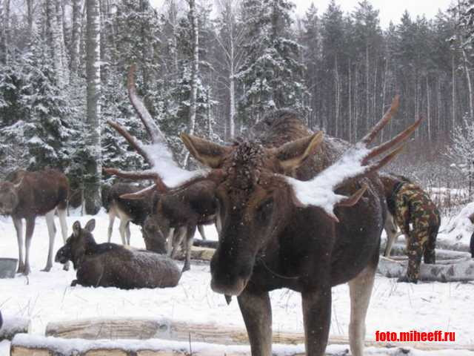

Slide 5
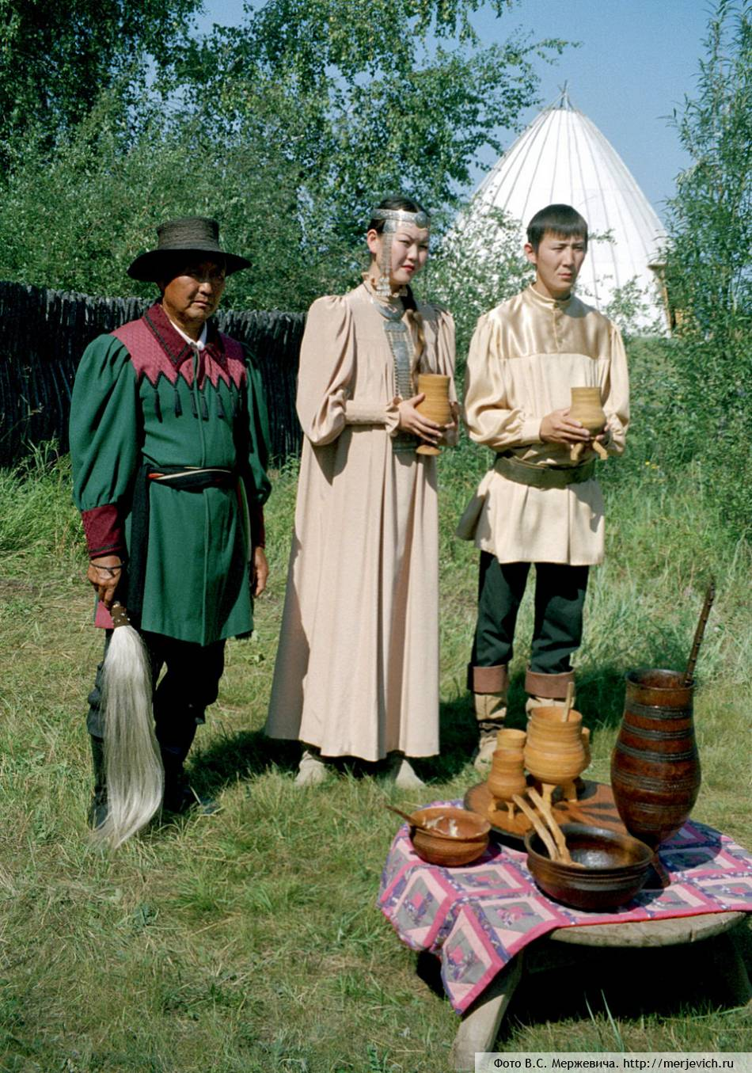

Slide 6
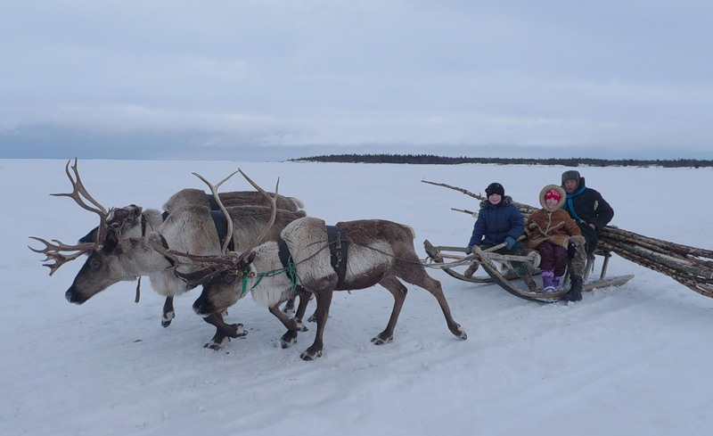

Slide 7
Camel Riding in Morocco
Enjoy a relaxing journey on a camel across the desert in Marrakech with its historic sites.
Visit traditional Berber villages.
Relax on the beautiful beaches at Essaouira.
Morocco is much more than sand because it has many varied landscapes.

Slide 8
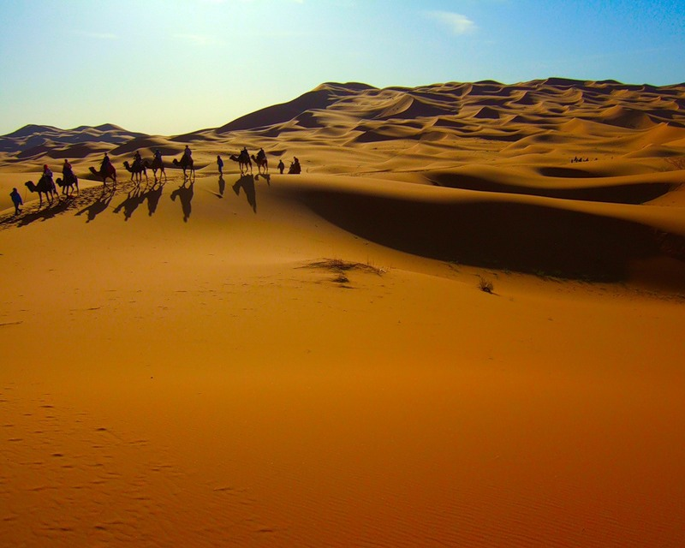

Slide 9
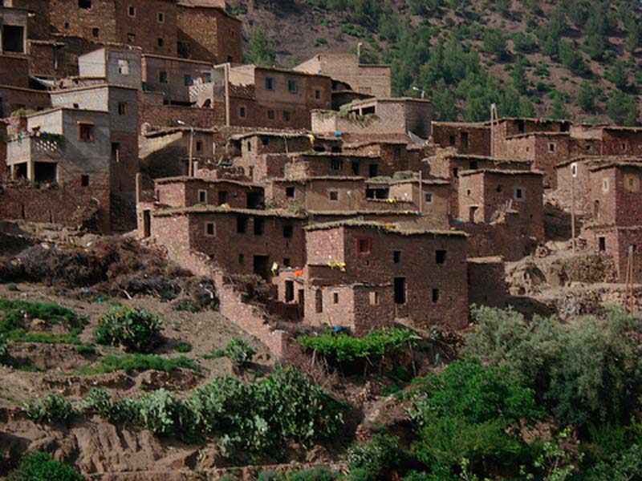

Slide 10
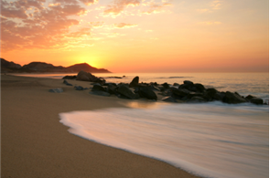

Slide 11
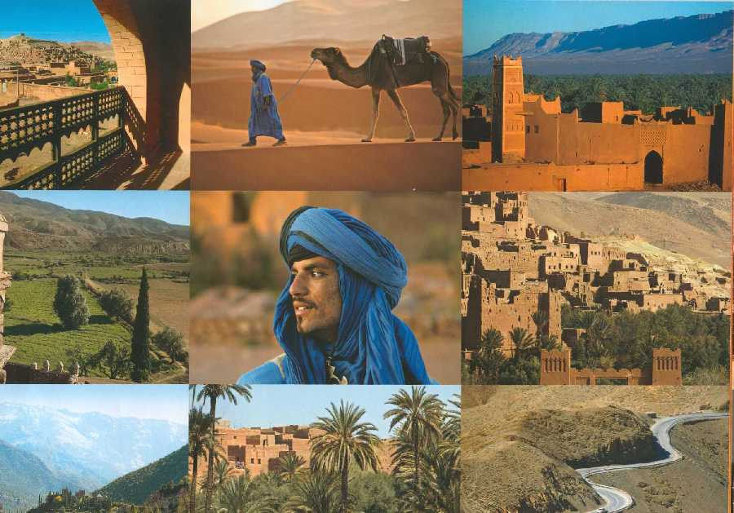

Slide 12
Wagon Travel in Wyoming
What was the life like 150 years ago in the Wild West?
A holiday in Wyoming will offer you a unique travel in a convoy of covered wagons through the countryside .
You will enjoy majestic views, go on nature hikes, go canoe swimming.
You can spend your evenings cooking on an open fire and singing cowboy songs.

Slide 13
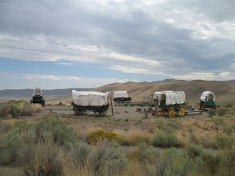

Slide 14
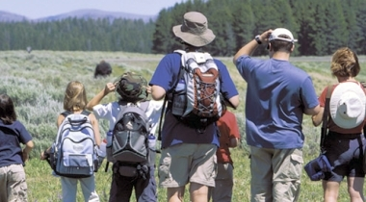

Slide 15
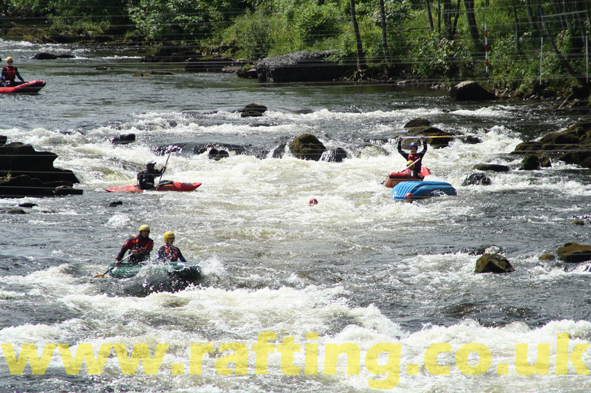

Slide 16
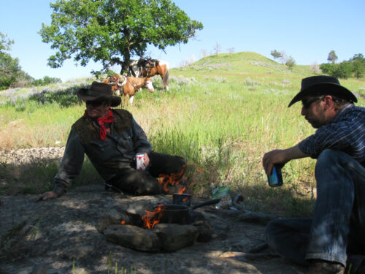

Slide 17
Thank you for your attention

