Slide 1
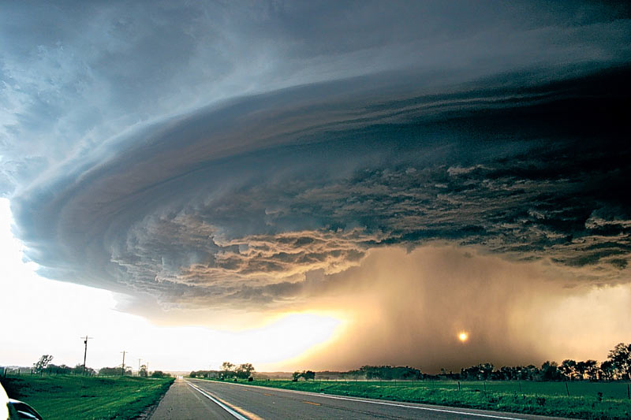
 | Tornadoes

Slide 2
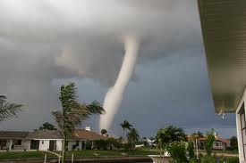
Tornadoes are storms with rapidly rotating winds that form a funnel cloud.

Slide 3
Post-Reading tasks
1) Read the texts and complete the gaps with the headings. Which words helped you decide?
a. Different sizes
b. Easy to hear
c. Getting ready to drop
d. Round and round
e. Measuring disasters
f. Any time, any place

Slide 4
2) Find words in the texts that mean:
Forceful (Text A)
Different (Text A)
Leave (Text A)
Harm (Text A)
Made (Text A)
Chunks (Text B)
Created (Text B)

Slide 5
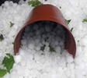
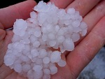
Hail

Slide 6
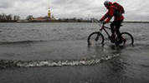
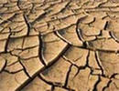
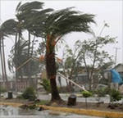
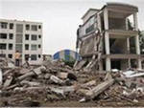
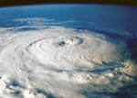
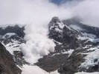
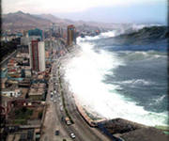
Vocabulary. Natural Disasters.
Drought
Flood
Tornado
Tsunami
Earthquake
Cyclone
Avalanche
Hurricane

Slide 7
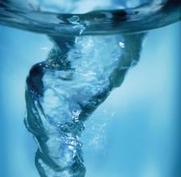
Create your own tornado
And now it’s high time to make an experiment.
Create a tornado yourself. Use the instructions in Ex.5

Slide 8
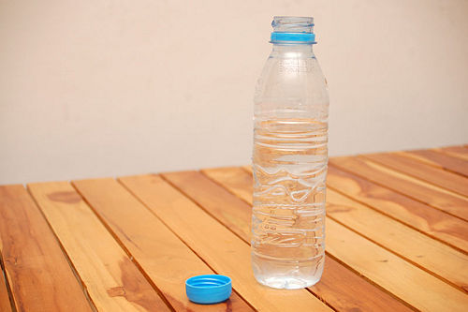
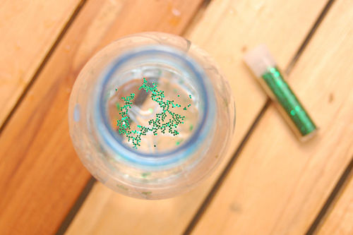
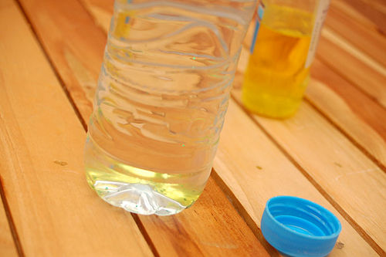
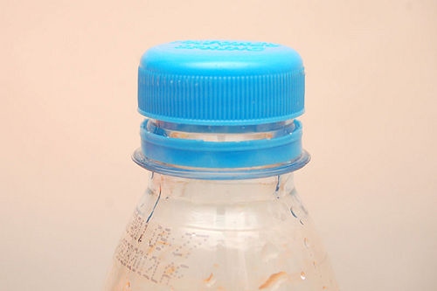
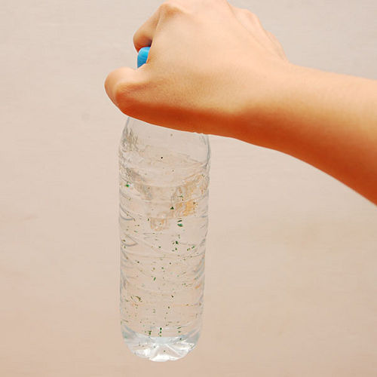
Create tornado in a plastic bottle

Slide 9
Across the curriculum
Across the Curriculum section
This section enables students to link the theme of
the module to a subject on their school curriculum,
thus helping them to contextualise the language
they have learnt by relating it to their own
personal frame of reference. These units containlively and creative tasks which stimulate students
and allow them to consolidate the language they
have learnt throughout the module.

Slide 10
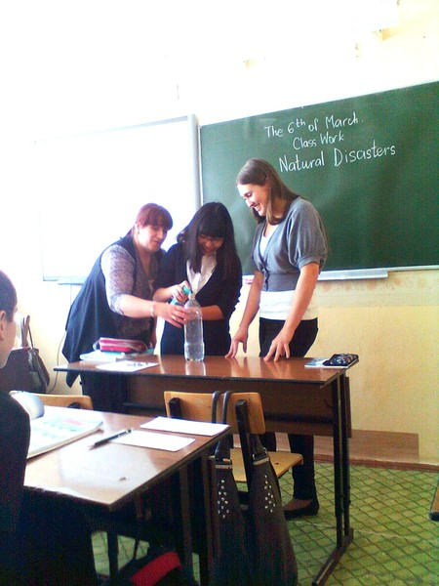
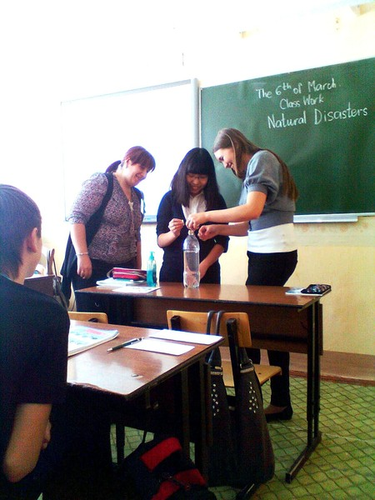
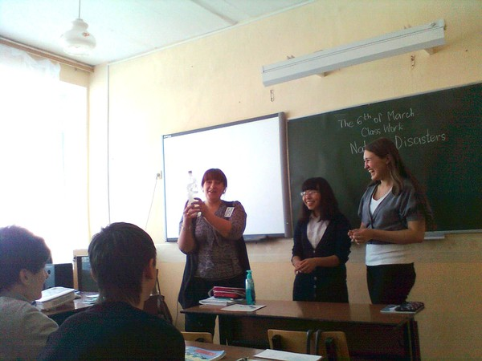
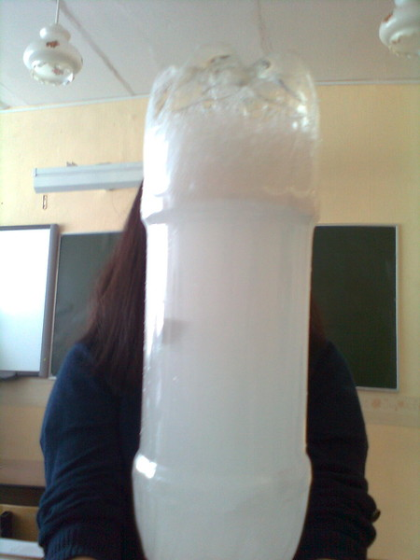
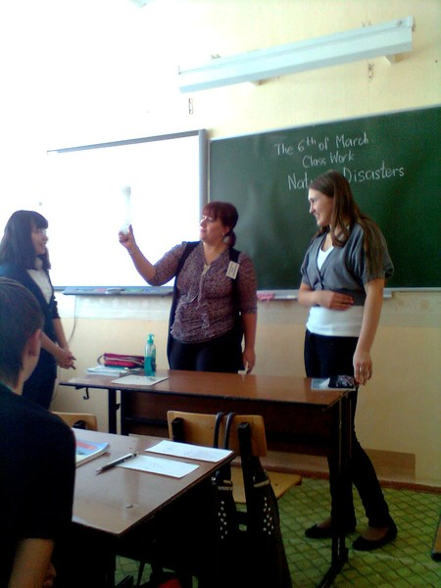
We are making an experiment

