Slide 1
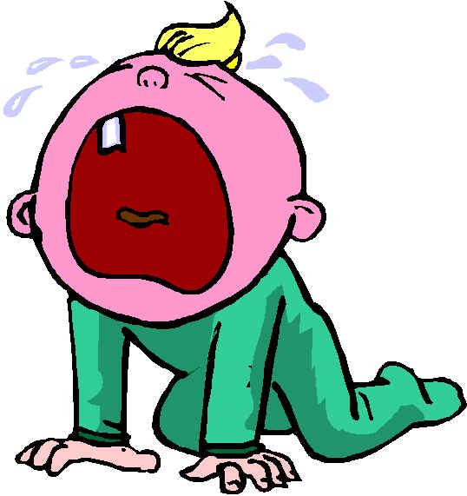
THE PRONUNSIATION {W}
Why, do you cry, Willy?
Why do you, cry?
Why, Willy, why Willy,
Why, Willy, why?

Slide 2
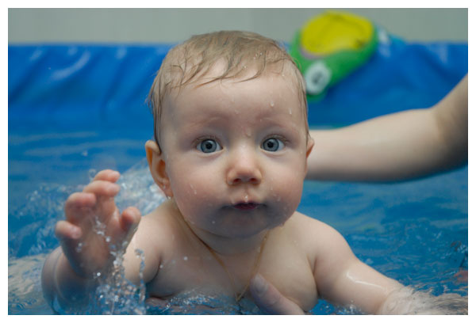

Slide 3
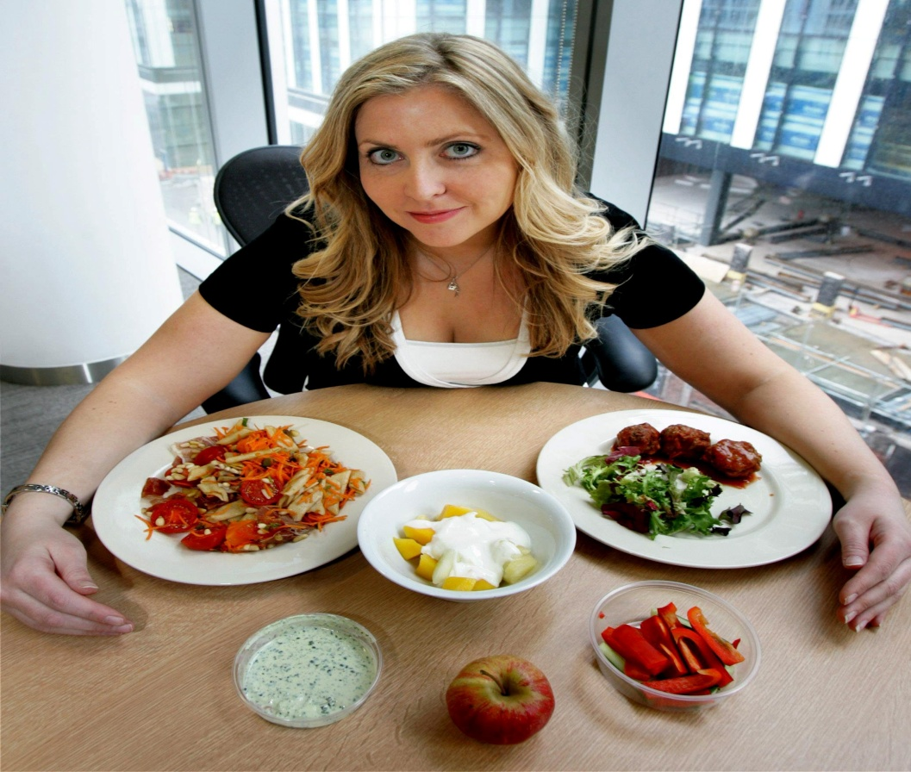
Тема урока:”Неalthy living”

Slide 4
Healthy living
1.Healthy food 5.daily routine
2.Do sports 6.eat more fruit
3.Good habits and vegetables
4.balanced diet 7.do morning
exercises

Slide 5
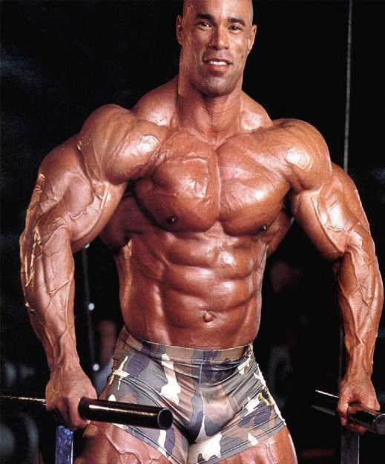
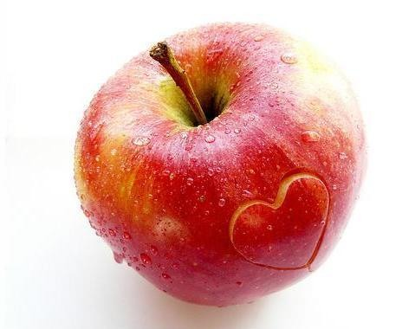
Proverbs about health
Health is better than wealth
Live not to eat but eat to live
An apple a day keeps the doctor away
Good health is above wealth
The appetite comes with eating
Eat at pleasure drink with measure
A sound mind in a sound body

Slide 6
To keep fit
It is very important to be fit, healthy and look nice.
Our health depends on many things:
the food the eat, our good and bad habits and
our physical activity.

Slide 7
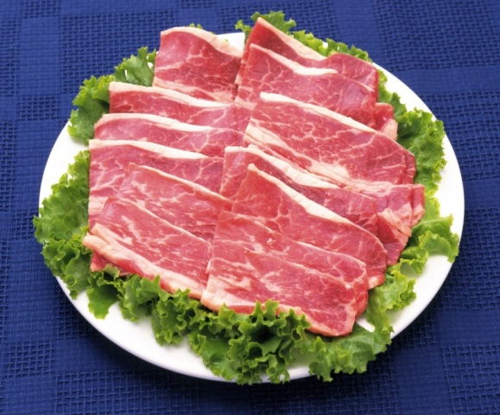
Balanced diet
Our body needs different types of food such as protein,
Fat, and carbohydrates.
Protein gives you energy.

Slide 8
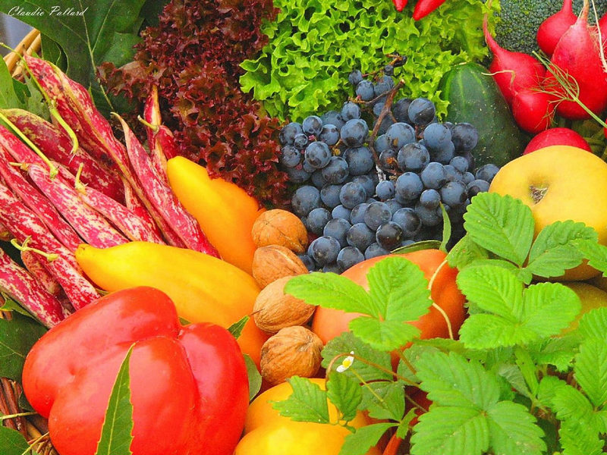
FRUIT AND VEGETABLES
You can get vitamins and minerals from fresh fruit and vegetables.
Vitamins are important for our eyes, bones, skin, heart and other parts of our body.

Slide 9
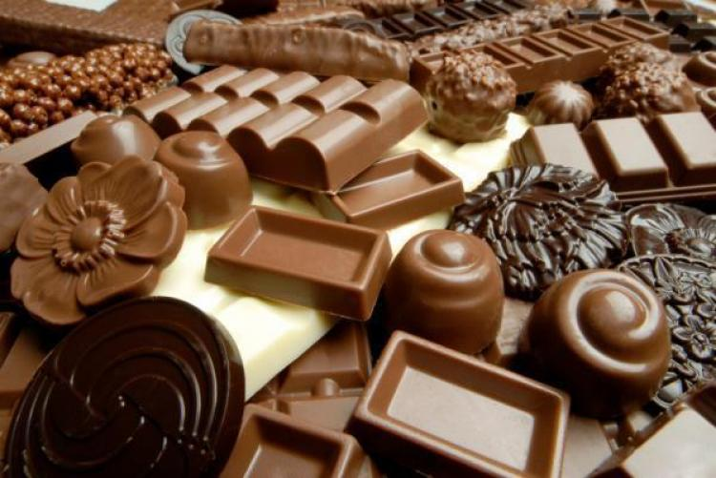
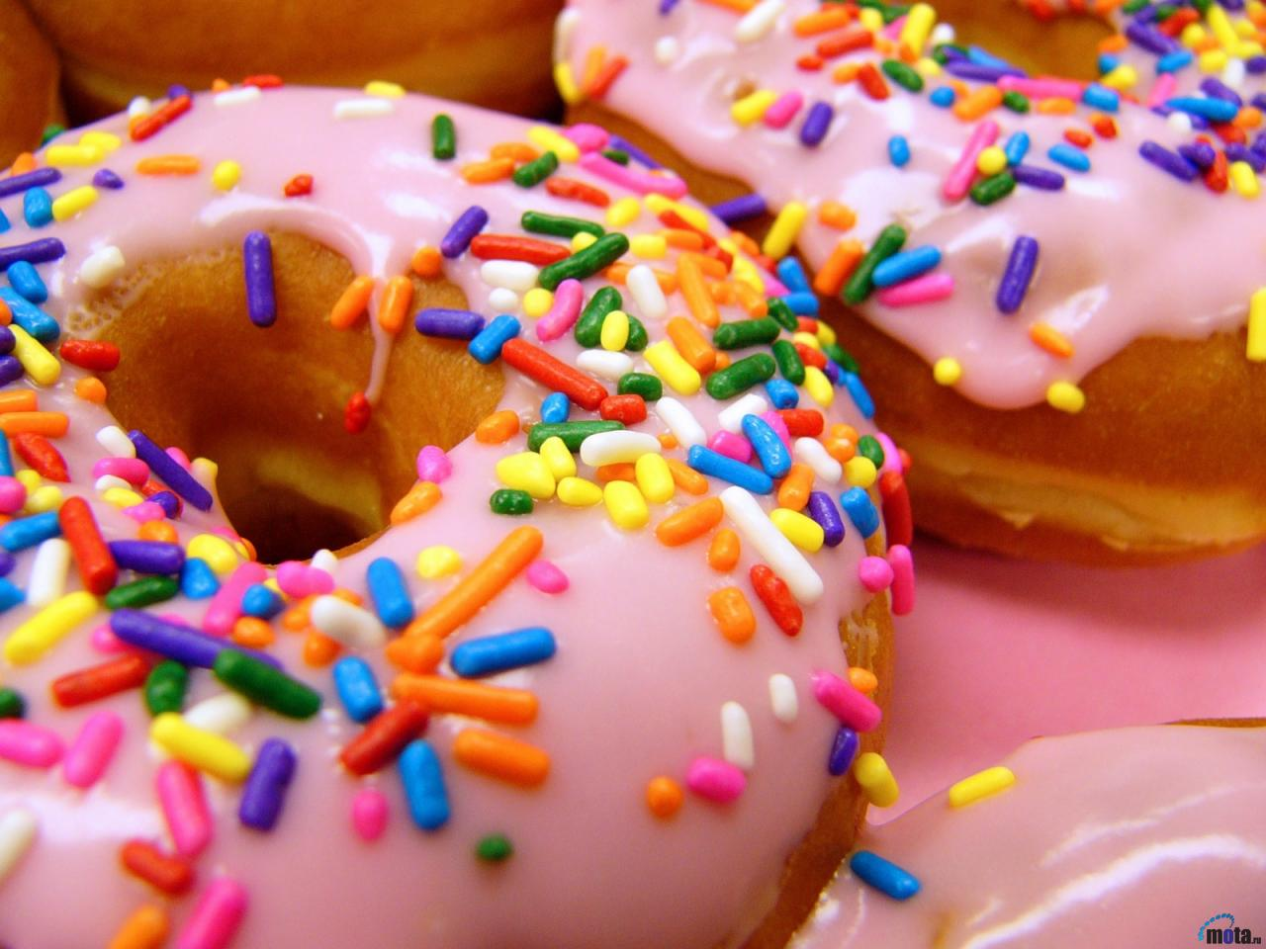
Sweets
You mustn’t eat a lot of sweets and chocolate because you get fat and they are also bad for your teeth.

Slide 10
conclusion
People can have good and bad healthy habits.
In order to stay healthy it is important to have good habits such as:
sleeping 7 or 8 hours, getting up early, eating breakfast, eat more fruit and vegetables, do sports, walking in the open air, do not smoke
and so on.

Slide 11
Кузнецова Алла Петровна
Школа «Классика»

