Slide 1
Кузнецова Алла Петровна, школа «Классика»
Настоящее продолженное(длительное)
время
Образование- To be+Ving
am are
Cигнальные is
слова: now, at the moment,
at present, still.

Slide 2
What are they doing?

Slide 3
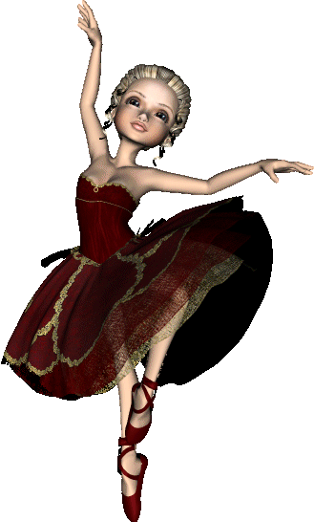
The girl/dance
The girl is dancing.

Slide 4
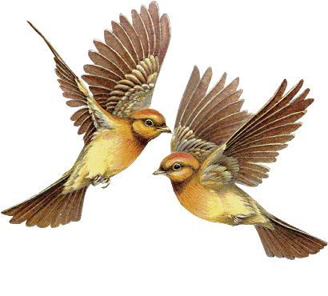
The birds are flying.
The birds/fly

Slide 5
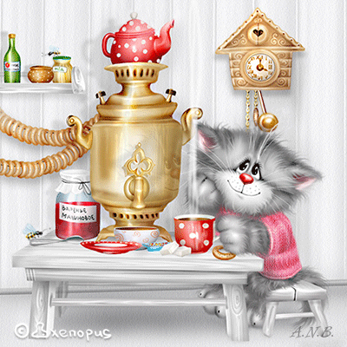
The cat/drink tea
The cat is drinking tea.

Slide 6
The girls are swimming.
The girls/swim

Slide 7
It is snowing.
It/snow

Slide 8
The sportsman/ride a bike
The sportsman is riding a bike.

Slide 9
They /play loud music
They are playing loud music.

Slide 10
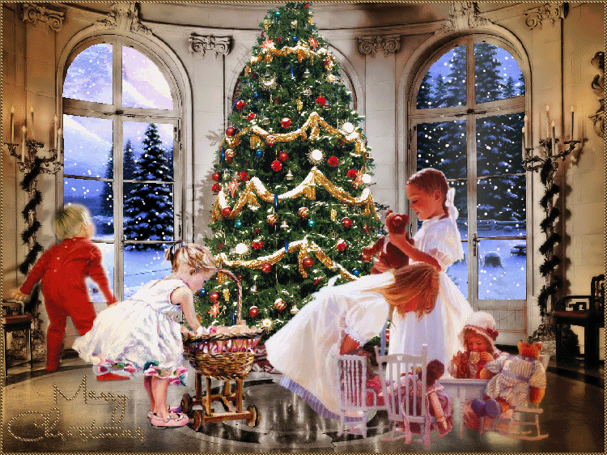
The children are playing.
The children/play

Slide 11
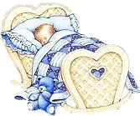
The baby/sleep
The baby is sleeping.

Slide 12
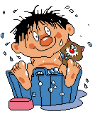
The boy is washing.
The boy/wash

Slide 13
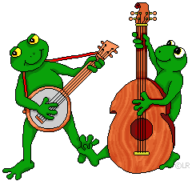
The frogs are playing musical instruments.
The frogs/play musical instruments

Slide 14
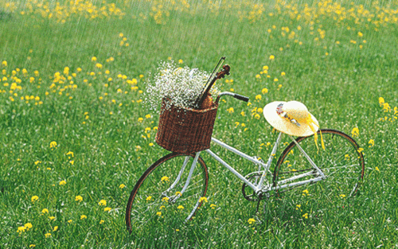
It/rain
It is raining.

Slide 15
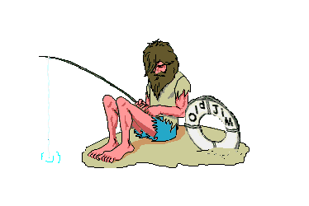
Guess what the people are doing.
Is he…?
Is she…? Are they…?
Is it…?

