Slide 1
Arguments for TV
(TV or not TV)

Slide 2
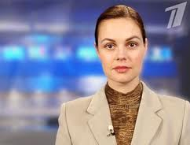
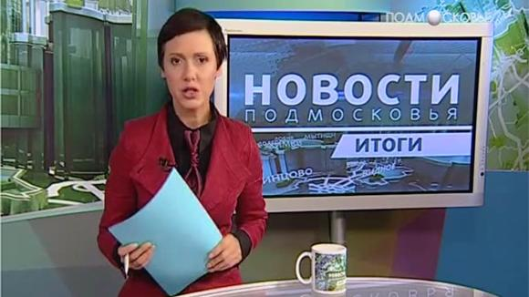
The News

Slide 3
Educational programmes

Slide 4
Educational programmes

Slide 5
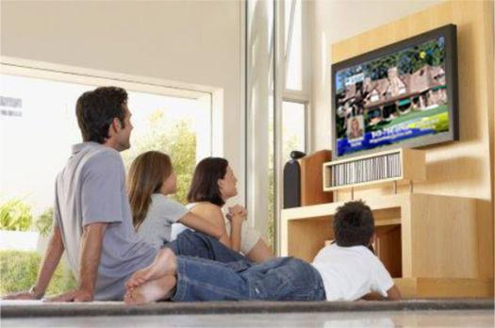
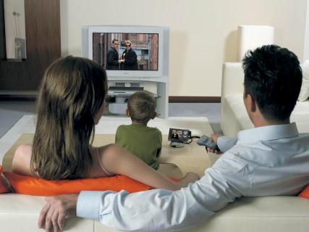
Family programmes

Slide 6
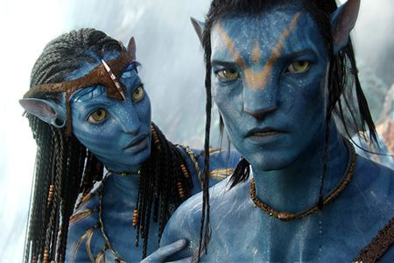
Entertaining Films

Slide 7
Arguments for TV
(TV or not TV)

