Slide 1
Do we need
an All-Russia TV-Turnoff Week?
11A – 11G
2012

Slide 2
The rules for teams.
*Work as a team and always support each other.
*Listen to your opponents carefully.
*Make notes while your opponents are speaking to
keep track of their ideas.
*Try to answer questions giving reasons for your
opinion.
*Be polite and disciplined during the debate.
*Never interrupt each other.
*Don’t speak longer than the set time limit

Slide 3
To be a good speaker:
*Demonstrate a good knowledge of the topic
*Use examples and facts to support the arguments
*Show enthusiasm and confidence
*Try to answer the questions even if they are
tough
*Speak loudly and clearly

Slide 4
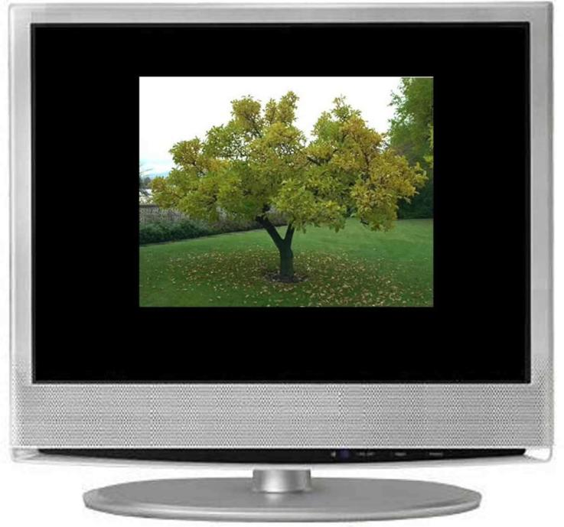
TV-Turnoff Week

Slide 5
Sports
Current affairs
Documentary
Educational film
The arts
Nature films
Science programs
Discussions
News
Quiz show
Phone-in
Soap opera
Sitcom
Movie / film
Cartoon
Series
Game show
Music show

Slide 6
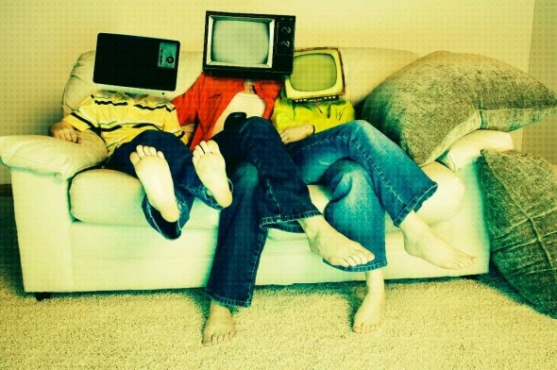

Slide 7
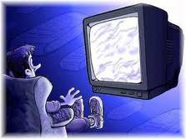

Slide 8
Screen Free Week 2012

Slide 9
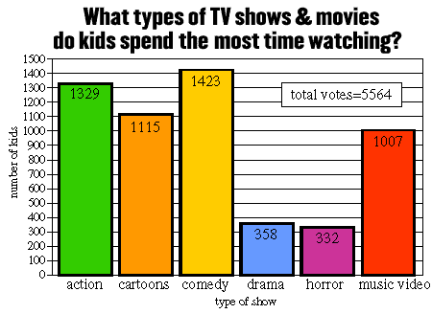
"Violence in the Media" Survey Results
We asked kids to pick their three favorite types of TV shows and movies. Here is the number of votes each type of program received.
Kids USA Survey Home

Slide 10
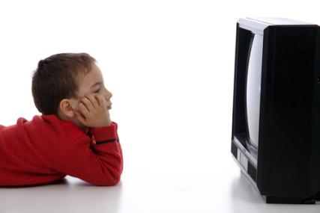
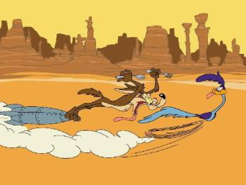
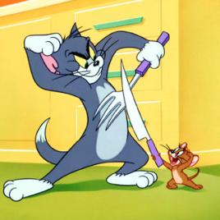
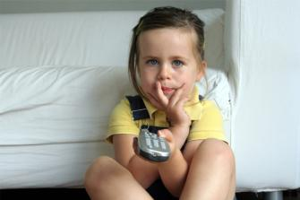
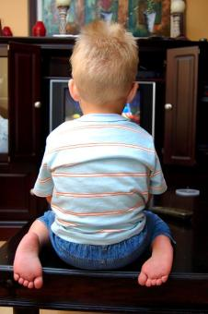
How to help your kids
break the screen habit

Slide 11
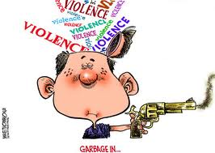
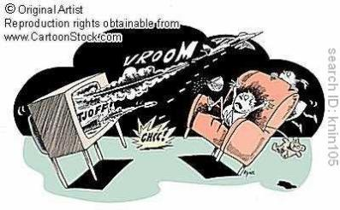
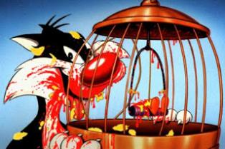
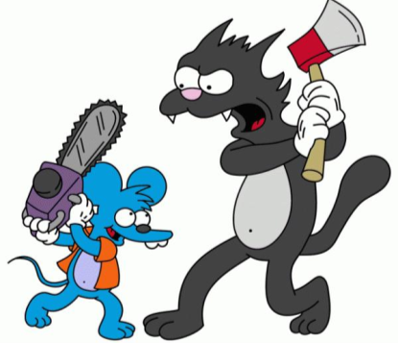
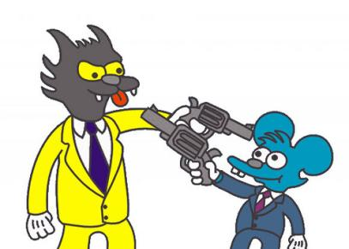
TV Violence Cartoons and Comics

Slide 12
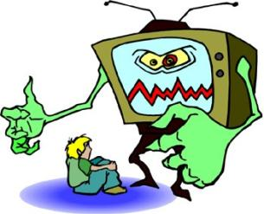
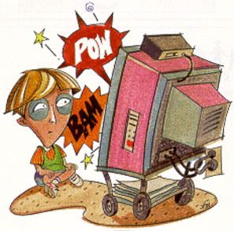
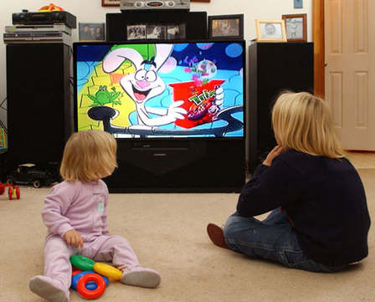
Does violence on TV
cause violence
in society?
Children Watching
Violent Cartoons -
Highlight Health

Slide 13
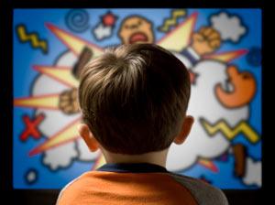
How many hours
of media per day
is it ok
for children to be ...
Additional Facts:
Children are exposed to 20-25 acts of violence per hour on Saturday morning television.
Sixty percent of cartoons and children’s shows contain violence.
By the end of elementary school, they will have seen approximately8,000 murders and 100,000 other acts of violence.
Source: www.DrDouglas.org, www.actagainstviolence.org

Slide 14
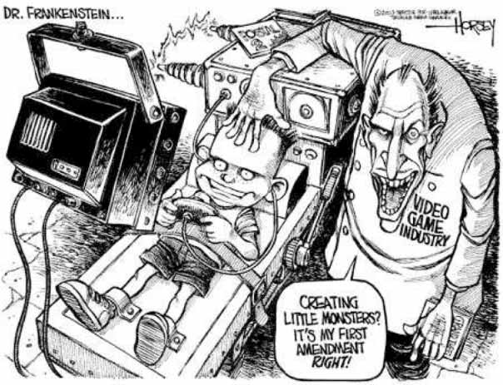

Slide 15
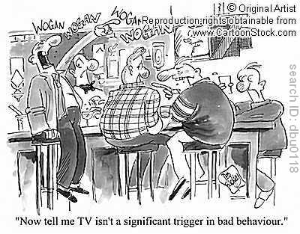
cartoonstock.com

Slide 16
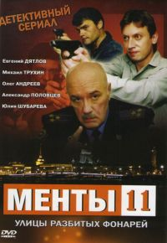
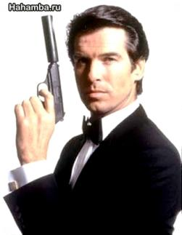

Slide 17
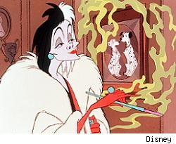
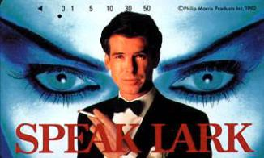
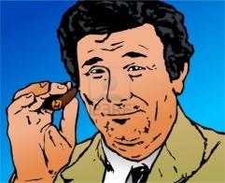
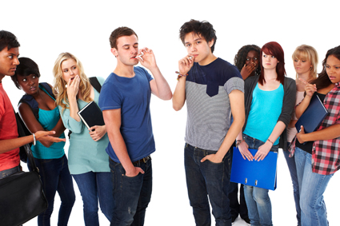
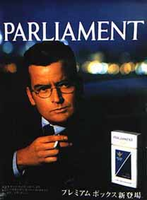
Does Smoking on TV
Influence You?

Slide 18
Do we need
an All-Russia TV-Turnoff Week?
11A – 11G
Учителя: Самохвалова Т.М., Иваненко Т.Л.
2012

