Slide 1
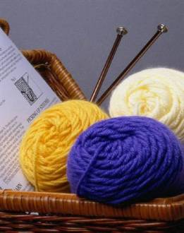
Hobbies and activities

Slide 2
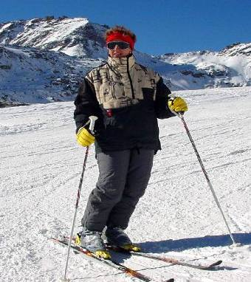
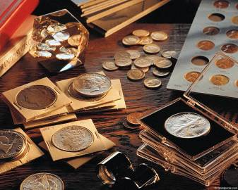
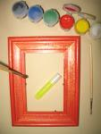
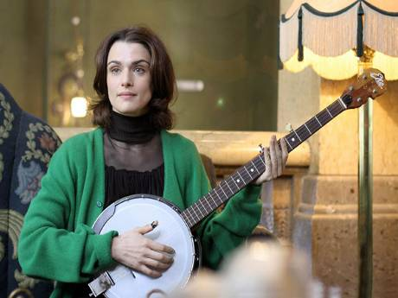
Hobbies and activities

Slide 3
Fill in the table horse riding travelling gardening doing sports playing computer games watching TV cooking hiking drawing reading collecting things fishing knitting hunting
Outdoor activities | Indoor activities

