Slide 1
Travelling to Wonderland

Slide 2
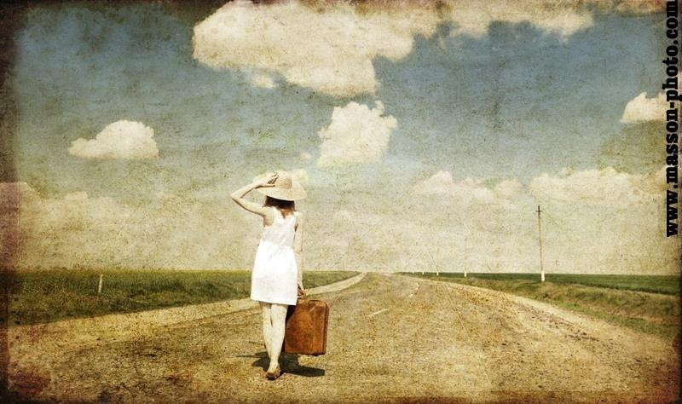
Journey of a thousand miles begins with the first step.

Slide 3
Read and translate
to go by train
to go by plane
a railway station
to stay for a week
cheap
excellent
a bus
an airport
a port
a bus stop
to fly quickly
a ticket to London
a ticket for a train
fast
to arrive in (at)
luggage
to feel like doing smth.
perhaps
nearly
a journey
a voyage
a ship
on board the ship
to miss a bus
to catch a train
a trip
fantastic

Slide 4
What is Wonderland?
It is a special place for children and grown-ups.
It is a dream that comes true.
It is …

Slide 5
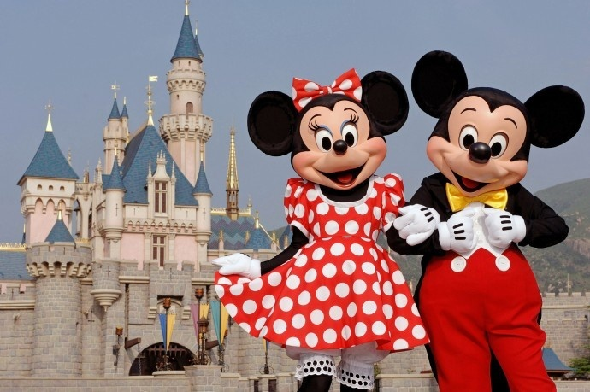
… Disneyland!

Slide 6
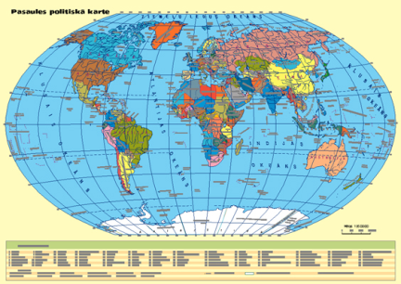
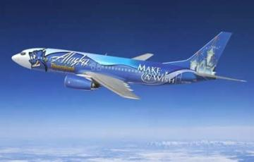
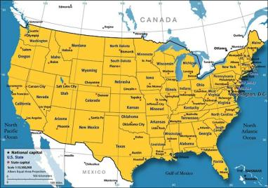
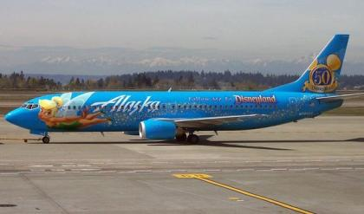
Fly by plane

Slide 7
Dialog
- I would like a ticket to Los Angeles, please.
- When are you going to fly?
- Today, I think.
- Just a minute. I think flight 304 is the best for you.
- When is the flight?
- At 7.45. And you will be in Los Angeles in 20 hours.
- Excellent. How much is the ticket?
- Business or tourist class?
- Tourist class, please. Business class is too expensive.

Slide 8
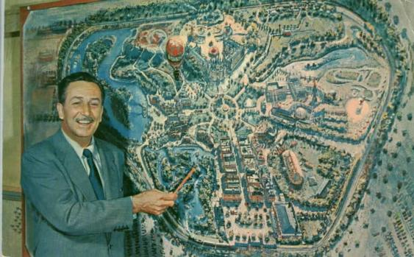
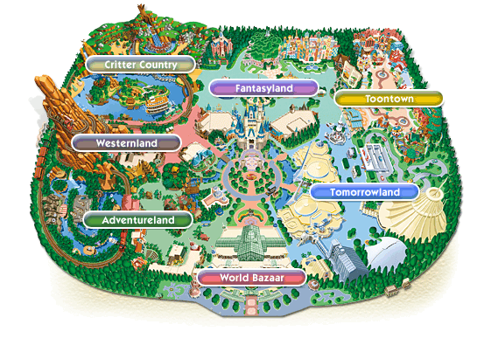
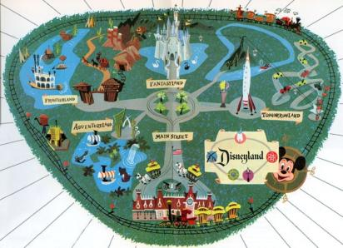
The map

Slide 9
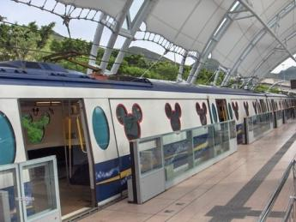
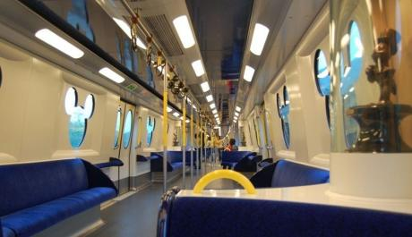
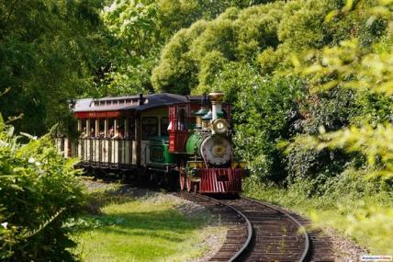
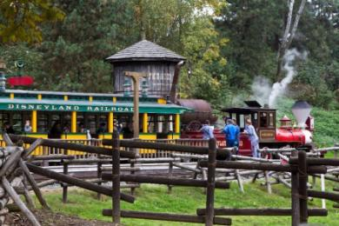
Travel by train

Slide 10
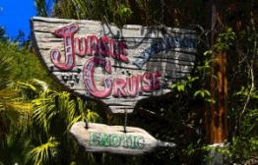
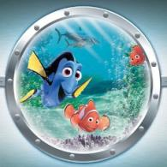
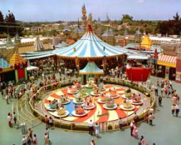
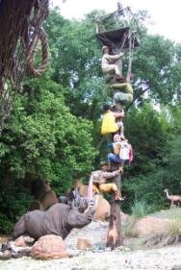
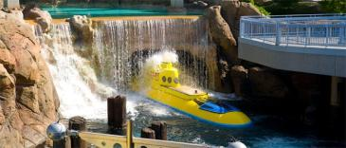
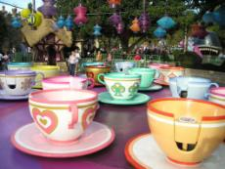
Park amusements
Jungle Cruise
Finding Nemo Submarine Voyage
Attraction of cup

Slide 11
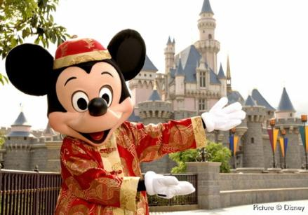
I have just come back from a trip (journey). I went to ____. I travelled there by ____. It took me____ hours to get there. I travelled with my____. I liked my trip (journey). My friends have travelled there too. I’d like to travel there again because ____.

Slide 12
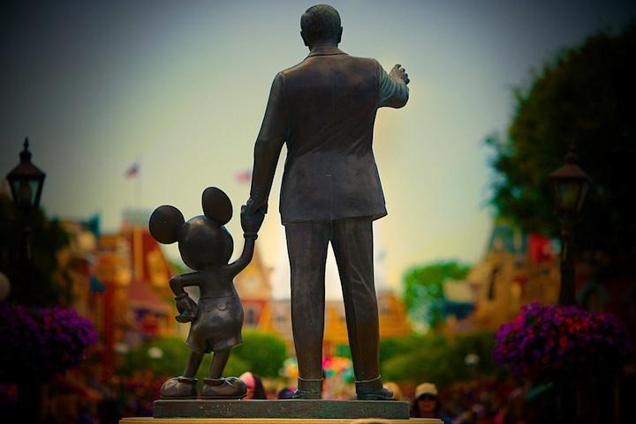
See you soon!

