Slide 1
Choosing a profession

Slide 2
Today’s world of jobs
Today’s world of jobs offers us new challenges. There is an increase in the variety of different jobs nowadays. Such jobs as Djs, web and interior designers, machine operators, have appeared recently. Besides as a result of technological advances traditional patterns of work are changing rapidly.

Slide 3
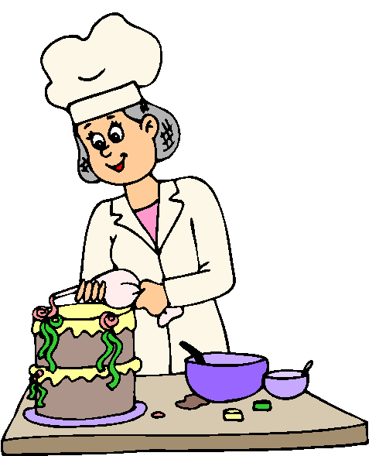
Today’s world of jobs
That’s why more flexibility is required from the workforce. If a young person wants to succeed in the 21st century labour market , self-investment in some certain skills and personal qualities is absolutely essential. To make a good career he or she should be quick to learn and adaptable.

Slide 4
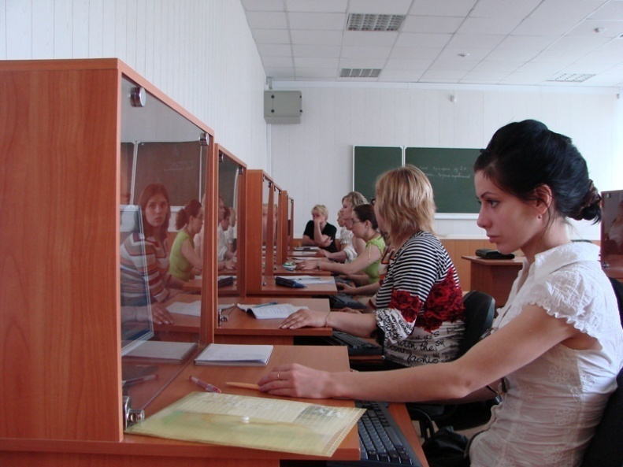
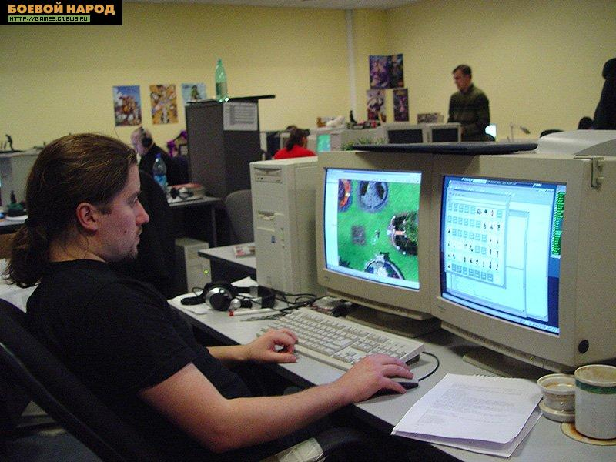
Today’s world of jobs

Slide 5
Reasons for work
People work for 2 sets of reasons: extrinsic (for a wage, to earn money) and intrinsic (for the interest and enjoyment of the job, for the companionship, for the status and the sense of identity).

Slide 6
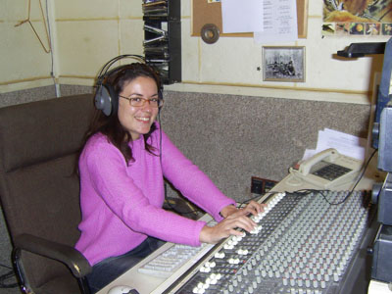
Reasons for work

Slide 7
Why is the problem so pressing?
The choice of the future profession is a very delicate topic. The problem is really rather urgent and acute because you have very little time to solve it. And making the wrong decision can result in many troubles in future.

Slide 8
Why is the problem so pressing?

Slide 9
How to make a decision
The first step towards making a decision is to find out our talents. It is good to bear in mind the professions of your parents because they often have similar abilities, though it is not a must.
We have many possibilities to solve the problem: we can consult a psychologist or ask someone you respect for advice.

Slide 10
How to make a decision

Slide 11
How to make a decision
Another opportunity to understand your preferences is to attend some extra classes or work during summer holidays. It is necessary to realize the advantages and disadvantages of the job chosen.

Slide 12
How to make a decision

Slide 13
My priorities
My priorities have changed with years. When I was small, what I valued was the interest and enjoyment of the job. Of course it is important to mind your bent for a job not to be torn apart between your job and your nature. But now I take into account some other criteria too.

Slide 14
My priorities
What matters to me is pay.
Besides we can’t but keep in mind the job security, convenient location, good prospects of promotion.

Slide 15
My priorities
What I mostly take into consideration is the working day. I’d like to avoid night shifts or working late. I don’t want to put up with working under pressure from 9 to 5. I feel like having flexible working hours. I mean piecework or working from home. I can’t do without freedom. I can’t stand taking responsibility for others – I’d rather work on my own, freelance to be exact.

Slide 16
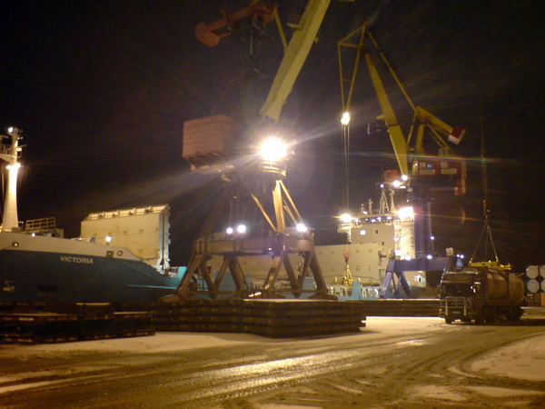
My priorities

Slide 17
My priorities
But what turns the scale is the creativity of the job (at least as far as I am concerned).
Thus, I am planning to have work which can give me freedom to create, to develop myself and to learn new things.

Slide 18
My priorities

Slide 19
End

