Slide 1
We are against wearing school uniforms

Slide 2
Preparing for our presentation, we have conducted a school survey. The list of two questions:
1) «Are you for or against wearing a school uniform?»
2) «What clothes would you like to choose?»

Slide 3
The results
We have asked 80 teenagers at the age of 11 -17.

Slide 4
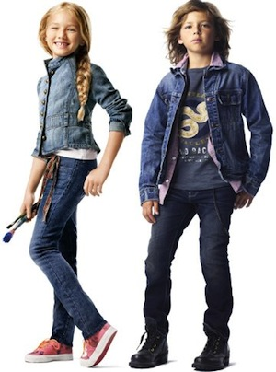
What clothes would you like to choose?
Students of our school choose jeans instead of school uniforms.

Slide 5
Our arguments against uniforms are following:

Slide 6
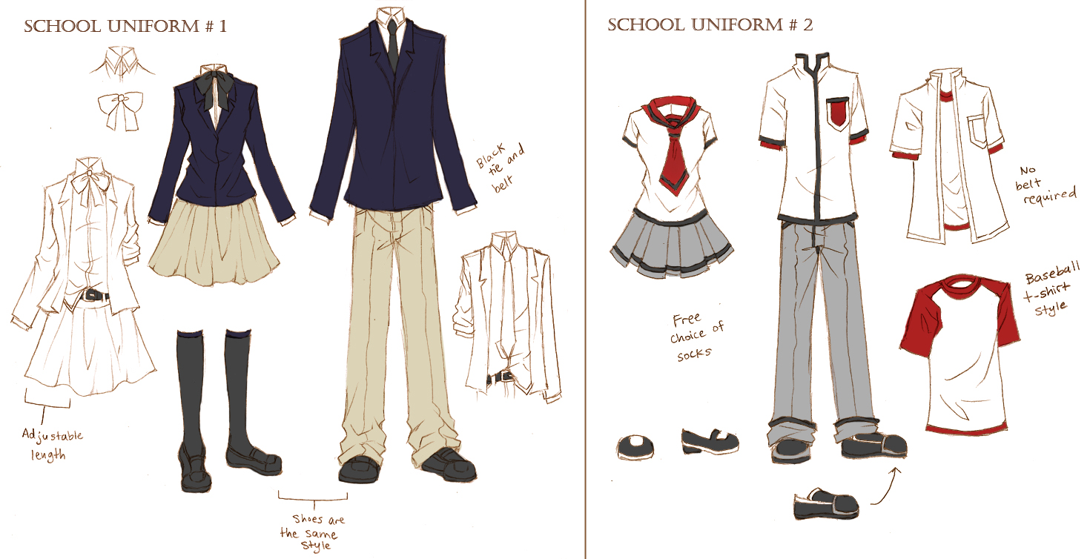
School uniforms deprive students of opportunity to express their individuality.

Slide 7
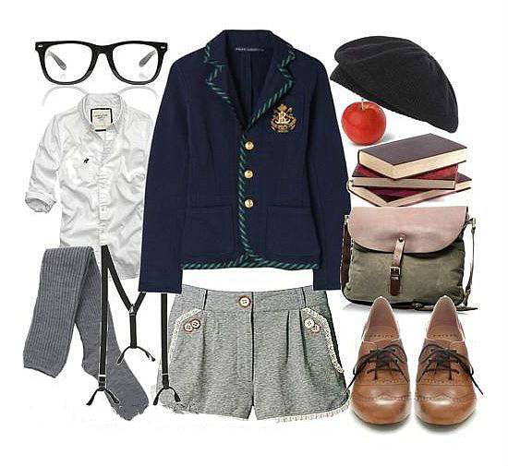
It easy for students to study in comfortable and stylish clothes

Slide 8
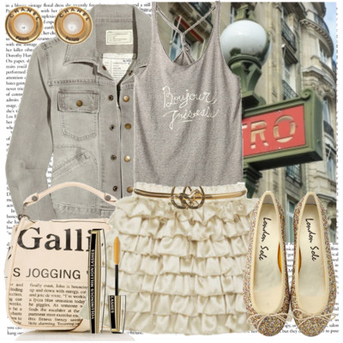
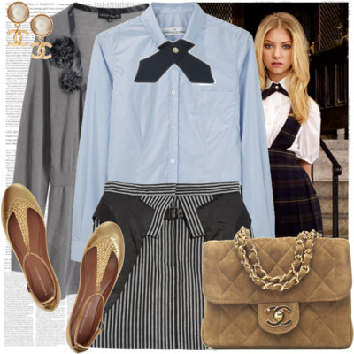
Every child has a right to express his individuality. So the school uniform restricts child’s freedom.

Slide 9
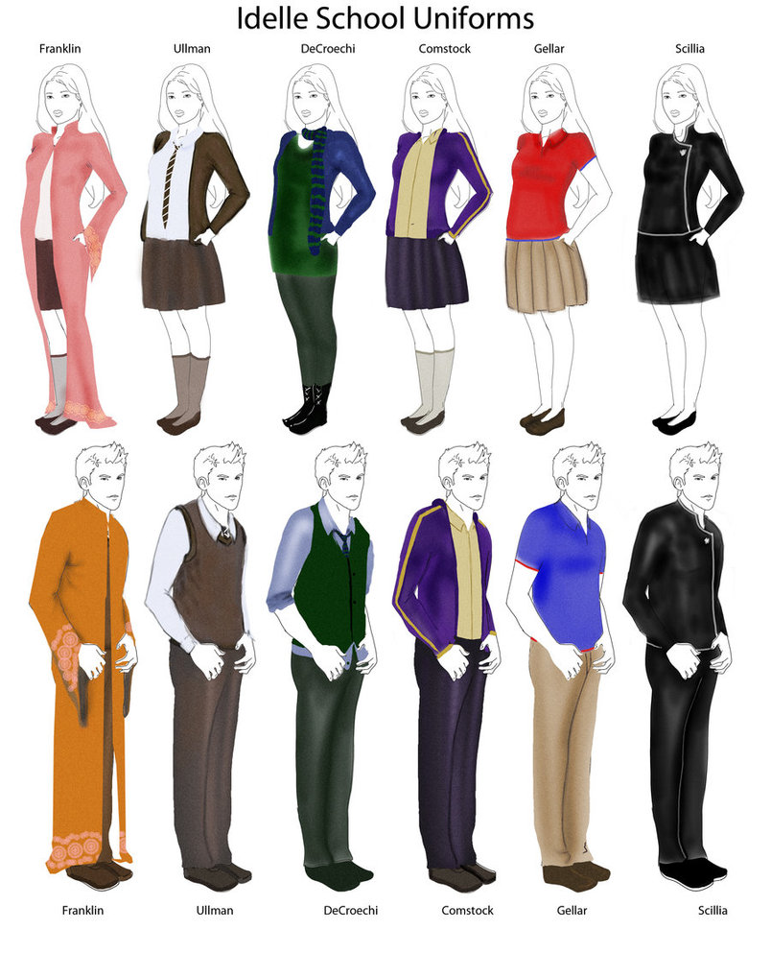
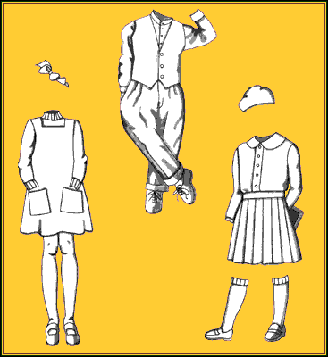
So, we can make a conclusion that school uniforms are not necessary.

