Slide 1
History of a school uniform in Russia.
A school uniform is a set of standard clothing, worn by members of an organization.
In Russia the school uniform appeared in 1834. This uniform was worn only by boys.
In 1896 a form for girls was created.

Slide 2
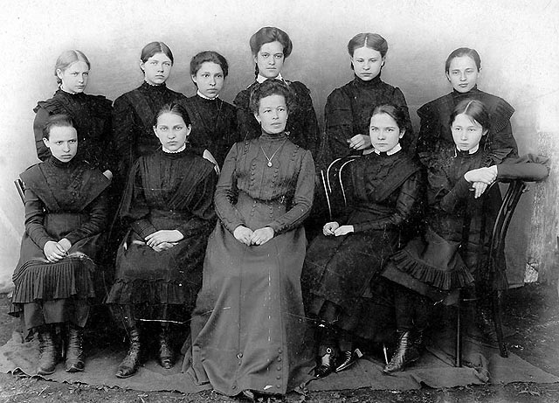
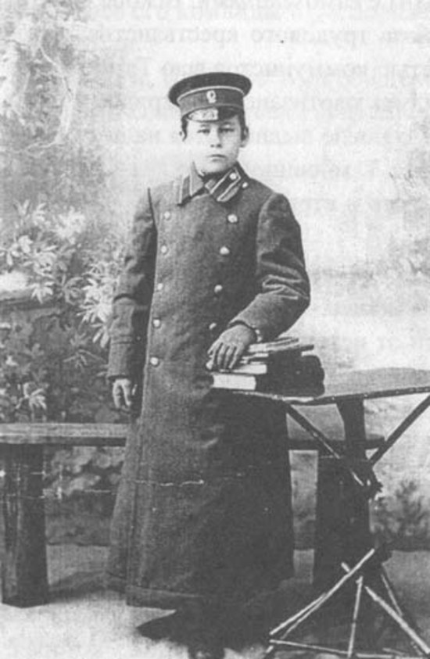
The uniform of a schoolboy was a subject of the pride. It consisted of a cap, a high-collared shirt, a coat and, of course, a satchel. Schoolgirls wore dark clothes.

Slide 3
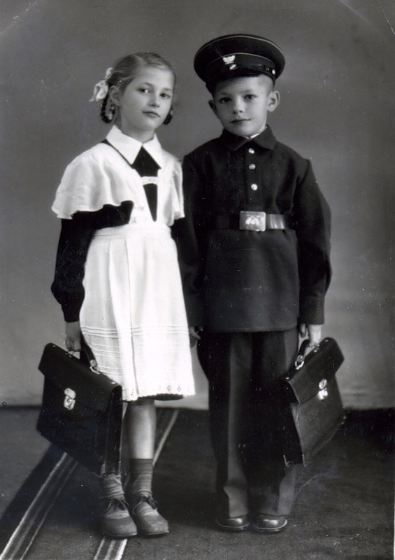
In 1949 it was introduced compulsory school uniforms. Boys wore gray tunics, girls wore brown dresses with black or white aprons.

Slide 4
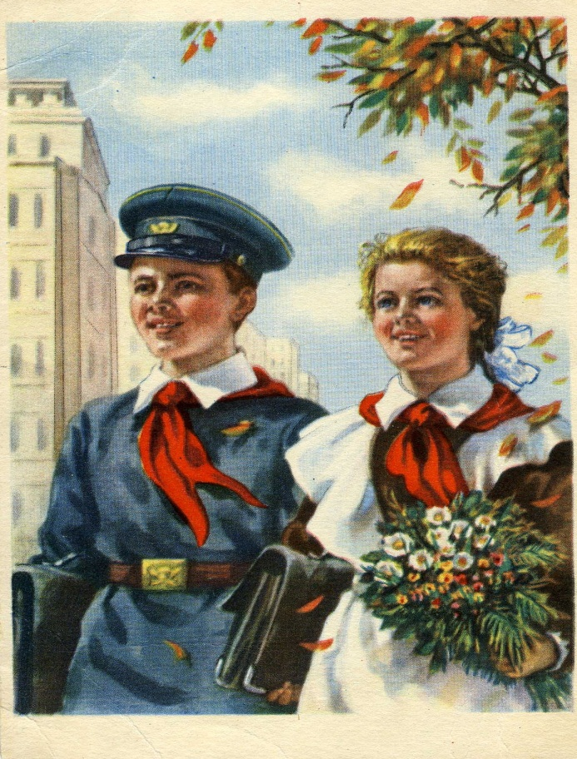
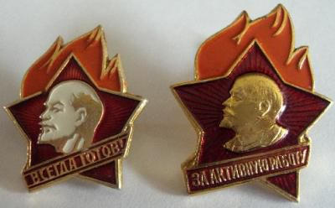
The symbols of young people were introduced: the pioneers wore red ties, octobrians and the members of Komsomol wore special badges.

Slide 5
From 1973 till 1987 school uniforms had some changes. But in 1988, schools were allowed to decline uniforms. In 1992 the school uniform was canceled, so students could wear whatever they wanted and loved . But at our time we have returned to a uniform again.

Slide 6
There are many kinds and styles of uniforms now.

