Slide 1
Let’s Help Our Nature!
(Ecological Problems)

Slide 2
Autumn

Slide 3
Mountains

Slide 4
Meadows

Slide 5
Forests

Slide 6
Winter

Slide 7
Cutting down trees

Slide 8
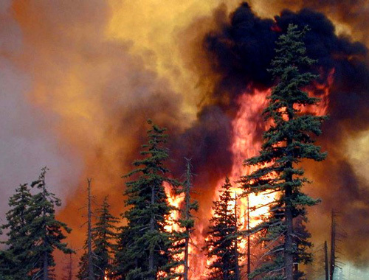
Forest Fires

Slide 9
Rubbish in Cities

