Slide 1
Consolidation lesson “English for fun and like fun”.
Урок английского языка в 6 классе
Батяева Наталья Васильевна
Старо-Семенкинский филиал
ГБОУ СОШ с. Старый Маклауш

Slide 2
Test-foreign literature
1.It is an English writer whose most famous novel is “Robinson Crusoe”:
D. Defoe;
J. Swift;
Ch. Dickens;
W. Scott.
2.He wrote his famous novel “ Oliver Twist” in 1838:
Jack London;
Conan Doyle;
Jerome K. Jerome;
Ch. Dickens.

Slide 3
Test-foreign literature
3.In this town the tourists can see the house where Shakespeare lived with his family:
London;
Edinburg;
Wales;
Stratford-oAvon.
4.“Tom Sawyer” is the famous novel written by a well-know writer:
Jerome K. Jerome;
B. Show;
Mark Twain;
Jack London.

Slide 4
Test-foreign literature
5.“Treasure Island” is an adventure story about...looking for buried treasure:
pirates;
children;
farmers;
policemen.
6. This writer began to write detective stories in 1920:
Jack London;
Mark Twain;
Agatha Christie;
J. Chase.

Slide 5
Test-foreign literature
7. “Brown Wolf” was written by this writer:
Mark Twain;
Th. Dreiser;
Jack London;
Jerome K. Jerome.

Slide 6
Translate the words
Caviar Curious
Law Separate
Permanent Departure
Sign Flute
Kingdom Arrival
Consist of Circus
Protect Exhibition
Hop Vacuum cleaner
Butcher Table
Poppy Job
Save Nurse
Deep Baker

Slide 7
Game “Irregular verbs- BINGO”
become | forget | keep | lead | Retell
choose | fly | grow | hide | know
meet | shine | steal | run | swim
tell | think | put | stand | understand
write | sing | drink | eat | read
put | write | set | see | sing
shake | take | meet | say | lead
grow | steal | give | go | hide
eat | do | learn | build | choose
find | become | know | can | catch

Slide 8
Crossword «In London»
m | f | u | n | m | e | a | r | c | a | n
a | r | t | g | a | l | l | e | r | y | i
r | f | a | i | r | t | s | l | a | a | c
k | l | u | b | b | s | q | q | r | r | e
e | z | w | a | l | k | u | x | e | d | n
t | a | s | k | e | g | a | r | d | e | n
s | u | n | d | a | y | r | o | a | s | t
b | e | p | a | r | k | e | s | e | e | b
p | a | l | a | c | e | r | e | g | o | t
g | o | o | d | h | v | a | l | l | e | y

Slide 9
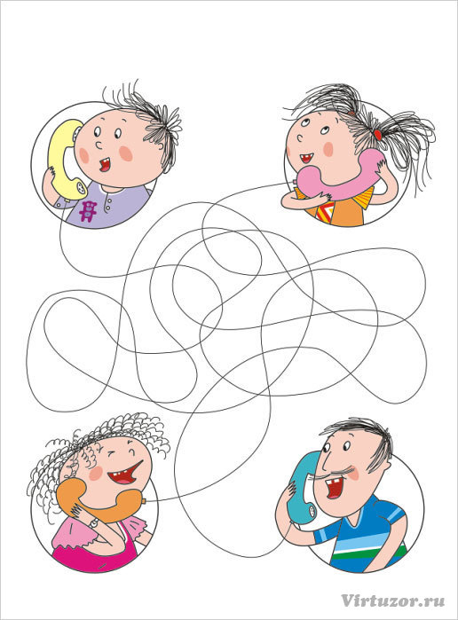
“Dialogue”

Slide 10
Good bye!

