Slide 1
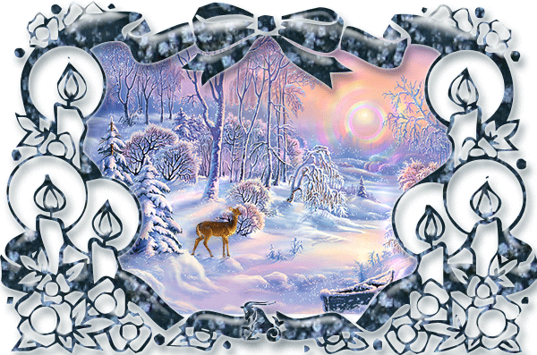
We are visiting Santa

Slide 2
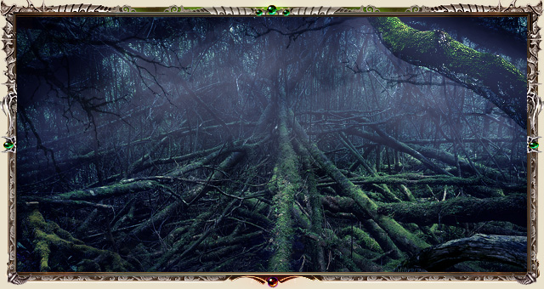

Slide 3
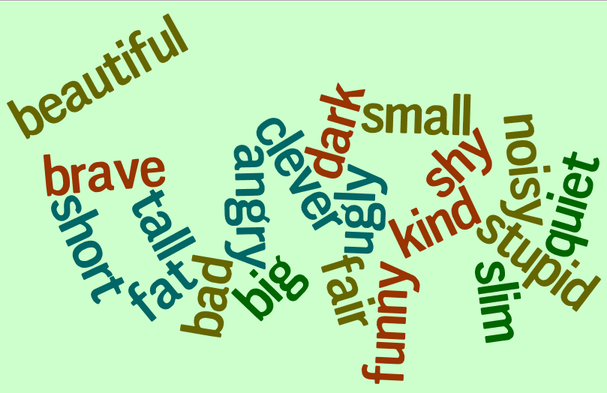

Slide 4
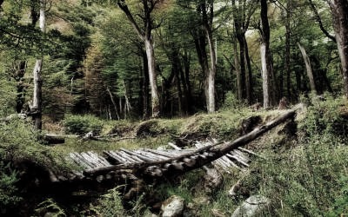

Slide 5
Match the questions to the answers
Hi! How are you?
What is your new flat like?
Where are the books?
Can your mum play the piano?
What’s your sister like?
Look at that girl over there! Who is she?
Do you have any hobby?
She’s really pretty. What’s her name?
It’s very nice.
No, she can’t. But she can play the guitar.
Kathy. She’s my friend’s sister.
The one with the long fair hair?
I’m fine, thanks. And you?
They are in the bookcase.
Yes, I have! I collect stamps.
She’s noisy but sweet!

Slide 6
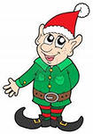
Who is this?
Is he tall or short?
Is he fat?
Has he got a moustache
or a beard?
What colour are
his eyes?
What is he wearing?
What is his favourite
colour?
What is he like?
His favourite colour is green.
He is short.
He likes the green colour.
He is funny and friendly.
No, he isn’t. He is slim.
He isn’t tall.
He’s wearing green trousers.
His eyes are dark.
This is an elf.
He has got dark eyes.
No, he hasn’t.
He’s wearing a red jacket
and a red cap.
He is wearing a jacket and a cap.
He is angry.

Slide 7
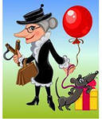
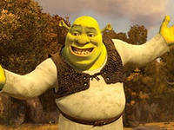
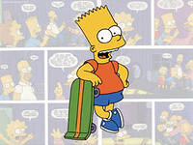
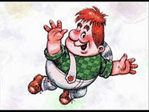
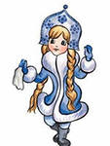
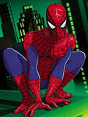
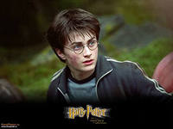
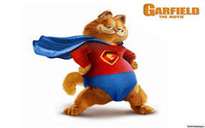
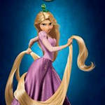
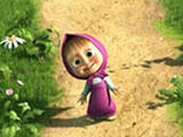
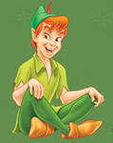
Is it a HE? Is it a SHE?
Is he/she tall?
Is he/she …?
Has he/she got long fair hair?
Has he/she got ….?

Slide 8
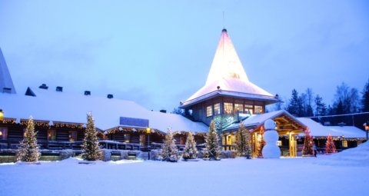

Slide 9
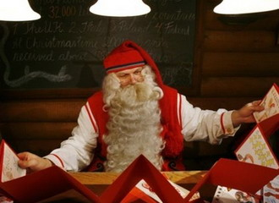

Slide 10
Santa’s Workshop

Slide 11
Dear friends!
Nice to meet you!
I’m waiting for your
letters. And I want
to meet your family.
Please write me about members of your families. What are they like? What do they look like?
Love,
Santa

Slide 12
Thank you!
Good bye!

