Slide 1
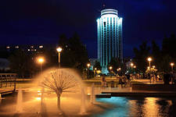
Naberezhnye Chelny
Выполнил: учитель МБОУ «Малошильнинская СОШ» Серебрякова Н.К.

Slide 2
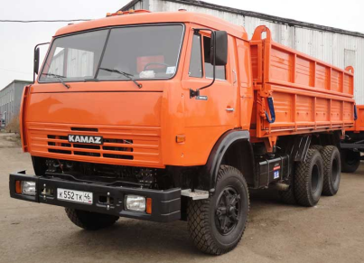
Гимн Набережных Челнов
Как чудесный корабль, выплывают Челны,
Парусами взметнув, свои белые башни.
Он прекраснее всех, город нашей судьбы,
Здесь причал всех надежд, и любви светлой нашей.
Город надежд, город ветров,
Город-мечта из сбывшихся снов.
Город, который построили мы -
Наши Челны, Наши Челны.
Распахнули проспекты объятья свои,
И знакомые песни, ветра напевают.
Самый мирный из всех, город нашей судьбы,
Из цветочных узоров, наряд примеряет.
Кама гладит волной золотые пески,
Время новые звезды для нас зажигает.
Самый лучший из всех, город нашей судьбы
Как счастливые рельсы, нас в жизнь отправляет.

Slide 3
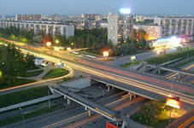
The city of Naberezhnye Chelny is one of the most developed and largest in terms of population and economic potential cities in the Republic of Tatarstan.

Slide 4
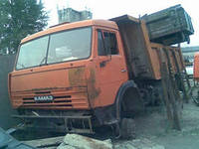
The quiet town on the Kama River began to change with the construction of the hydro-electric power project and the rate of change became especially fast during the years of KAMAZ plant construction. It was one of the most grandiose in the USSR.

Slide 5
KAMAZ has got a very experienced team “ Kamaz-Master”.

Slide 6
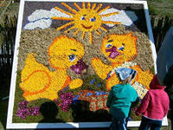
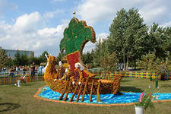
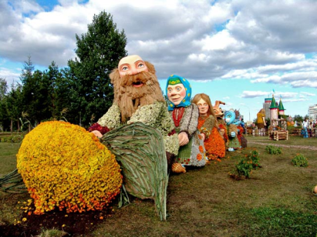
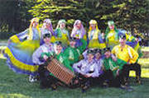
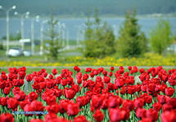
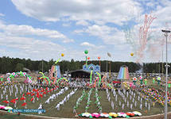
Besides being an industrial town Naberezhnye Chelny is proud of its festivals and holidays. One of the greatest is the holiday of flowers on the square in front of the administration building. It is dedicated for the day of the Sovereignty of Tatarstan.

Slide 7
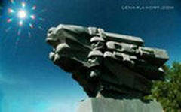
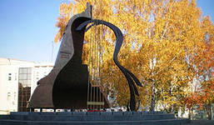
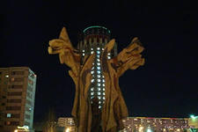
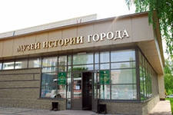
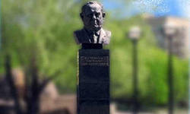
e
There are some places of interest. For example, there is a Cenotaph and Eternal Flame in memory of those who were killed during The Great Patriotic and Civil wars.

Slide 8
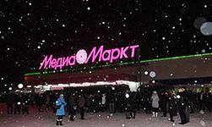
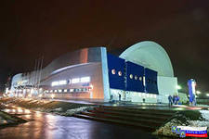
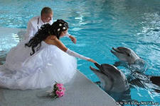
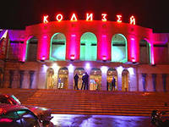
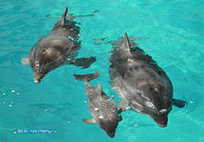
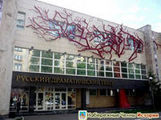
There are some cinemas, many galleries, museums and parks,
the Organ Hall, Tatar Drama Theatre, ‘Masterovye’ theatre, swimming pools, a puppet theatre,
a dolphinarium, Winter Sports Palace, children’s activity centre etc.

Slide 9
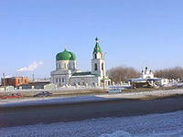
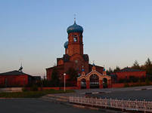
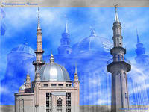
More than 85 nationalities live in Naberezhnye Chelny.

Slide 10
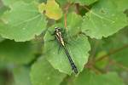
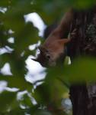
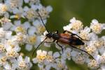
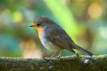
In order to prevent the destruction many special conserved natural territories were set up, one of them is the Nizhnyaya Kama. It was founded in 1991 in order to preserve and multiply some rare species of flora and fauna. The citizens of our Republic can enjoy its nature and wildlife and have a wonderful rest there.

Slide 11
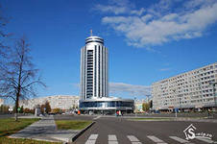
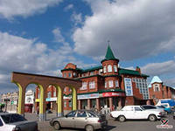
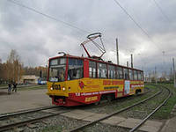
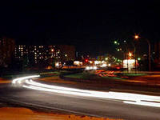
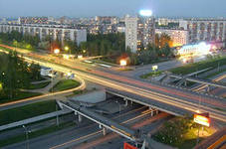
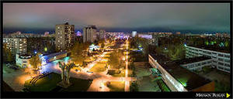
Our city is often called
“ a city of the future”, because the most up-to-date town-planning ideas are being realized here and there is still much more to be build.

