Slide 1
Festivals

Slide 2
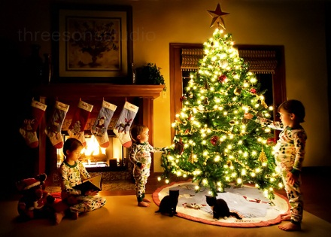
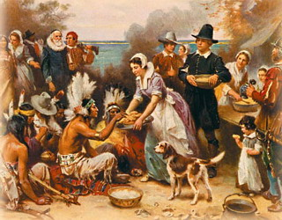
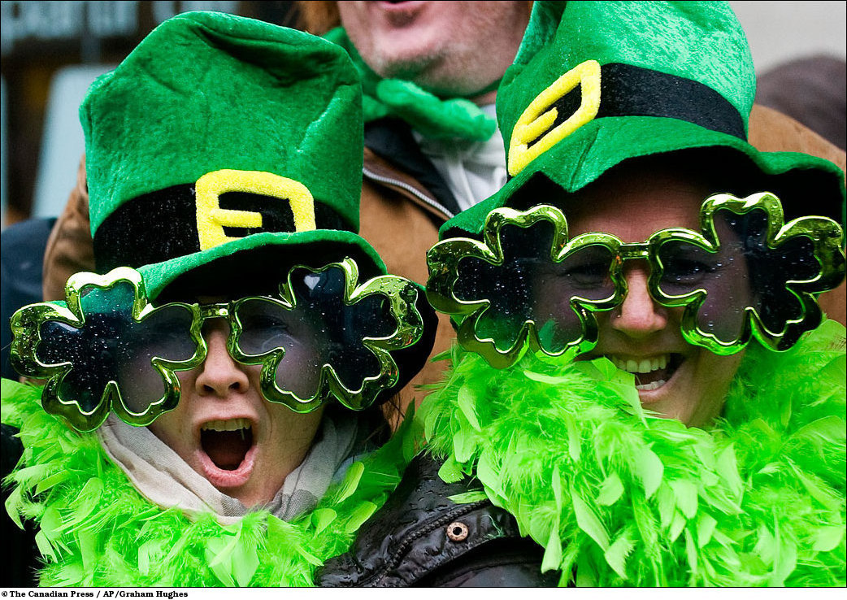
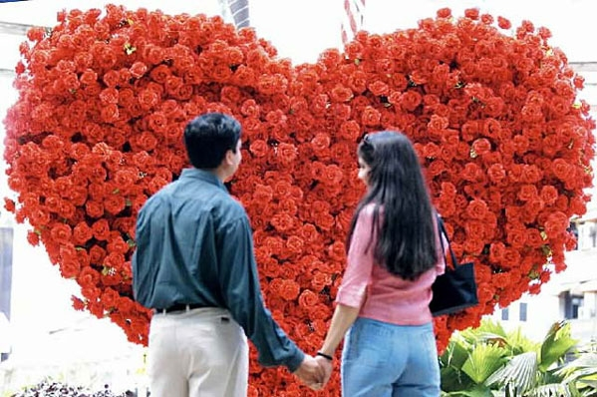

Slide 3
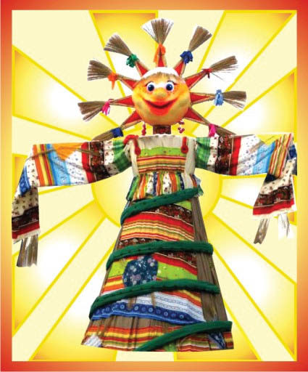

Slide 4
Halloween
…………… is on October 31st.
…………………. is on March 17th.
………………… is on January 1st.
………………..is on the 4th Thursday of November.
…………………is on the 14th of February.
……………is on the 24th of December.
……………is on the 1st of May.
St Patrick’s Day
New Year’s day
Thanksgiving
Valentine’s Day
Christmas
May Day

Slide 8
Celebration
Cool, super
Sing, dance, play
Тhis party is absolutely brilliant
Рarty.

Slide 9
Homework
AB. p 31 ex1,2,3

