Slide 1
Informal style Formal style
Виктория Львовна

Slide 2
Informal -Formal style

Slide 3
Informal -Formal style
Formal
Informal
Ящик высказываний
I would appreciate an early reply
I am writing to enquire about
I am writing in connection with
Well, I think that’s all for now
Why don’t you come to dinner
I am currently working at
I’d love to see you again
Thanks for the invitation
I’m looking forward to
I look forward to
Do keep in touch
I am sorry to inform you that

Slide 4
Informal -Formal style
About your advert
I am considered to be
I am interested in applying for
I want to apply for
With reference to your advertisement
I have not worked before
I attach a reference from the principal of my school
I get on well with people
People think I’m
I am sociable and enjoy helping people
There’s a note from the
head of my school
I have no previous work experience
I’m free to talk to you
Drop me a line sometime

Slide 5
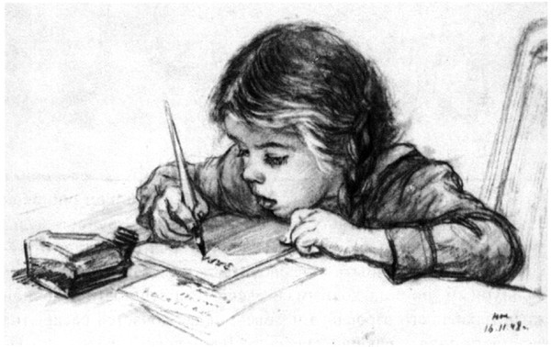
Informal -Formal style
Dear Mr. Barlow,
I am writing 1______________ my forthcoming visit to London. My trip begins on 4 February and lasts till 15 February. 2__________ our telephone conversation, I would like to add that my two colleges, Mr. Ivanov and Mr. Petrov , will accompany me. I would be 3______________ if you could book two single rooms for theme in the same hotel I will stay in.
If you require any further information please 4_____________.
5______________ ,
Peter Limonov

Slide 6
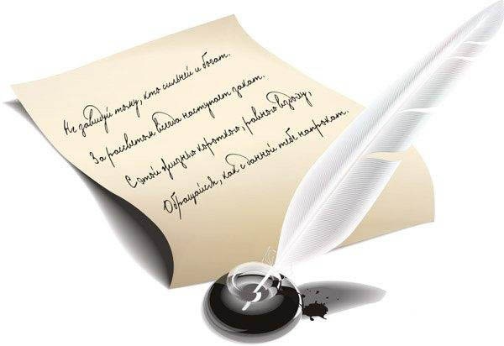
Informal -Formal style
How about you? Have you finished your exams yet? Perhaps we can get together when school finishes. If you want to come down to Bristol for a weekend in July, it would be great to see you. Tell me that you think. The only other news is that my brother Andrew has got a new girlfriend. She is quite nice actually, and I think we are going to get on really well.
I have taken so long to write back because I have been busy studying for my exams. They are over now, and I think I have passed everything, except physics, of course.
Thanks for your letter. It was great to hear from you and to hear about your skiing trip. I am glad you had a good time!
Dear John,

Slide 7
Informal -Formal style
TOEFL Services
Educational Testing Service
PO Box 6151
Princeton NY 085411-6151, USA
7F l., 57 Novaya St.
Moscow 334521
Russian Federation
Dear Sirs,
I would you grateful if you send me all the necessary information. I need.
I am looking forward to hearing from you.
I hope you have TOEFL preparation centres in Moscow where people can be trained to take the examination well. I will be obliged if you could inform me of the location of such centres.
In addition to it, I don’t know anything about payment policies and service fees. I wonder if you could tell me about acceptable forms of payment.
I am writing to find out the information concerning TOEFL tests. I live in Russia and as I want to study in one of the US universities, I must take the TOEFL test to be admitted.
Yours faithfully,
Peter Limonov
11 January, 2009

Slide 8
Informal -Formal style
Yours faithfully,
Kevin Waterstone
Last summer, I worked for a company called Sunny Days which organises holidays for children with disabilities. My duties included arranging sports and other activities and taking the children for excursions. I was considered to be a hard-working and responsible employee,
and my manager at Sunny Days has already offered to provide a reference, should you require one.
I am enclosing my Curriculum Vitae and I look forward to hearing from you in due course.
I am a second year student at Bristol University and am currently taking my end-of-year exams. The Summer vacation begins on 21st June and ends on 23rd September, and I am hoping to find a job for as much of that period as possible.
I am writing to apply for the temporary post of
Summer Activity Co-ordinator , as advertised in The Times last Saturday.
Dear Sir or Madam,

Slide 9
Informal -Formal style
?
,
:
-
;
!
.
( )
« »
‘
A question mark
A semi-colon
A colon
A comma
An apostrophe
A full stop
An exclamation mark
A dash
Inverted commas
Brackets

Slide 10
Informal -Formal style
I’m twenty years old and in my last year of a business studies
course I have already received the offer of a job with a
company where I did a placement last year however I do not
really want to accept it as it is an old fashioned firm which
doesn’t do much to develop its staff I want to find something
which is more forward looking do you think I am being
unreasonable my friends say I am turning down a golden
opportunity as the salary is good how can I find out about
opportunities in more dynamic organizations before it is too
late what do you think I should do.

Slide 11
Informal -Formal style

Slide 12
Thank You !
Good Bye! =)

