Slide 1
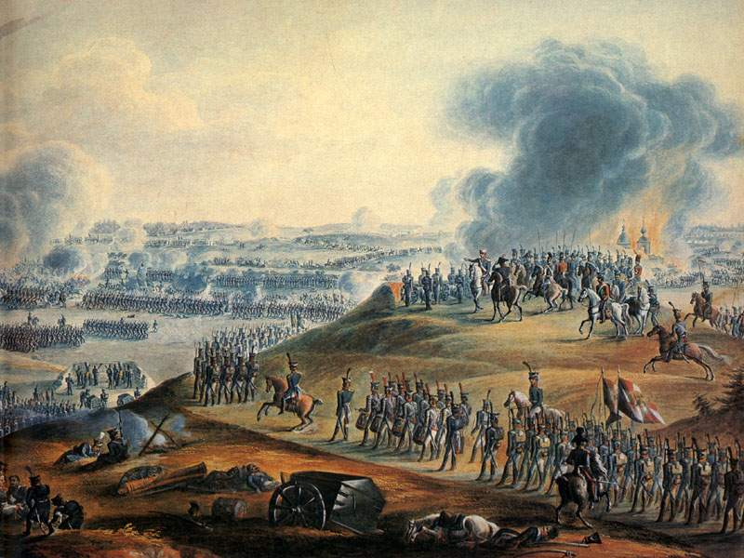
The Patriotic War of 1812

Slide 2
DATES,
Projects
HEROES,
RESULTS…

Slide 3
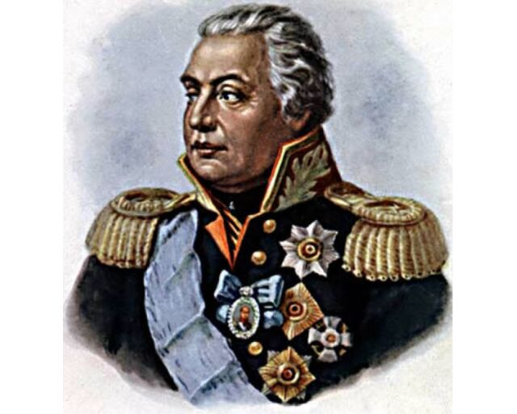
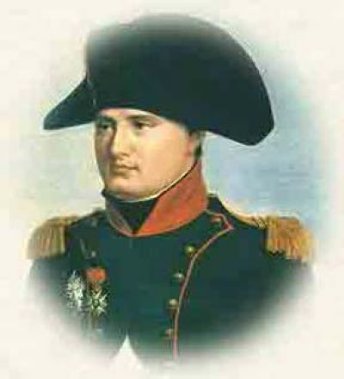
What was this great man?

Slide 4
Mikhail Illarionovich Golenishchev-Kutuzov
He was a Field Marshal of the Russian Empire.

Slide 5
Napoleon Bonaparte
He was a French military and political leader.

Slide 6
When was he born and how many years did he live?

Slide 7
M. I. Kutuzov was born on the 5th of April in 1745.
He lived for 67 years.

Slide 8
Napoleon Bonaparte was born on the 15th of August in 1769.
He lived for 51 years.

Slide 9
What were the results of the Battle of Borodino for the army the Commander-in-Chief of which he was?

Slide 10
The Russian Army couldn’t defeat the French Army and had to retreat.

Slide 11
The French Army couldn’t defeat the Russian Army but it was ready to conquer Moscow.

Slide 12
What battles did he take part in?

Slide 13
Kutuzov took part in such battles as the battle of Borodino, the battle at Austerlitz, the Russian-Turkish War of 1768-1774 and others.

Slide 14
Napoleon took part in the Battle of Waterloo, the battle near Cape Trafalgar, Peninsular War and others.

Slide 15
When and where did he die?

Slide 16
Kutuzov died on the 16th of April in 1813 at Bunzlau in Prussia.

Slide 17
Napoleon died on the 5th of May in 1821 on the island of Saint Helena.

