Slide 1
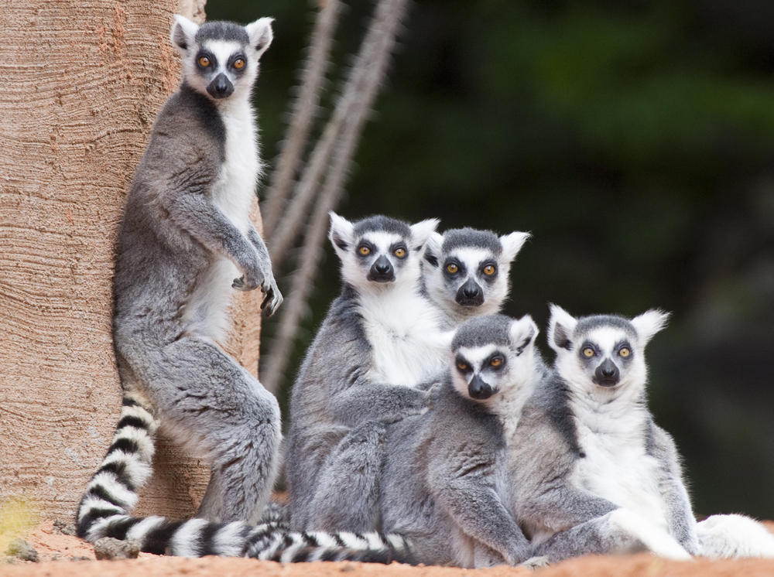
Красникова Мариана Владимировна, 230-415-431
Красникова Ольга Анатольевна, 258-755-357
Lemures

Slide 2
The word lemur comes from the Latin. It means “a ghost”.

Slide 3
They live silently at night and have large mysterious eyes.

Slide 4
They live on the Earth very many years only on Madagascar and Comoro island.

Slide 5
They are of different colours and sizes.

Slide 6
The biggest weighs 30 kilos and the smallest weighs 30 grams.

Slide 7
They eat nuts, fruits and berries.

Slide 8
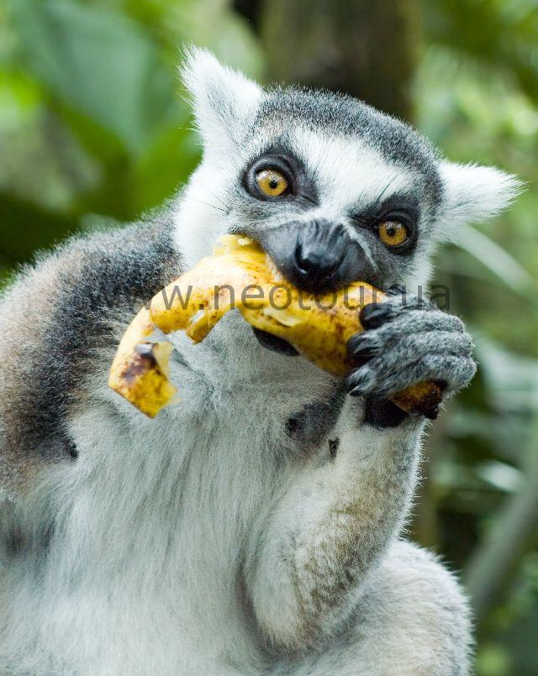
Sometimes they can eat insects, but their favourite food is dates.

Slide 9
Babies are always with their mums. Lemurs are shy but curios.

Slide 10
But it’s dangerous, you know, because curiosity killed the cat.

Slide 11
They are very funny and cute animals!!!

