Slide 1

Name the country

Slide 2
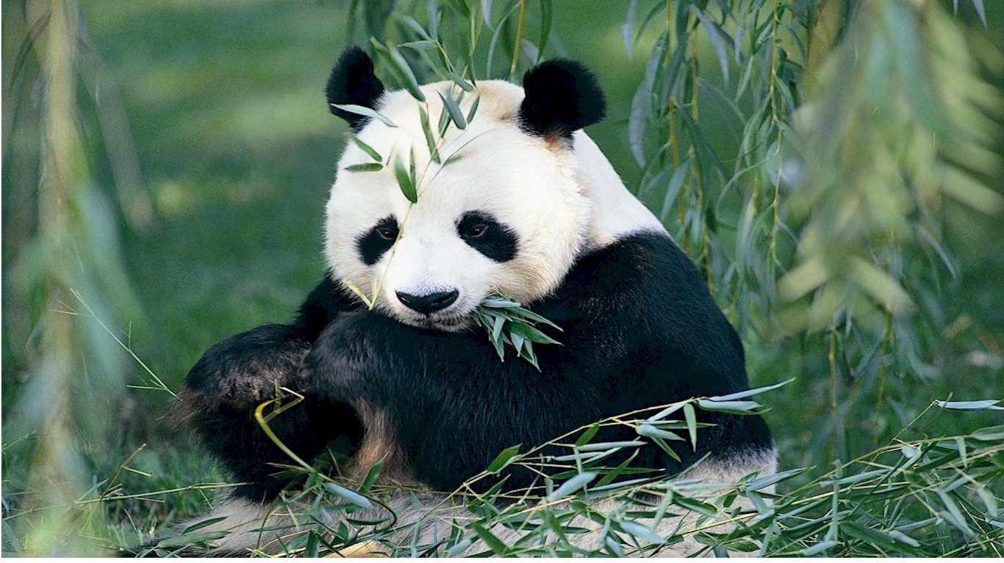
The panda is the national symbol of China

Slide 3

Name the country

Slide 4
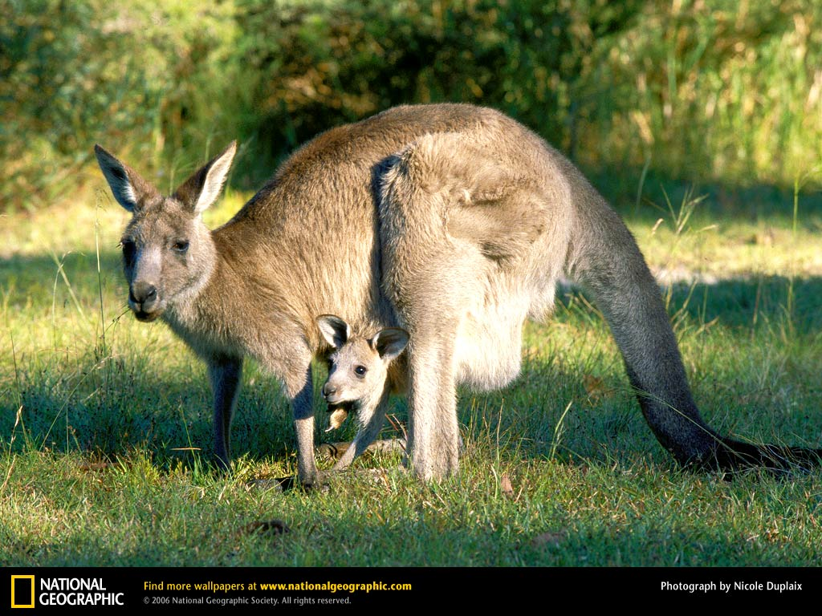
The kangaroo is the national symbol of Australia

Slide 5

Name the country

Slide 6
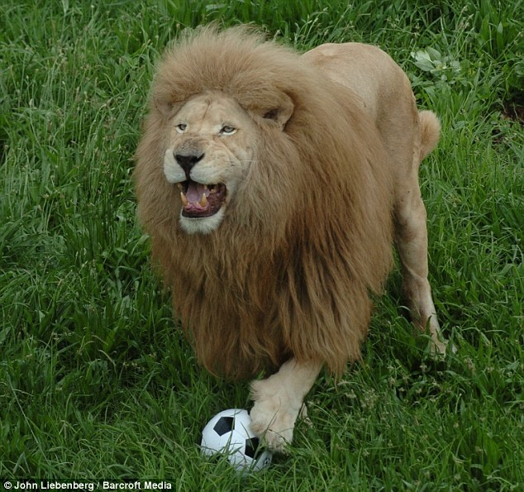
The lion is the national symbol of the UK

Slide 7

Name the country

Slide 8
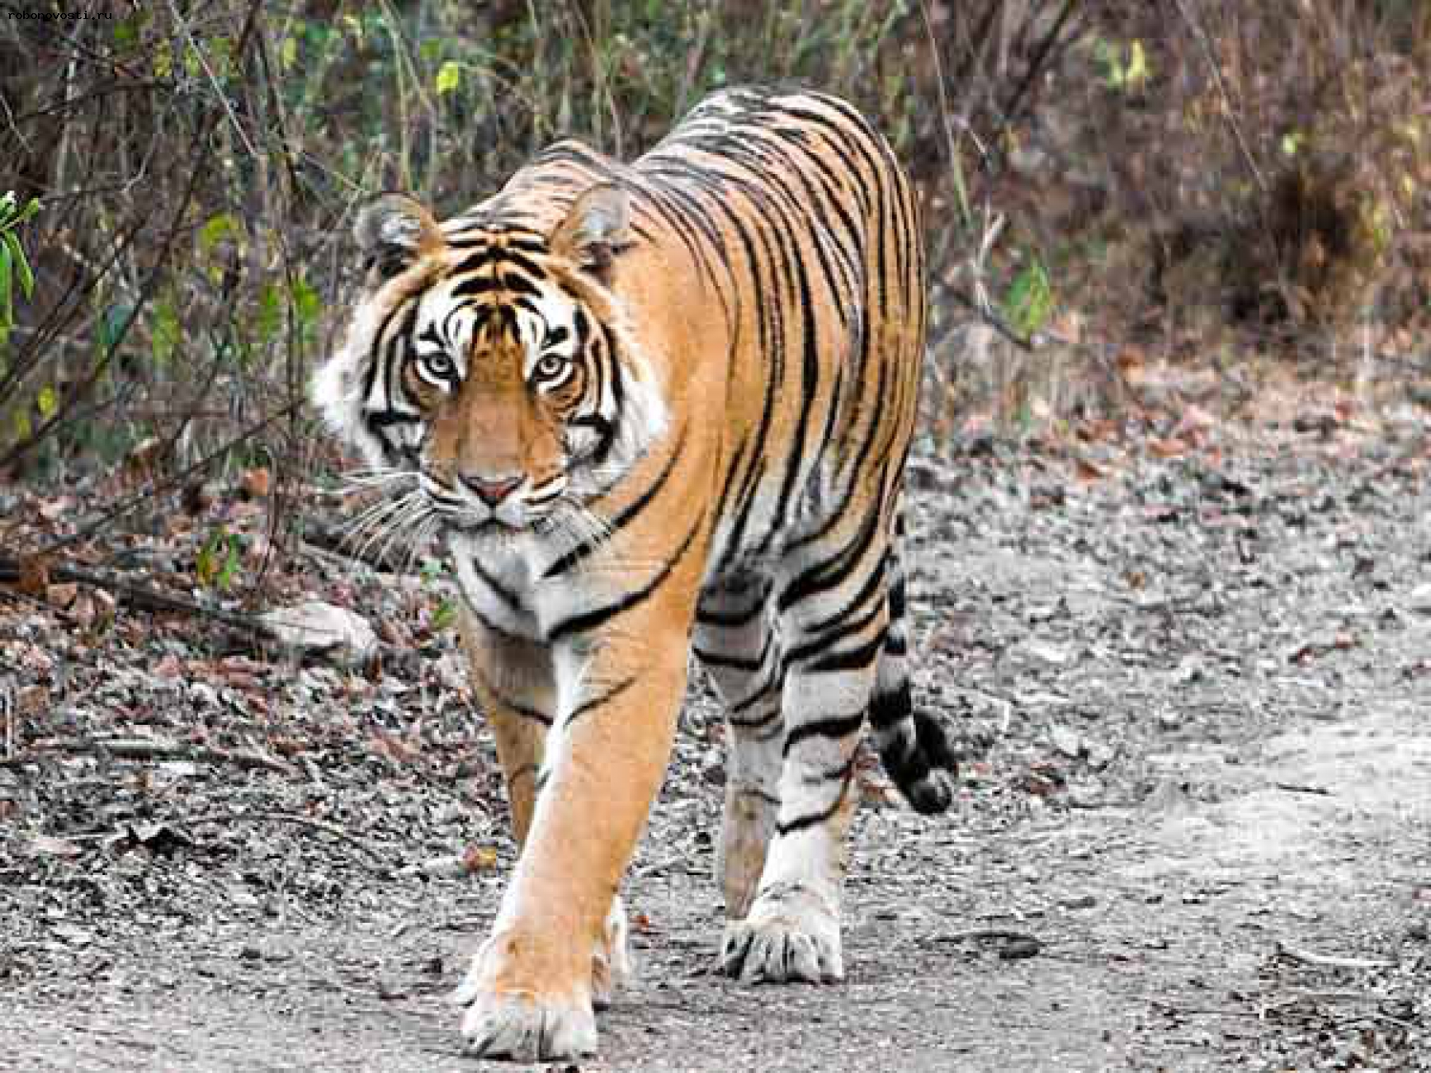
The tiger is the national symbol of India

Slide 9

Name the country

Slide 10
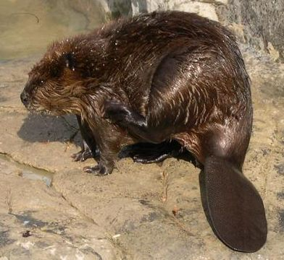
The beaver is the national symbol of Canada

Slide 11

Name the country

Slide 12
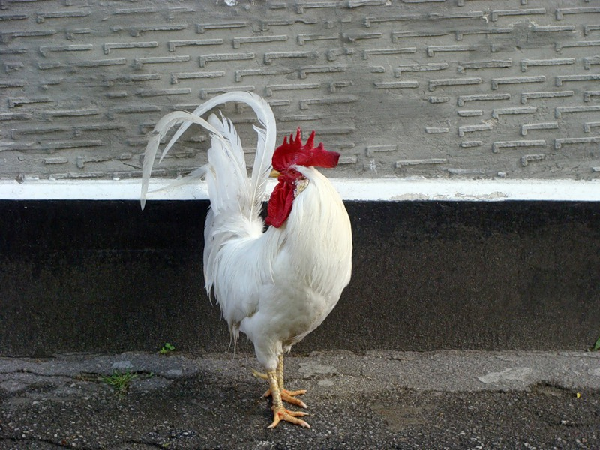
The cock is the national symbol of France

Slide 13

Name the country

Slide 14
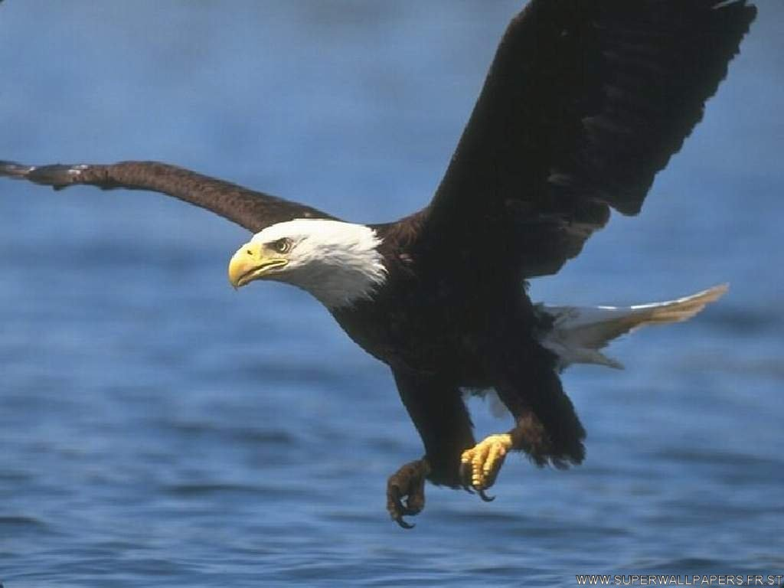
The eagle is national symbol of the USA

Slide 15

Name the country

Slide 16
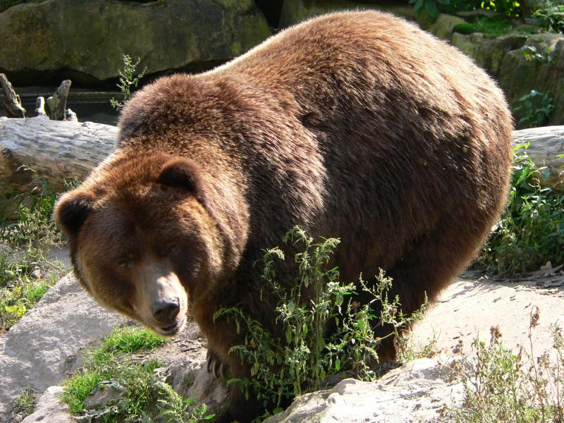
The bear is the national symbol of Russia

Slide 17

Name the country

Slide 18
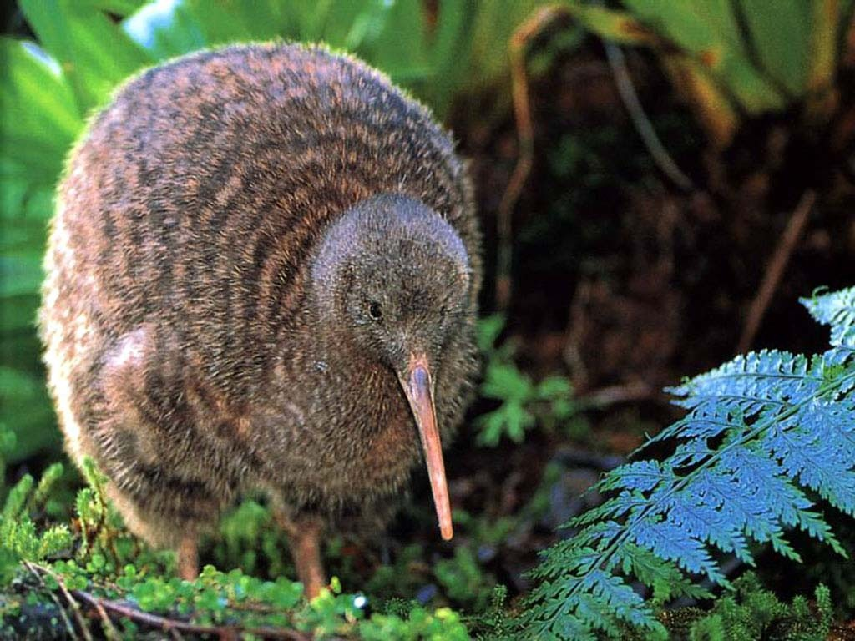
The kiwi is the national symbol of New Zealand

Slide 19

Name the country

Slide 20
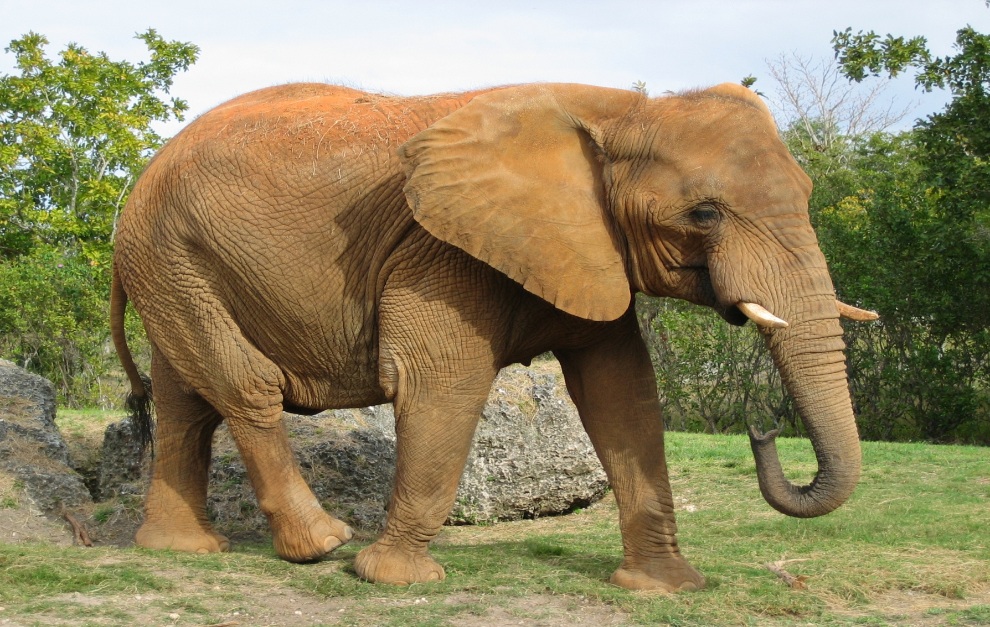
The elephant is the symbol of Thailand

Slide 21

Name the country

Slide 22
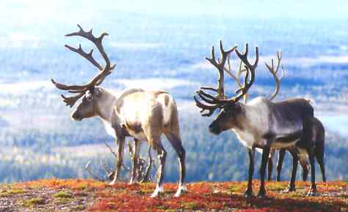
The deer is the symbol of Finland

