Slide 1
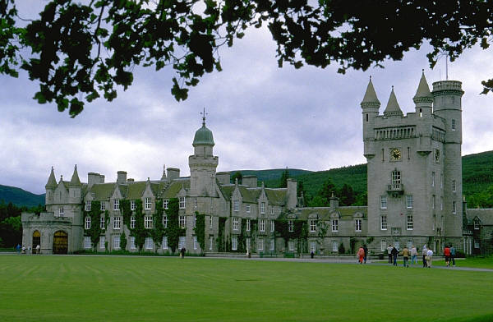
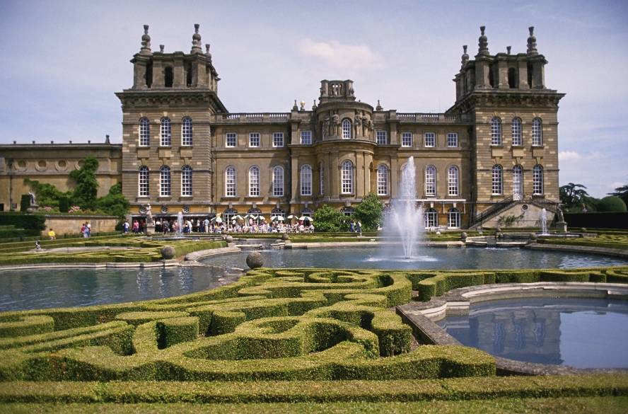
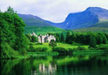
Travelling in time
Урок в 5 классе по учебнику «Happy English.ru» авторы К.Кауфман, М. Кауфман.

Slide 2
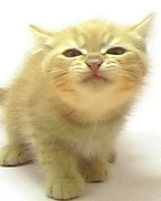
Super cat

Slide 3
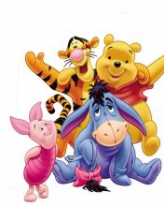
Jilly and Dorris
Jilly and Dorris must read the stories.
Jilly and Greta must write a letter.
Jilly and Pat must find the cat.
Jilly and Dennis must play tennis.
Now tell me, you and you and you.
How many things must Jilly do?

Slide 4
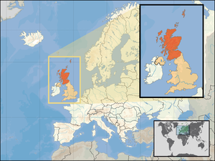
Scotland

Slide 5
Edinburgh is the capital of Scotland

Slide 6
He is from Scotland.
Kilt is Scottish nationalmen ‘s shirt

Slide 7
At the airport

Slide 8
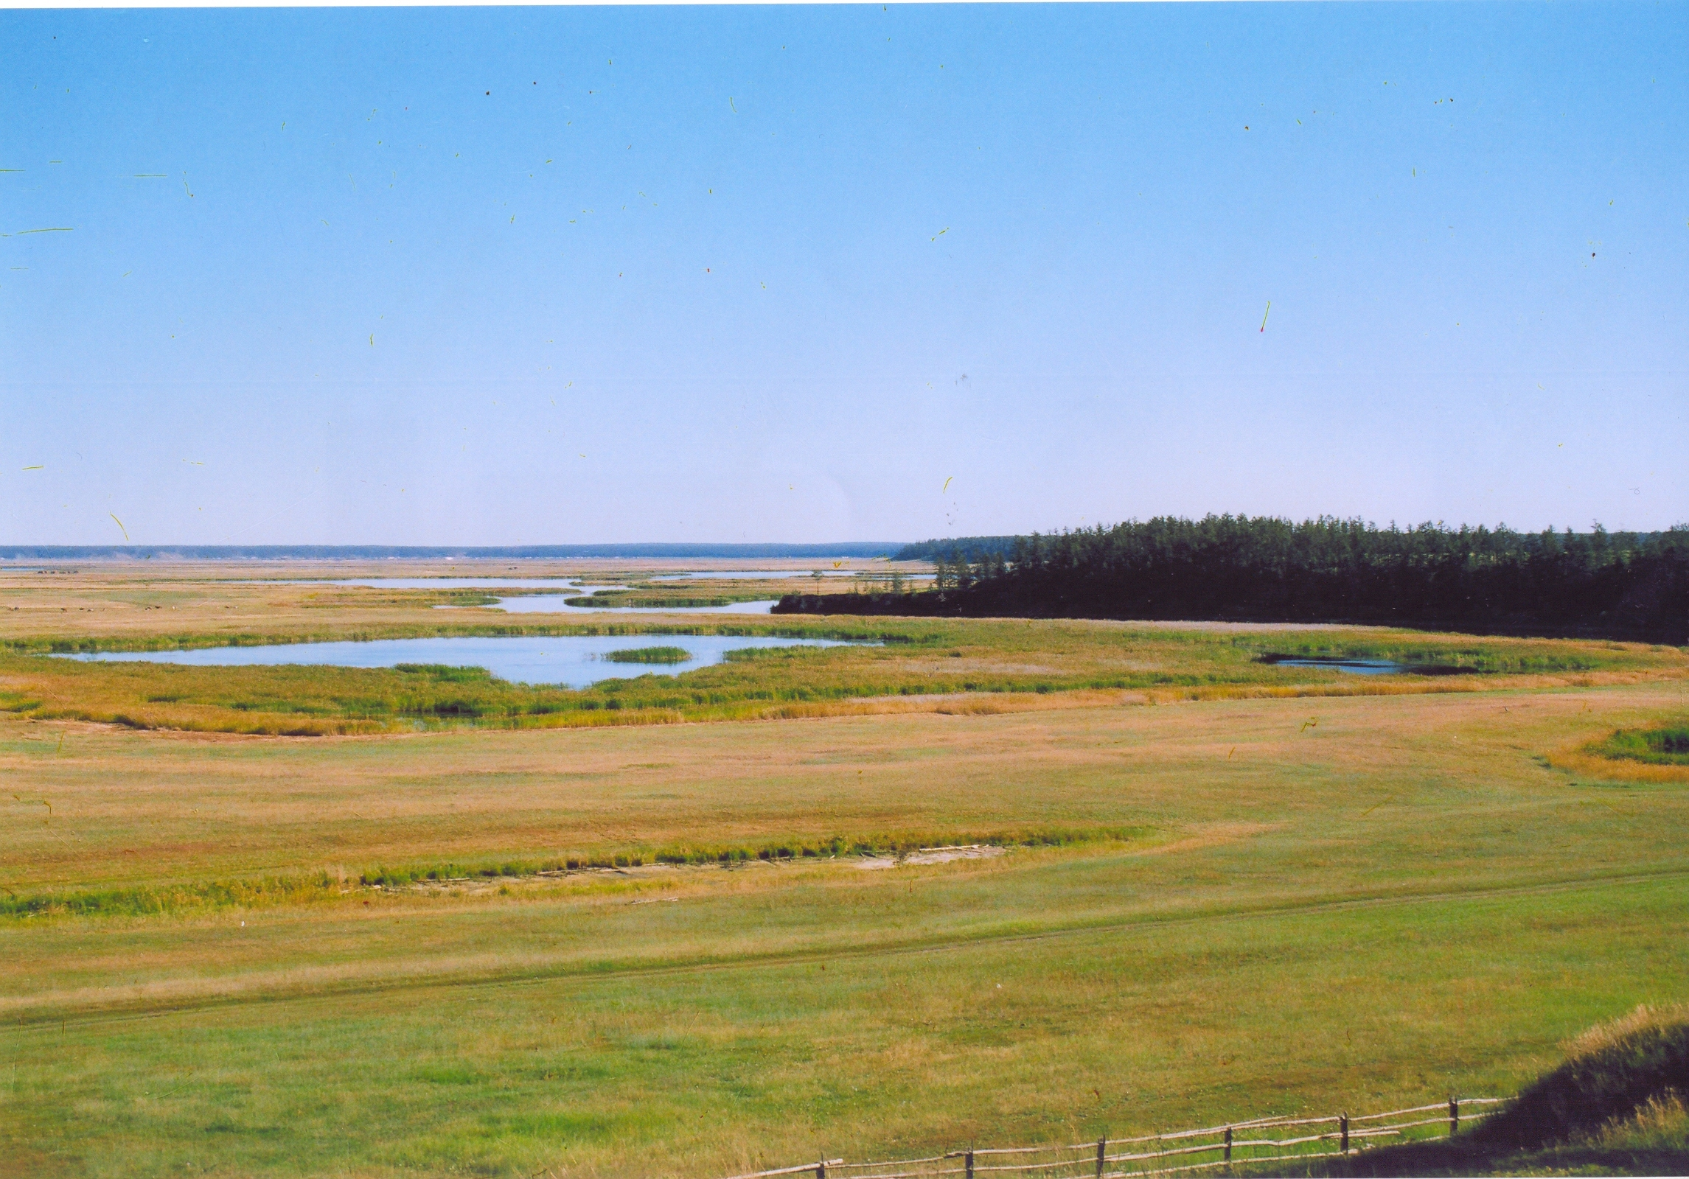
I am from Yakutia.

Slide 9
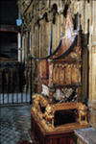
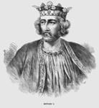
История Камня Судьбы (The Stone of Destiny )
Камень Судьбы
Эдуард I
Трон шотландских королей

Slide 10
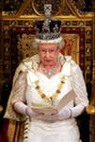
Королева Елизавета II сидит на троне.
Вестминстерское
Аббатство

Slide 11
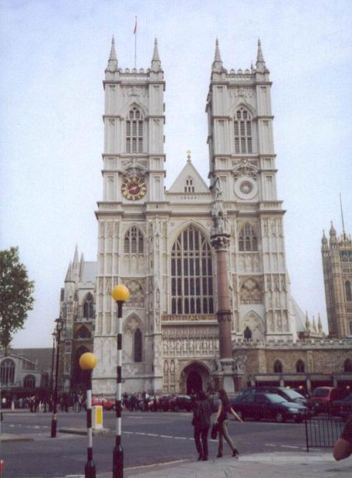
The Stone of Destiny is in
Russia
Scotland
London

Slide 12
Robin’s mission is
to take the Stone back to Scotland
to speak English
to play computer games

Slide 13
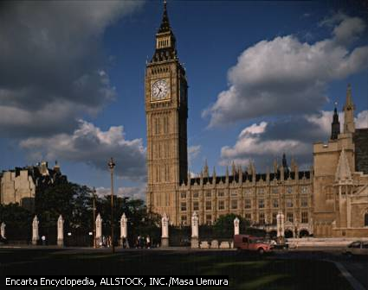
London is the capital of
Scotland
England
France

Slide 14
Robin can’t play computer games because
.
he doesn’t like computer
he has no computer
he is from the past

Slide 15
Can you V ?
+
Yes, I can.
-
No, I can’t

Slide 16
What can he / she do?
-
He /She can’t V .
+
He/ She can V .

Slide 17
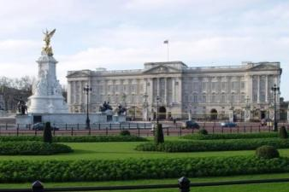
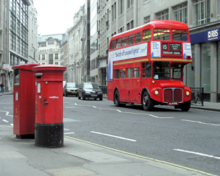
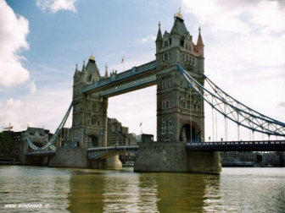
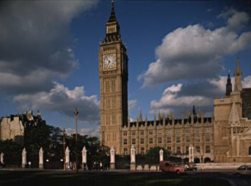
Thank you for the lesson!
Подготовили учителя английского языка Васильева В.Л. Аммосова М.А.

